Slide 1


OBJECTIVE CHROMATIC PUPILLOMETER-BASED PERIMETRY IN PATIENTS WITH RETINAL AND MACULAR DYSTROPHYS
Daniel Ben Ner
Ifat sher
Ygal Rotenstreich
The Maurice and Gabriela Goldschleger Eye Institute, Sheba Medical Center, Tel-Hashomer
The Sackler School of Medicine, Tel-Aviv University, Tel-Aviv, Israel

Slide 2
Lecture structure
Eye and retina structure
The Visual Field tests
The pupillometer and the PLR
RP project
BEST project
Alzheimer project
Future plans

Slide 3
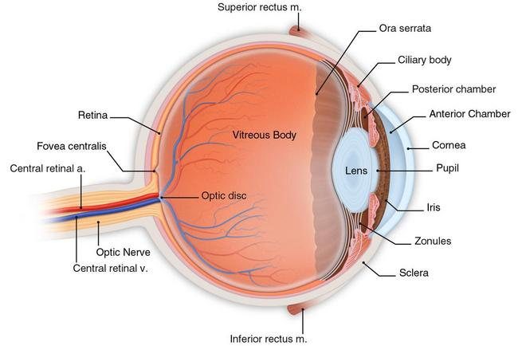
The Human Eye
www.midwestglaucoma.com

Slide 4
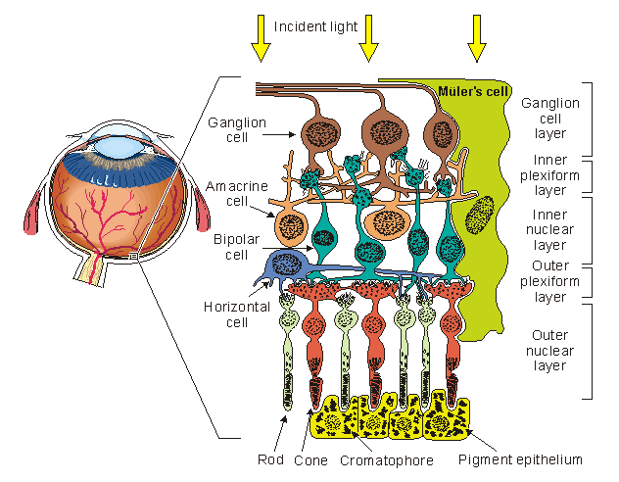
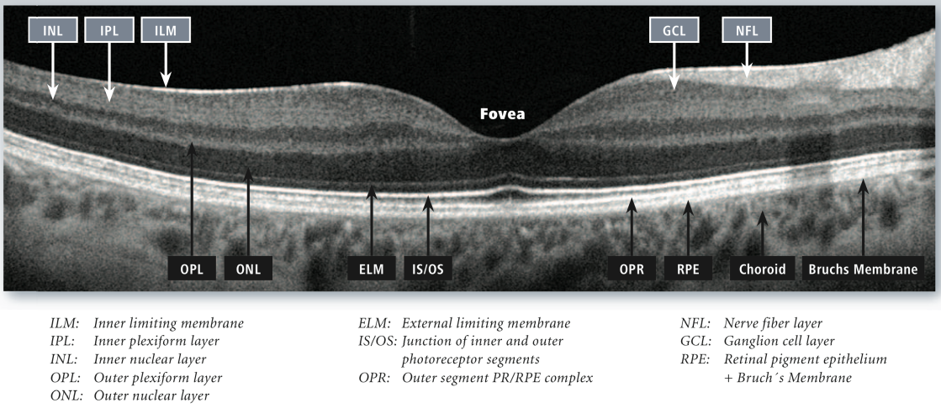
The Retina
Retinal pigmented epithelium(RPE)
Photoreceptors
Ganglion cells
http://www.bem.fi/book/28/28.htm
www.hoacls.org
OCT -Optical coherence tomography

Slide 5
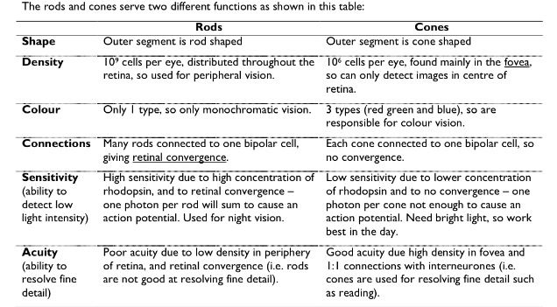
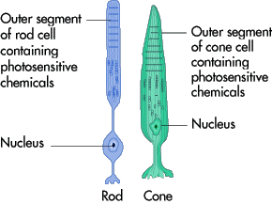
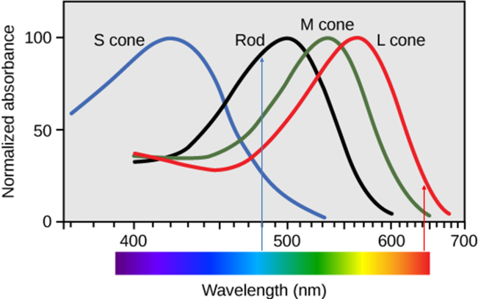
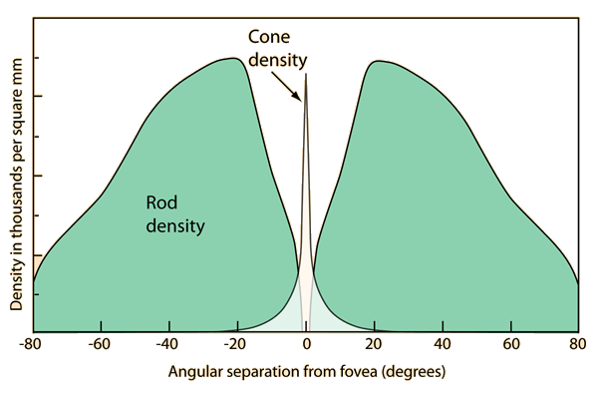
The Rods and Cones
485nm
640nm

Slide 6



Visual field testing
Goldmann perimetry kinetic - subjective
Humphrey perimetry – subjective
VF tests are used for -job selection, visual competence assessment, school or community screenings, military selection, and disability classifications, monitoring of disease progress and treatment evaluation

Slide 7
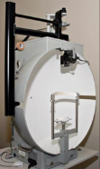
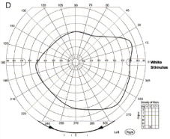
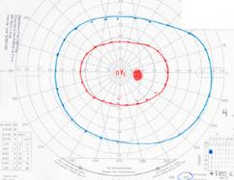
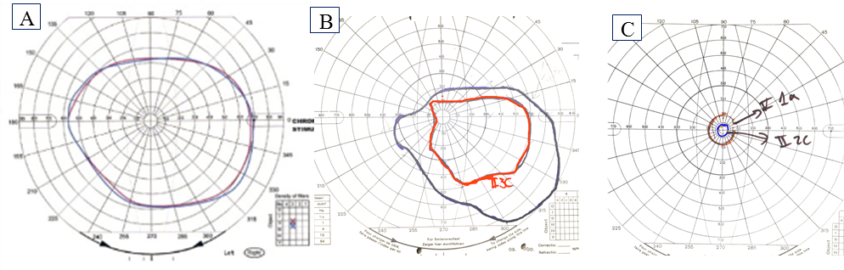
1. Goldmann perimetry kinetic
A
B
C

Slide 8
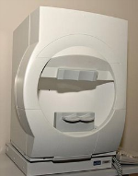
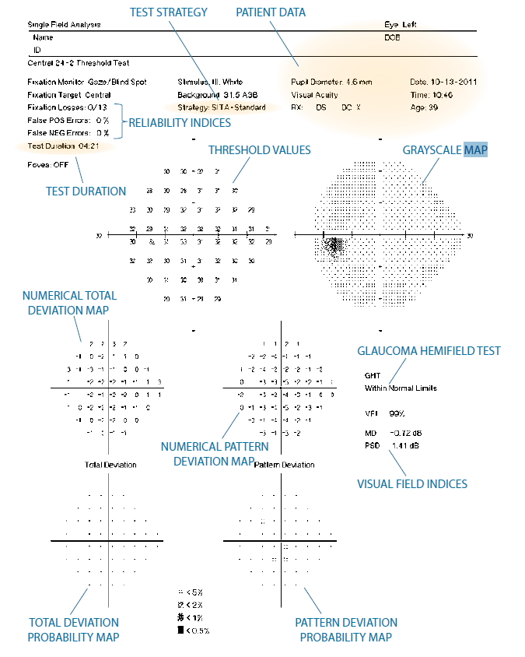
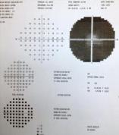
2. Humphery perimetry
A
C
B

Slide 9
The current VF tests disadvantages
Subjective!
Are totally dependent on patient cooperation
Stressful
High test-retest variability
Not chromatic

Slide 10
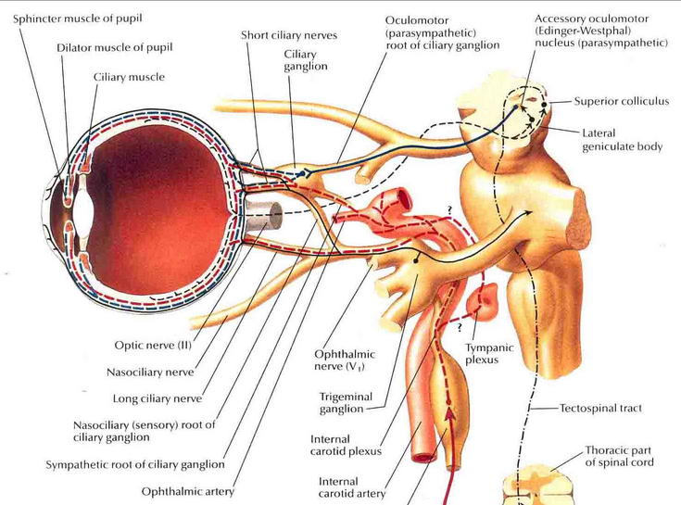
Pupillary light reflex

Slide 11
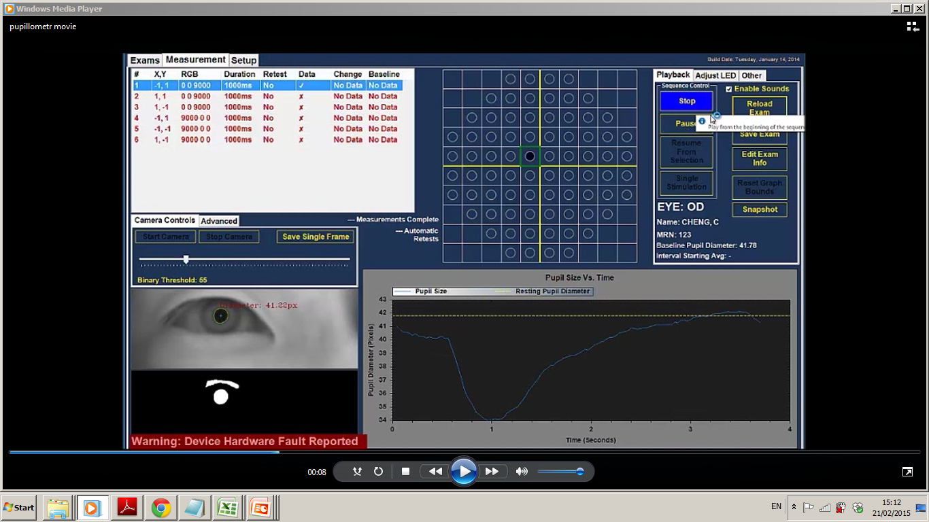
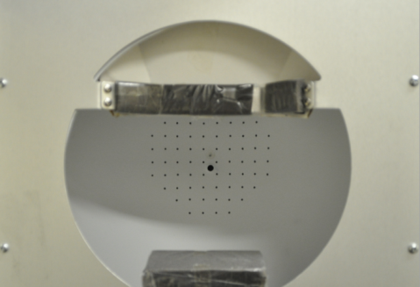
3. The Chromatic multifocal pupillometer:
Objective perimetry
76 LEDs for blue and red stimuli
16.2° Visual Field
485nm
640nm
©Accutome, PA

Slide 12
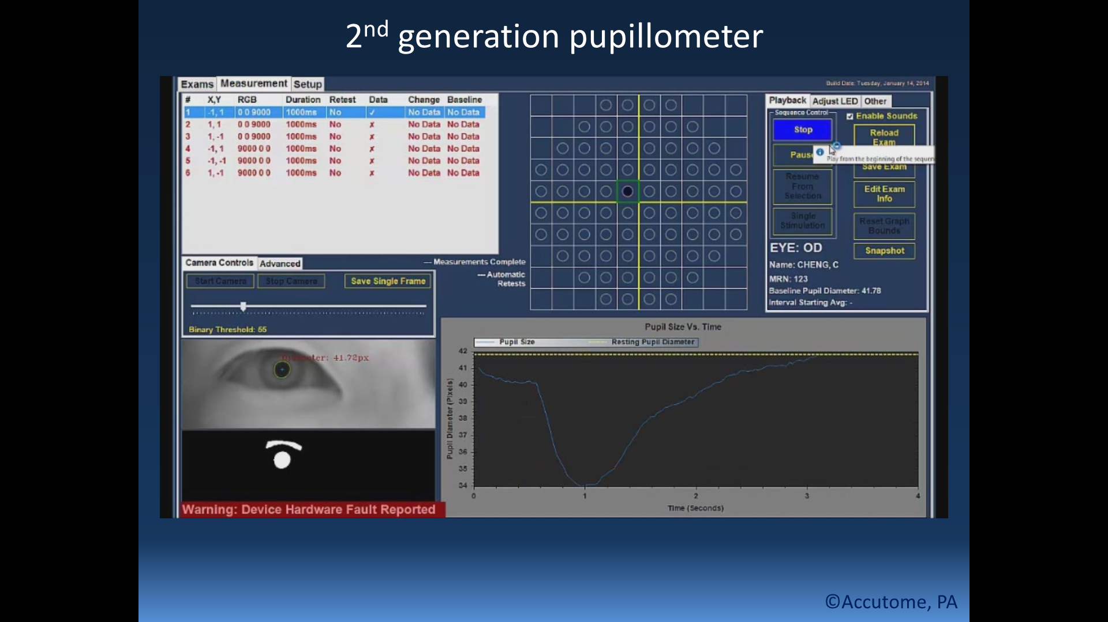
Pupillary responses
Different parameters in the pupillary response are analyzed :
% Pupil constriction (PPC)
Maximal Constriction Velocity (MCV, pixel/sec)
Latency of MCV (LMCV, sec)

Slide 13
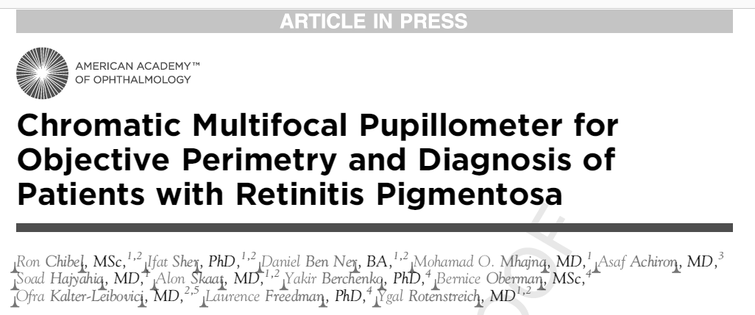
Ophthalmology, accepted for publication
(Ophthalmology 2/59, IF 6.135, Q1)

Slide 14
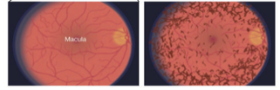
Previous work - Retinitis Pigmentosa (RP)
An inherited progressive degenerative disease
Rods degeneration
  Night blindness
  Tunnel vision
  Development of bone spicules in the fundus
  Poor color separation
  Eventual blindness

Slide 15
Study design:
13 retinitis pigmentosa (RP) patients
17 healthy age-matched volunteers
In RP patients, the chromatic pupillometer recordings
were compared with their dark-adapted Chromatic
Goldmann
Notes:
בריאים – כחול 7 עיניים 6 נבדקים

Slide 16
The test protocol
Non-tested eye is covered by a patch
Stimulus duration - 1 second
Tracking of pupil size - 4 seconds
Chromatic stimulus
  Red (1000 cd/m², 624nm)
  Blue (200 cd/m², 485nm)

Slide 17
RP patients: reduced response to blue light, correlating with VF restriction severity

Slide 18
RP patients: milder reduction in PLR to red light

Slide 19
Case I – patient with no light detection
Blue
Red

Slide 20
Case II – patient with VF restriction
Blue
Red

Slide 21
Variability in the time to maximal velocity of contraction was significantly higher in RP patients compared with controls (p<0.0001)

Slide 22
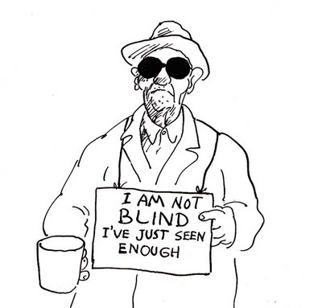
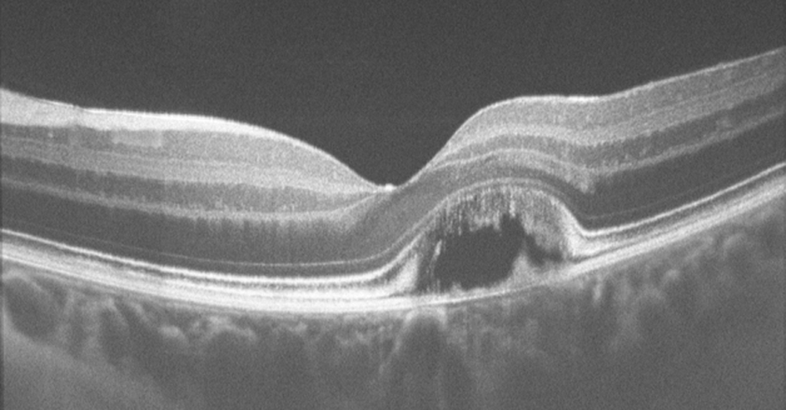
BEST disease - Vitelliform macular dystrophy
Autosomal dominant disease that affects the retinal pigment epithelium (RPE) at a very young age.
A rare disorder; its incidence is unknown
Characterized by lipofuscin accumulation in the RPE.
Atrophic changes of the RPE or scarring secondary to subretinal neovascular membranes with hemorrhage causes loss of central visual acuity.

Slide 23
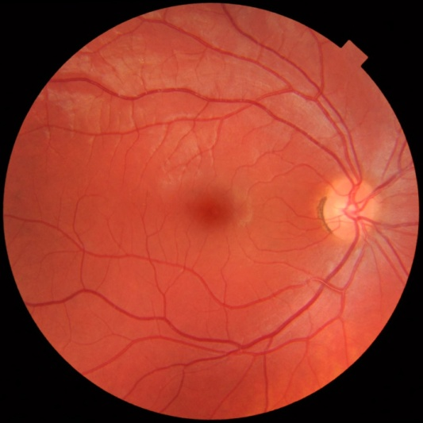
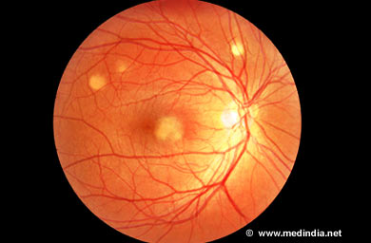
Best disease - Vitelliform macular dystrophy
Typically, patients will present with an early central scotoma
More dense scotomas will likely develop as the disease progresses- studies showed cone damage in these patients.
In these patients the visual system has adapted by choosing an eccentric preferred retinal locus (PRL) to perform visual tasks that used to be performed by nonfunctioning fovea
Leading to a discrepancy between retinal damage and Humphrey perimetry.

Slide 24
BEST - Study design
15 participants were recruited (6 BEST patients and 9 healthy individuals).
PLR to short-wavelength stimulus (480 nm, 400cd/m²) and long-wavelength stimulus (624 nm, 1000cd/m²) was recorded.
Stimuli were presented by 76 LEDs in a 16-degree visual field. Duration of stimulus was 1 sec with diameter of 2 mm.
The pupillary responses of BEST patients were compared with the pupillary responses obtained from normal control subjects.
Results of patients where also compared with their findings on Humphrey's 24-2 perimetry and OCT.

Slide 25
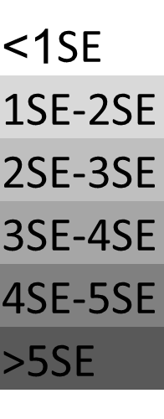
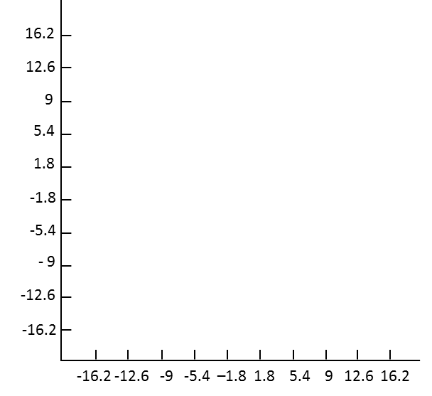
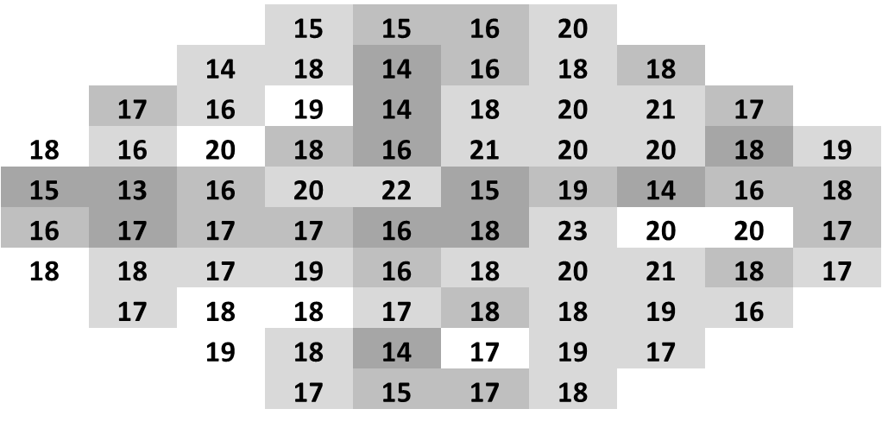
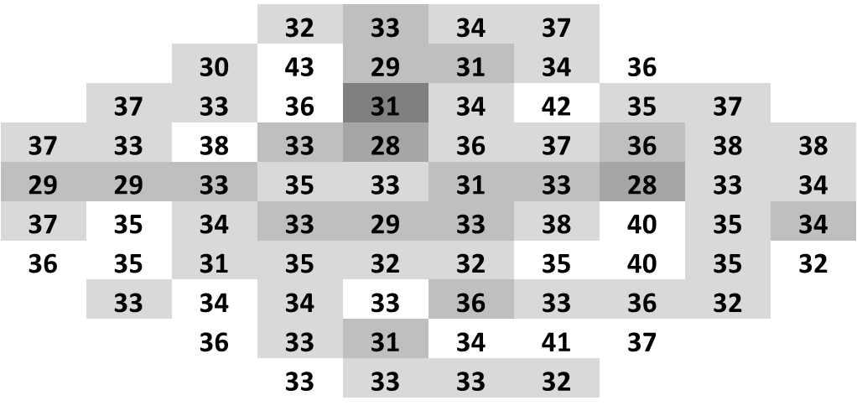
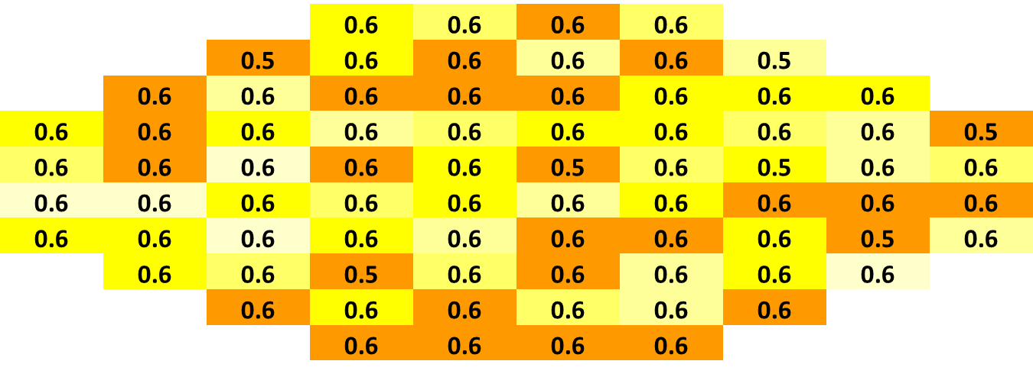
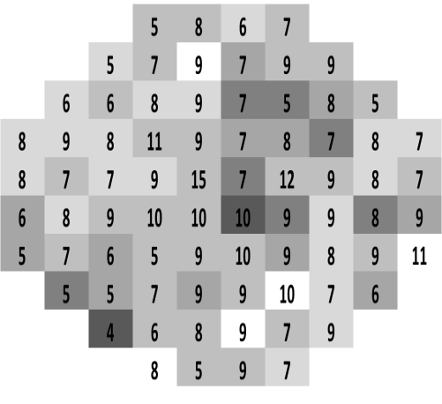
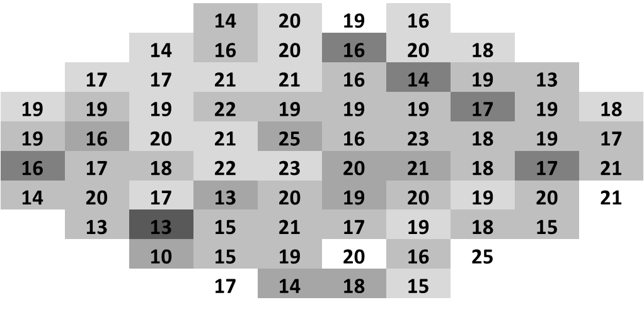
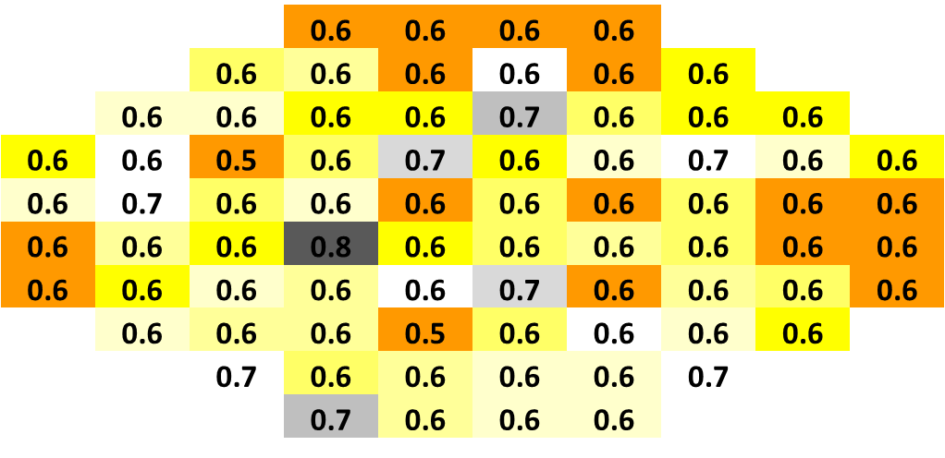

  The mean pupillary response of BEST patients in response to red and blue stimuli
Blue
PPC
MCV
LMCV
A
B
C
Vertical (deg)
Vertical (deg)
Vertical (deg)
RED
Horizontal (deg)
Horizontal (deg)
Horizontal (deg)
D
E
F
Vertical (deg)
Vertical (deg)
Vertical (deg)
Horizontal (deg)
Horizontal (deg)
Horizontal (deg)

Slide 26
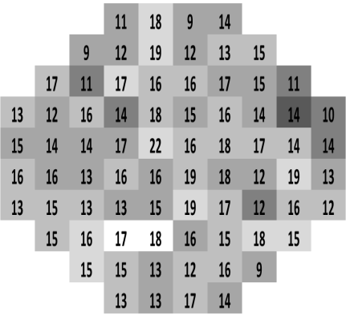
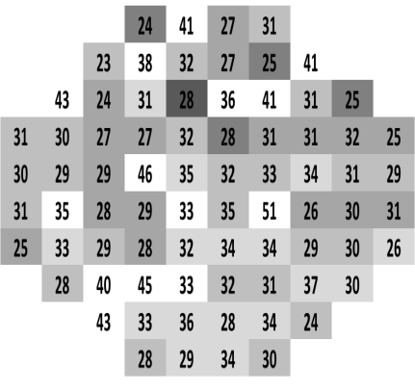
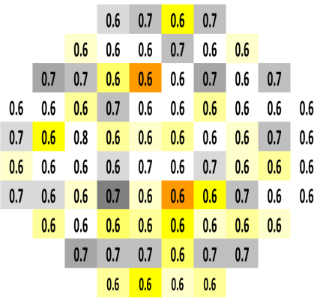
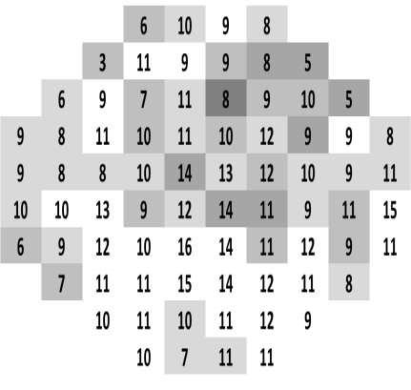
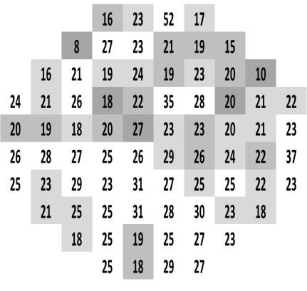
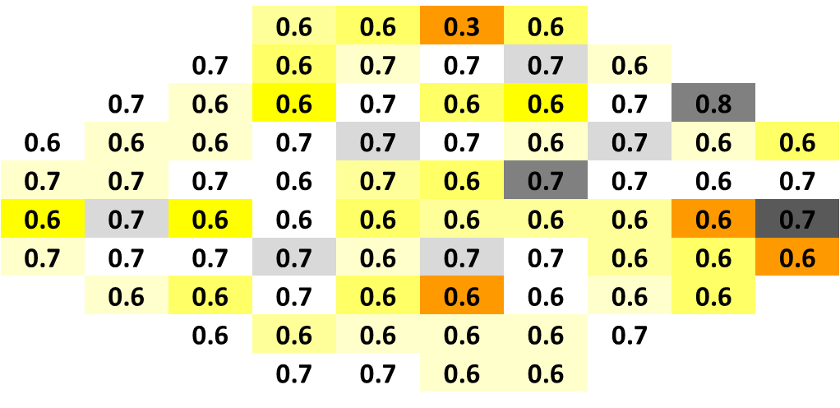
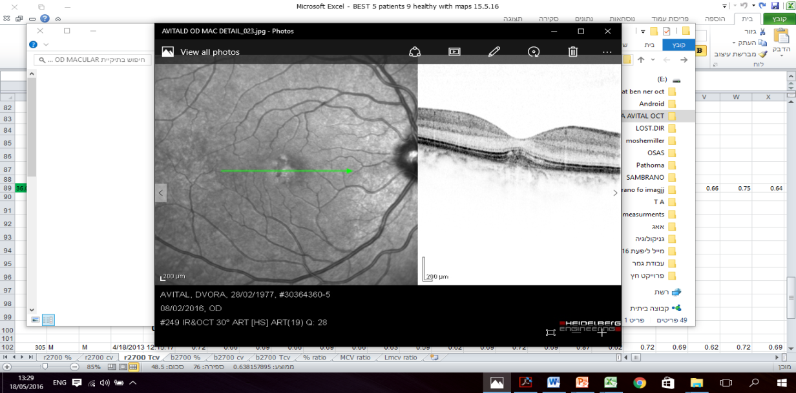
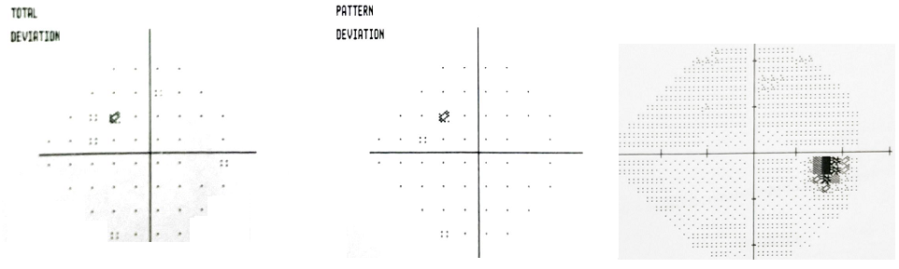
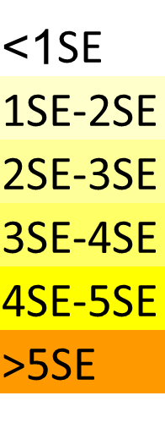
Patient #2 – BCVA 6/6
PPC
MCV
LMCV
A
B
C
Vertical (deg)
Vertical (deg)
Vertical (deg)
Blue
Horizontal (deg)
Horizontal (deg)
Horizontal (deg)
D
E
F
Vertical (deg)
Vertical (deg)
Vertical (deg)
RED
Horizontal (deg)
Horizontal (deg)
Horizontal (deg)
G
H
I

Slide 27
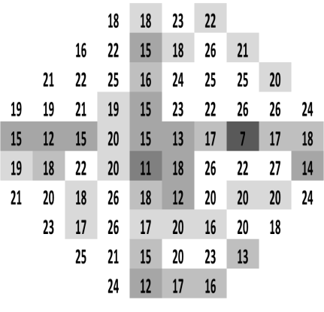
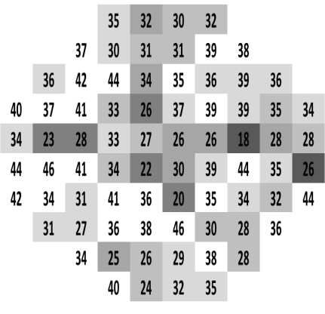
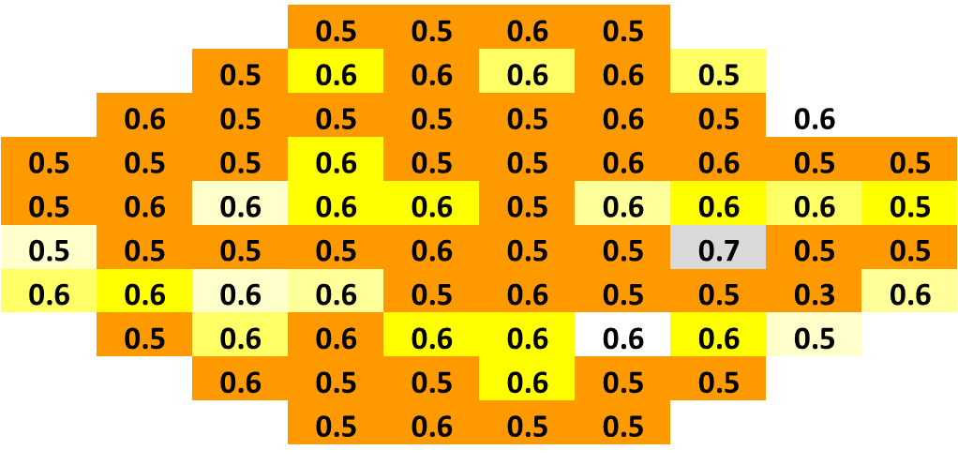
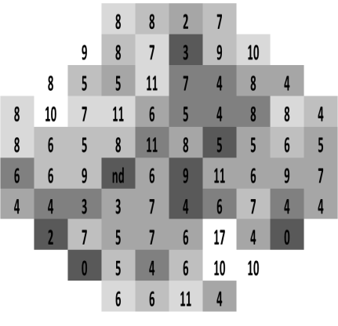
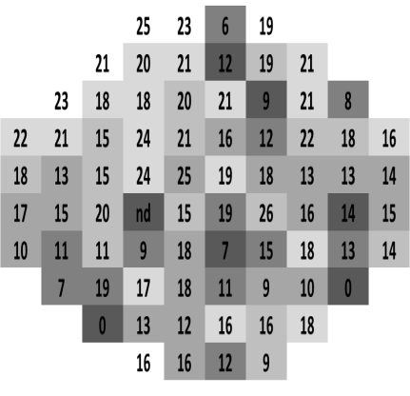
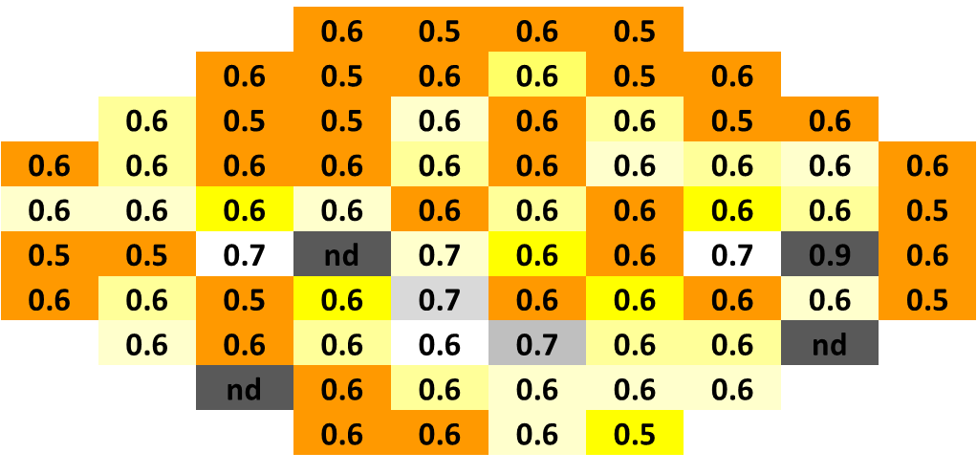
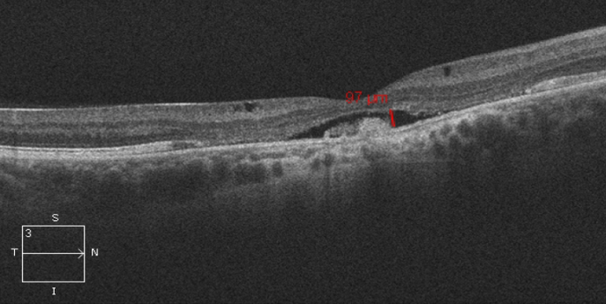
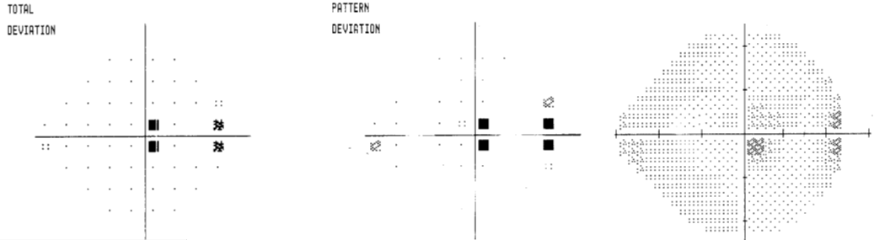
Patient #1 – BCVA 6/45
PPC
MCV
LMCV
A
B
C
Vertical (deg)
Vertical (deg)
Vertical (deg)
Blue
Horizontal (deg)
Horizontal (deg)
Horizontal (deg)
D
E
F
Vertical (deg)
Vertical (deg)
Vertical (deg)
RED
Horizontal (deg)
Horizontal (deg)
Horizontal (deg)
G
H
I

Slide 28
Conclusions
The pupil multifocal response pathology
  The mean % constriction :reduced red>blue
  The mean maximal constriction velocity: reduced red>blue
Significant cone deficit was demonstrated in BEST patients, correlating with their OCT findings, while subjective VF tests did not
The pupil multifocal response pathology
  The mean time of maximal constriction velocity : shorter red = blue
  Different than in other dystrophies
The chromatic pupillomter enables objective diagnosis of BEST patients and non invasive determination of their retinal function.

Slide 29
Alzheimer’s will be a global epidemic by 2050
There are 44 million people suffering from dementia globally.
The WHO 2013 report estimates that by 2050 over 135 million people worldwide will have dementia, tripling the amount of people who have it now.

Slide 30

The unmet need -
Lack of beneficial treatments
No objective testing

Slide 31
Pupillometry for early detection of AD

Slide 32
Study design
12 cognitively normal young elderly subjects with no observed ophthalmic pathology (age: 60-74, mean 66.1 years).
Cognitive performance was examined using the Montreal Cognitive Assessment (MoCA) test. MoCA>26 was considered normal
PLR to blue (480 nm, 200cd/m²) and red (624 nm, 1000cd/m²) were recorded. Stimuli were presented by 76 LEDs in a 16-degree visual field. Duration of stimulus was 1 sec with diameter of 2 mm.
The pupillary responses of subjects scoring MoCA>26 were compared with those of subjects who scored MoCA<26

Slide 33
Results
12 subjects
6 OS
2 subjects MoCA<26
4 subjects
MoCA>26
6 OD
1 subjects MoCA<26
5 subjects
MoCA>26

Slide 34
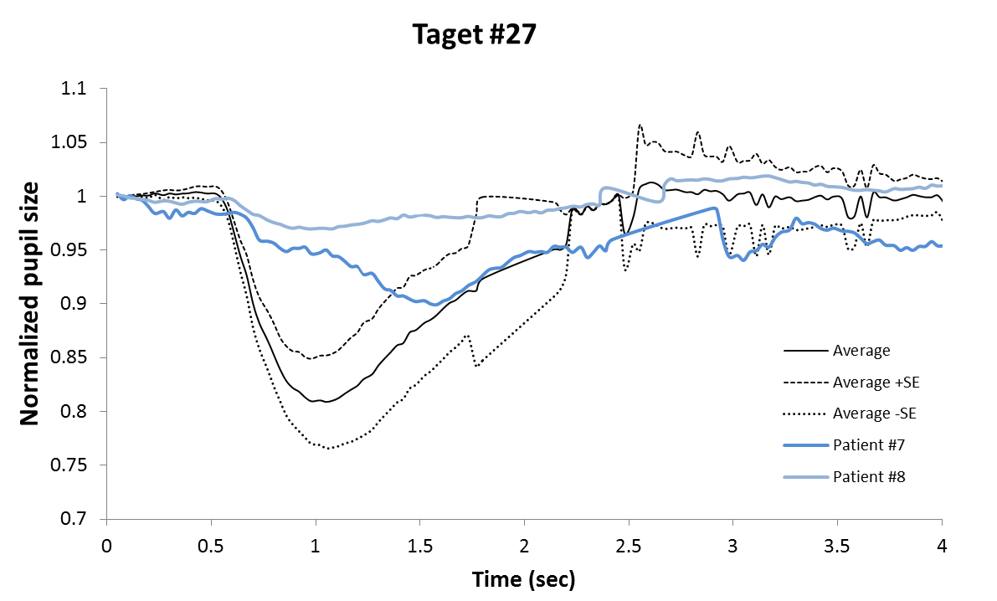



Subjects with low MoCA score demonstrated diminished and “sluggish” pupil response to blue light

Slide 35




Subjects with low MoCA score demonstrated diminished and “sluggish” pupil response to red light
Target 33
Target 43

Slide 36

Subject with low MoCA score demonstrate significantly reduced PPC in different peripheral locations of the VF

Slide 37
In response to red light, MoCA<26 was associated with reduced PPC in the nasal area compared to normal MoCA (≥26)
With blue light, subjects with MoCA<26 compared to MoCA ≥26 showed reduced PPC in all quadrants except the inferior
RED light 624 nm, 1000cd/m2
 | Normal: MoCA>26 (N=9) | MCI : MoCA<26 (N=3) | P value
Nasal | 10.1% (SE=0.8) | 3.3% (SE=0.3) | *P=0.018
Temporal | 8.2%(SE=0.8) | 4.6% (SE=1.2) | P=0.201
Superior | 8.6% (SE=0.9) | 4.7% (SE=1) | P=0.207
Inferior | 8.3% (SE=0.9) | 4.3% (SE=0.6) | P=0.239
Blue light 480nm, 200cd/m2
 | Normal: MoCA>26 (N=9) | MCI: MoCA<26 (N=3) | P value
Nasal | 15.1% (SE=1.1) | 5.8% (SE=0.9) | *P=0.018
Temporal | 13.9%( SE=1.1) | 4.6% (SE=0.5) | *P=0.028
Superior | 13.8% (SE=1.2) | 4.8% (SE=0.6) | *P=0.033
Inferior | 12.8% (SE=1) | 4.8% (SE=0.6) | P-0.162

Slide 38
Conclusions:
Our preliminary study suggests that subjects with low MoCA score demonstrate defects in PLR to focal chromatic light stimuli
Correlation with OCT findings are currently being evaluated
The Chromatic Multifocal Pupillometer may potentially be used for objective early detection of AD.

Slide 39
Plans for the future
Complete AD study – recently Dr. Rotentreich won the prestigious NNE grant to perform a study of 430 subjects at high risk for AD.
New pupillometer – 30° VF, automatic calibration – study retinal, macular and optic nerve degeneration
Study patients with optic neuritis – collaboration with Prof. Achiron
Continue to publish our results in the best scientific journals

Slide 40


Thank you arrow project!

Slide 41
Acknowledgements
Collaboration:
Prof. Belkin Michael, Tel Aviv University, Israel
Prof. Laurence Freedman, The Gertner Institute, Israel
Dr. Ofra Kalter-Leibovici, The Gertner Institute, Israel
Dr. Yakir Berchenko, The Gertner Institute, Israel
Bernice Oberman, The Gertner Institute, Israel
Dr. Ygal Rotenstreich
Dr. Ifat Sher
Dr. Mohamad Mahjna
Dr Asaf Ahiron
Dr. Soad Haj Yahia
Roni Chibel
Luba Biniaminov
Ravit Gatenuo
Financial Disclosure : patent owned by Sheba Medical Center

