Slide 1
Understanding Risk in allogeneic hsct
Joshua Fein
NY/American Program, Year 3
Mentor: Dr. Roni Shouval

Slide 2
Allogeneic Hematopoietic stem cell transplantation
Only curative therapy for many hematological malignancies and severe benign conditions, as well as certain autoimmune and other diseases
Associated with a high rate of morbidity and mortality

Slide 3
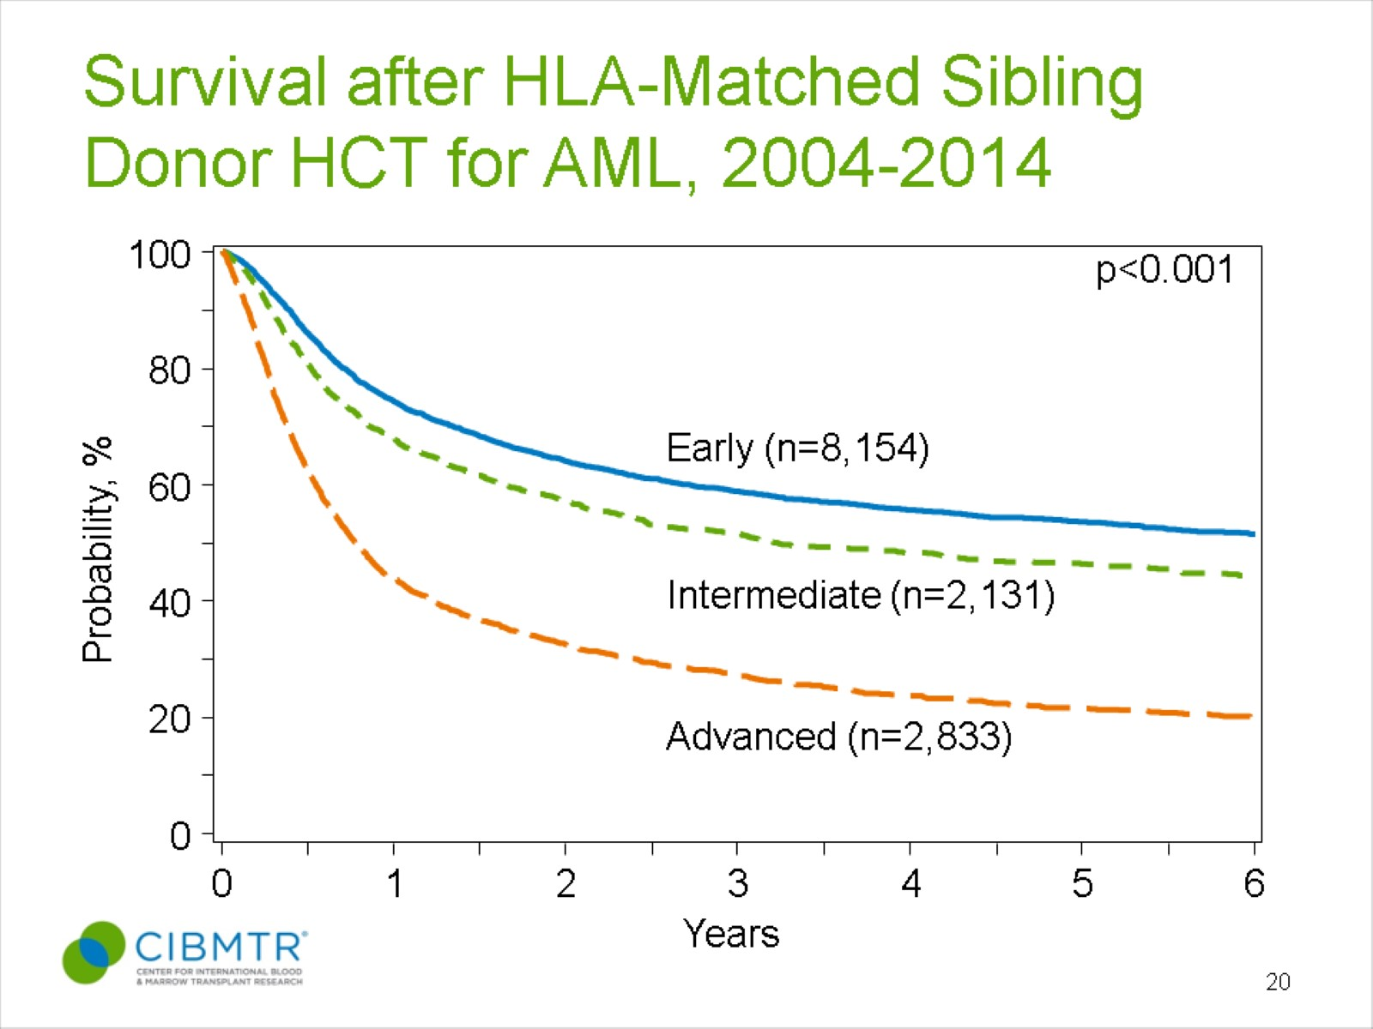
Survival after HLA-Matched Sibling Donor HCT for AML, 2004-2014
Notes:
Slides 20 & 21: The CIBMTR has data for 32,272 patients receiving an HLA-matched sibling (n=13,118) or unrelated donor (n=19,154) transplant for AML between 2004 and 2014. Their disease status at the time of transplant and the donor type are the major predictors of post-transplant survival. The 3-year probabilities of survival after HLA-matched sibling transplant in this cohort was 59% ± 1%, 51% ± 1%, and 27% ± 1% for patients with early, intermediate, and advanced disease, respectively. The probabilities of survival after an unrelated donor transplant were 51% ± 1%, 48%± 1%, and 25% ± 1% for patients with early, intermediate, and advanced disease, respectively.

Slide 4
Outcomes we study – and why?
Mortality
Overall Mortality
Relapse
Non-Relapse Mortality
Morbidity (→ Mortality)
Acute Graft-versus-Host Disease
Chronic Graft-versus-Host Disease
The Goal
Can we
make better decisions about which patients to transplant?
make better decisions about the parameters of the transplantation procedure?
prevent morbidity and mortality by dynamically predicting risk after HSCT and initiating better, timelier interventions?

Slide 5
Recent projects and publications
Shouval R, Ruggeri A, Labopin M, Mohty M, Sanz G, Michel G, Kuball J, Chevallier P, Al-Seraihy A, Milpied NJ, Diaz Heredia C, Arcese W, Blaise D, Rocha V, Fein J, Unger R, Baron F, Bader P, Gluckman E, Nagler A. An Integrative Scoring System for Survival Prediction Following Umbilical Cord Blood Transplantation in Acute Leukemia. Clin Canc Research. Accepted.
Shouval R, Bonifazi C, Fein J, Boschini C, Oldani E, Labopin M, Raimondi R, Sacchi N, Dabash O, Unger R, Mohty M, Rambaldi A, Nagler A. Validation of the acute leukemia-EBMT score for prediction of mortality following allogeneic stem cell transplantation in a multi-center GITMO cohort. Am J Hematol 2017 May;(92)5.
Shouval R, Fein J, Labopin M, Kroger N, Duarte R, Bader P, Bonini C, Dreger P, DuFour C, Gennery A, Kuball J, Lanza F, Montoto S, Polge E, Snowden J, Styczynski J, Sureda A, Mohty M, Nagler A. Application of the Disease Risk Index for Risk Stratification of Allogeneic Hematopoietic Stem Cell Transplantation in a Large Cohort of the EBMT. Presidential Symposium, European Blood and Marrow Transplantation Congress 2017.

Slide 6
Selected current projects
Can we create a rich and predictive model of Non-Relapse Mortality following HSCT?
Laboratory & Clinical Biomarkers of Non-Relapse Mortality in HSCT
Comorbid condition-associated risk in HSCT
The Sheba dataset
Can we better systematize how we think about underlying disease-associated relapse risk following HSCT?
Refining the Disease Risk Index
The EBMT dataset
Can we intervene in acute Graft-versus-Host Disease, cause of significant morbidity/mortality following HSCT?
The Sheba Registry – Redcap
Fecal Microbiota Transplantation – Clinical Trial

Slide 7
Non-relapse Mortality & the Sheba dataset
Rich retrospective dataset for > 1000 patients transplanted at SMC since 2000
High dimensional:
Laboratory results at admission (CBC/D, Comp Metabolic)
Comorbid conditions
Multiple outcomes (engraftment, death, relapse, aGvHD, cGvHD)

Slide 8
DIAGNOSIS DISTRIBUTION
Diagnosis | n | %
Aplastic Anemia | 34 | 3.3
AML | 402 | 39.1
ALL | 110 | 10.7
CLL | 35 | 3.4
CML | 37 | 3.6
MDS | 128 | 12.5
Hodgkins’ Lymphoma | 31 | 3.0
Multiple Myeloma | 43 | 4.2
MPN | 43 | 4.2
NHL | 147 | 14.3
Other (benign) | 5 | 0.5

Slide 9
Non-relapse mortality: Biomarkers

Slide 10
Non-relapse mortality: comorbidities
Poster, ASH 2016

Slide 11
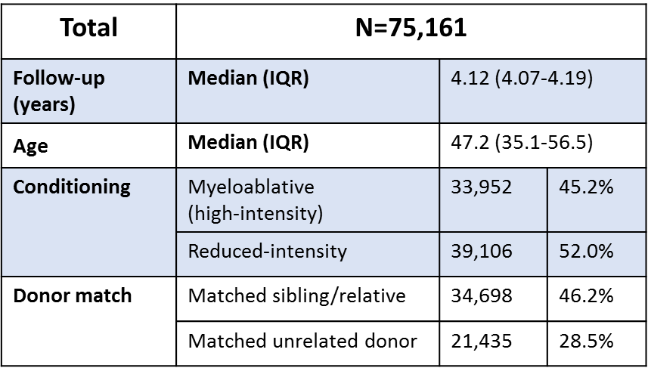
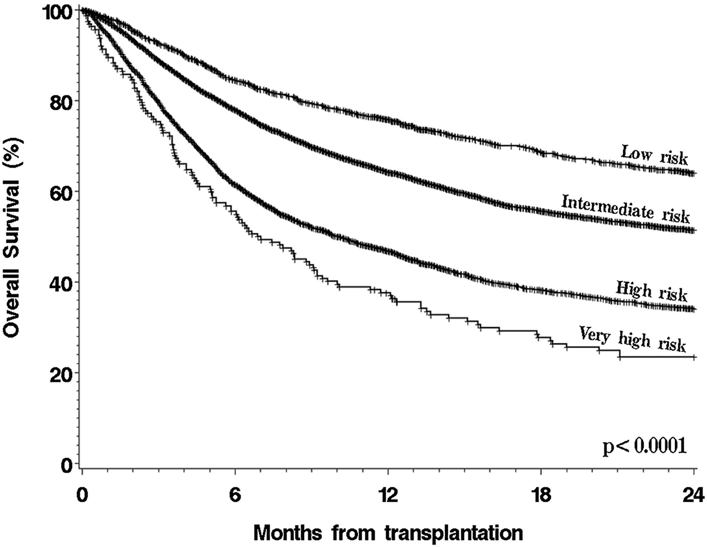
relapse – the disease risk index
low
int
high
v. high
Shouval R, Fein J, et al. EBMT 2017
Armand, 2014

Slide 12
The sheba registry
Prospective database of transplantations using RedCap for data capture/management
Currently > 90 patients enrolled and with data collected
Can be linked to other ongoing trials and tissue banking for correlative science
Particularly interested in understanding the causes of morbidity in HSCT: GvHD, VOD, infection, mucositis

Slide 13
Fecal microbiota transplantation
Phase I trial of fecal microbiota transplantation for management of steroid-resistant or steroid-dependent gut aGvHD
Recently approved by the Ministry of Health; expect to be begin enrollment soon

Slide 14
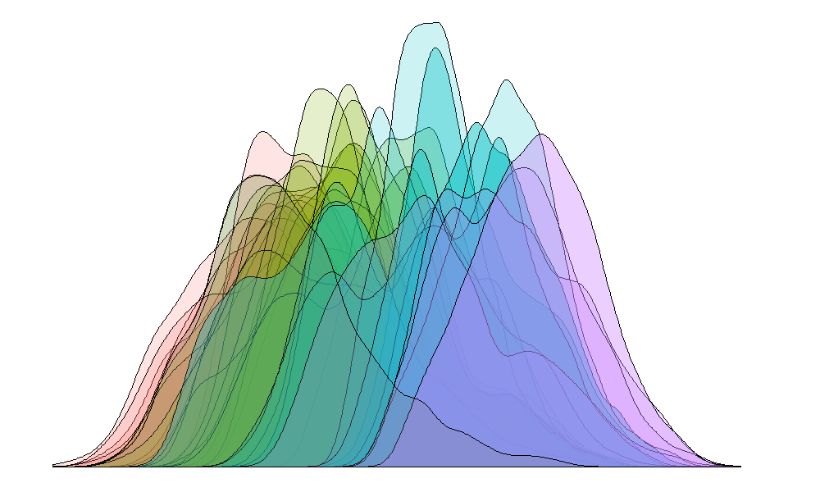
Questions?
Searching for new ways to understand, assess and address risk in Allogeneic HSCT

