Slide 1
Carotid Plaque Morphology and Vulnerability Across the Spectrum of Coronary Disease
Inna Epstein
Under supervision of Dr. Salo Haratz

Slide 2
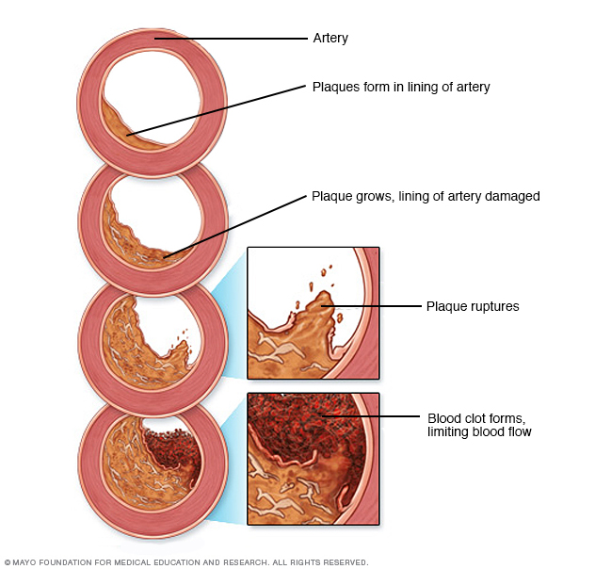
Atherosclerosis
Notes:
Atherosclerosis is a systemic chronic inflammatory vascular disorder that impinges multiple arterial beds, characterized by lipid accumulation, inflammation, and extensive degradation of extracellular matrix components, neovascularization and by epigenetic changes.
Atherosclerosis-related cardiovascular events (myocardial infarction - AMI) and cerebrovascular (CV) events (stroke) are the cause of the major cause of death in industrialized countries.

Slide 3
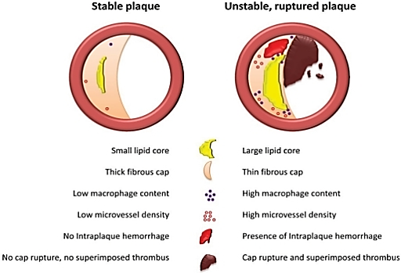
Plaque Stability
Atherosclerotic plaque biomarkers: beyond the horizon of the vulnerable plaque.
W van Lammeren G, L Moll F, Borst GJ, de Kleijn DP, P M de Vries JP, Pasterkamp G - Curr Cardiol Rev (2011)
Notes:
In order to characterize the atherosclerotic plaque and to assess it’s potential for damage it’s not enough to estimate the percentage of luminal occlusion, but also needed to evaluate it’s morphology or stability. Because many researches have proven that the rupture of the plaque, even a relatively small one can lead to acute ischemia of the organ and fatal consequences.
So what is “unstable plaque”?
Deposition of free cholesterol, macrophage infiltration, enlargement of the necrotic core as well as intraplaque microvessels that result from angiogenesis under influence of hypoxic and inflammatory stimuli and cause intraplaque hemorrhage increase the risk of plaque destabilization.
Atherosclerotic plaques form gradually over years. They begin with the accumulation of LDL cholesterol and saturated fat in the intima (the inner layer) of blood vessels. This is followed by the adhesion of leukocytes to endothelium, then diapedesis and entry into the intima, where they accumulate lipids and become foam cells. Foam cells are a rich source of proinflammatory mediators. The lesion up to this point is referred to as a fatty streak, and may be reversible to a certain extent.
Mentions: Postmortem studies revealed that acute myocardial infarction and coronary death were associated with coronary plaque disruption caused by fibrous cap rupture, superimposed thrombus formation and coronary occlusion. Thinning of the fibrous cap was shown to be caused by a decreased collagen production as a result of decreased SMC content, or degradation by matrix metalloproteinases (MMPs) excreted by macrophages [12]. This led to the description of the entity vulnerable plaques by Davies in 1996, who stated that plaques with large lipid cores, low SMC content, high macrophage content and a thin fibrous cap are rupture prone and therefore vulnerable [13]. Based on these principles and plaques found in patients who died from sudden coronary death, a morphological classification and scoring system for atherosclerotic lesions was established by Virmani et al. [14]. In 2003, the importance of intraplaque hemorrhage for progression of atheroma was elucidated by Kolodgie et al. [15]. The researchers showed that intraplaque hemorrhage contributes to deposition of free cholesterol, macrophage infiltration and enlargement of the necrotic core which increases the risk of plaque destabilization. One of the causes for intraplaque bleeding was hypothesized to be related to leaky microvessels inside the atherosclerotic plaque. Intraplaque microvessels result from angiogenesis, most likely under influence of hypoxic and inflammatory stimuli [16]. The leaky vessel hypothesis was recently extended by Sluimer et al. who showed that increased microvessel density was associated with an unstable plaque morphology and rupture prone plaques [17]. Compromised integrity of the endothelium of microvessels was held responsible for leakage of red blood cells into the atherosclerotic plaque, giving rise to intraplaque hemorrhage. A schematic illustration of the current view on stable and unstable atherosclerotic plaques is depicted in Fig. (1). The vulnerable plaque concept also applies for carotid plaques. Vulnerable plaques were observed in symptomatic patients, who suffered from cerebrovascular events like stroke and transient ischemic attack (TIA), as opposed to asymptomatic patients, who had relatively stable plaques [18]. These findings confirmed that local plaque processes are associated with local plaque stability and the occurrence of an event in the respective area of the vascular tree.
Atherosclerotic complications may occur through different pathophysiological mechanisms in the different arterial beds. The terms ‘‘vulnerable plaque’’ or ‘‘rupture-prone plaque’’ are frequently used in order to define the pathophysiological mechanisms leading to plaque instability. An extended term ‘‘cardiovascular vulnerable patient’’ is proposed, which integrates both intraplaque and systemic factors to assess the cumulative risk of cardiovascular events, including various serum markers, lipid profile, state of inflammation, and changes in coagulation. Those patients with irregular carotid plaques are more likely to have both irregular plaques in the contralateral carotid artery¹⁰ and subsequent acute coronary events¹¹ compared with patients having smooth carotid plaques.
Acute ischemic events are more closely related to the histopathologic characteristics of atherosclerotic plaque than to the number of plaques or the degree of stenosis.
Atherosclerotic changes of the carotid vessel wall can lead to plaque vulnerability and may result in arterio-arterial embolism, which frequently underlie carotid-related cerebrovascular ischemic events. The progression of atherosclerosis towards vulnerable plaques increases the risk of ischemic stroke.

Slide 4
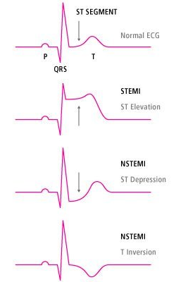
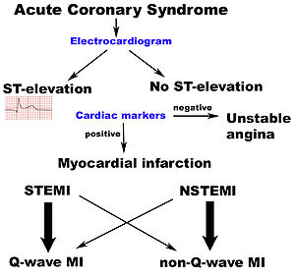
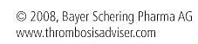
STEMI vs NSTEMI
Notes:
* STEMI- diagnosed based on anginal type chest pain lasting > 20 minutes and ST > 1 mm in two or more consecutive leads on the admission electrocardiogram.
** NSTEMI- diagnosed based on troponin elevation with anginal type chest pain and\or ST-T changes compatible with myocardial ischemia.
STEMI results in an injury that affects the entire thickness of the myocardial wall, due to complete major coronary vessel occlusion.
NSTEMI involves only the subendocardial myocardium and is developing due to a minor coronary artery or partial occlusion of a major coronary artery.
The etiology of Acute Coronary Syndrome is mainly attributed to the abrupt and catastrophic disruption of a cholesterol-laden plaque, whereas stenosis can limit flow under conditions of increased demand, causing angina or chest pain without permanent damage to the myocardium.

Slide 5
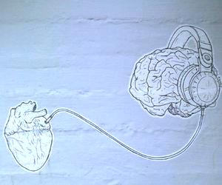
The relationship between Cardiovascular and Carotid diseases
The prevalence of severe carotid stenosis increases with prevalence of coronary stenosis
Coronary atherosclerosis is detected in 60 % to 70% of stroke cases
Patients with carotid stenosis are at higher risk of myocardial infarction than stroke
There are common risk factors, although the effects in both vascular systems may not be identical
The peak incidence of myocardial infarction precedes that of stroke by approximately 10 years, perhaps due to the existence of a natural protection of cerebral vessels.
Jashari et al., Coronary and carotid atherosclerosis: Similarities and differences. Atherosclerosis. 2013 Apr;227(2):193-200.
Drouet, L, Atherothrombosis as a systemic disease. Cerebrovasc Dis, 2002. 13 Suppl 1: p. 1-6.
Rosengarten, B, M Grebe, A Muller, RK Voss , M Kaps, Severity of coronary artery disease but not degree of coronary stenosis is correlated to cerebrovascular reactivity, in Cerebrovasc Dis. 2009. p. 290-7.
Notes:
The relationship is commonly accepted between coronary and carotid arterial disease, suggesting that atherosclerosis is a systemic condition.
The prevalence of severe carotid stenosis increases with prevalence of coronary stenosis, with the latter being found in a significant number of stroke patients, while those with carotid stenosis may be at higher risk of myocardial infarction than stroke.
There also appear to be common risk factors (age, diabetes, hypertension, smoking and dyslipidemia), although the effects in both vascular systems may not be identical. Furthermore, while the degree of stenosis in the coronary artery has little ability to predict acute coronary syndrome, which is caused by local thrombosis from a ruptured or eroded plaque, severe carotid stenosis causing hypoperfusion is highly predictive of stroke, although this effect may be time-limited.
Overall, the evidence shows that a clear relationship exists between disease in the coronary and carotid arteries, since conventional risk factors and the extent of stenosis and/or previous events emanating from one artery have a strong bearing on the prevalence of events in the other artery. Nevertheless, the exact correspondence between the two arteries is unclear, with sometimes contradictory study results.
The prevalence of clinically significant severe carotid artery stenosis (>50%) is progressively increased among patients with either non-obstructive CAD, single vessel disease (VD), double VD, triple VD and disease of the left main coronary artery.
Despite being within the scope of the same systemic disease process, coronary and cerebrovascular atherosclerotic stenosis are found in different disease stages and might be a more complex pattern of interaction between coronary and cerebrovascular atherosclerotic processes.

Slide 6
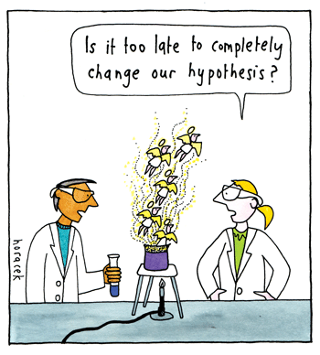
Working Hypothesis
There is a direct relationship between the occurrence of acute coronary events and the degree of morphological instability of carotid plaques
There is a proportional graded association between the severity of the atherosclerotic cerebrovascular and coronary artery disease, being specifically related to biomarkers of atherosclerosis
The presentation of MI (as STEMI vs NSTEMI) is directly related to the carotid plaque presence and it's morphology.

Slide 7

Aims of the Study
To examine the degree and morphology of carotid asymptomatic atherosclerotic disease among patients with ischemic heart disease stratified by STEMI and NSTEMI.
To assess how ethnicity, vascular risk factors and biomarkers affect these associations.

Slide 8
Specific aims:
To examine and quantify the associations between carotid disease (intima media thickness, plaque characteristics, degree of stenosis) and clinical acute coronary artery disease type.
To examine and quantify the associations between carotid disease and coronary disease severity.
To examine how ethnicity, vascular risk factors and biomarkers interact with the associations between carotid and coronary artery disease.
To examine the associations between the recurrence of cerebrovascular events and severity of the carotid disease.

Slide 9
Study Design
A cross-sectional stratified open study.
Subjects are patients presenting to the emergency department with MI who had undergone percutaneous cardiac catheterization.
Collection of the medical information including demographic details, risk factors, concomitant medications, medical history, routine blood test results, etc.,
Notes:
All patients will be treated according to the standard clinical protocol of the cardiology department. The patients will be screened after the coronary disease diagnosis has been done. All screened patients will be identified by patient number and will sign the informed consent prior to any study procedure initiation. Enrolled subjects will be assessed within 72-96 hours of symptom onset for the presence of cerebrovascular extracranial arterial disease by means of carotid ultrasound study. All study procedures will be performed assuring no interference with the medical treatment and the patient comfort. Blood samples will be collected and plasma and serum samples will be stored for supplementary advanced biochemical atherosclerosis related markers analysis.

Slide 10

Sample size:
The study will comprise 300 consecutive patients presenting with chest pain:
100 patients presenting with STEMI
100 patients presenting with NSTEMI
100 patients presenting with chest pain but with no significant coronary disease

Slide 11

Working Progress
Collaboration with Cardiologists
Final Research question
Methods approval
Helsinki approval of the new protocol
Beginning of the pilot study

Slide 12
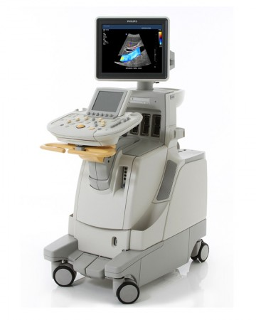
A small insight of what we do…

Slide 13
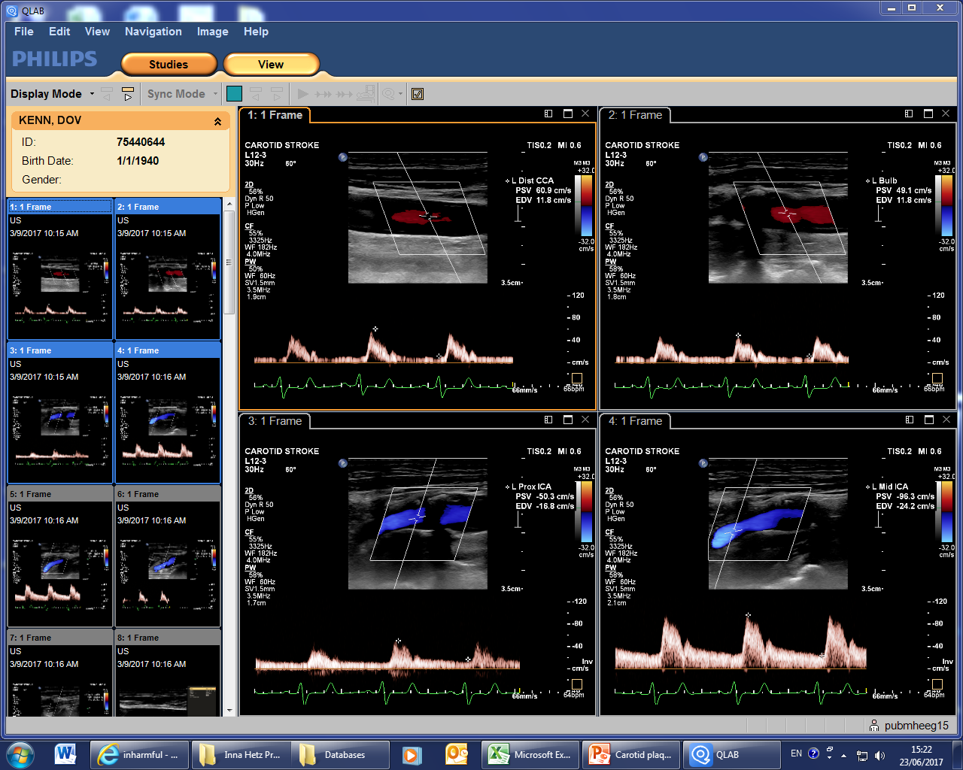
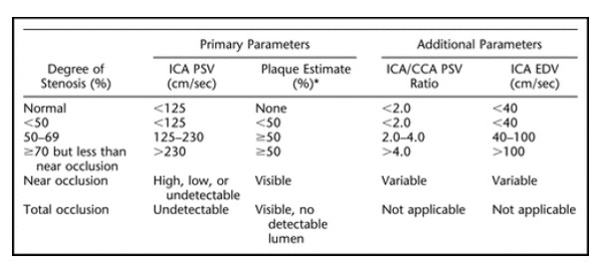
Blood Flow Velocity
Notes:
The first parameter we look at is Blood Flow Velocity, using doppler sonography. This indicates the degree of stenosis in the artery.
For example for Internal Carotid artery normal velocity is under 125cm/sec and the higher the velocity the greater is the degree of stenosis.
Normal velocity values differs between the blood vessels.

Slide 14
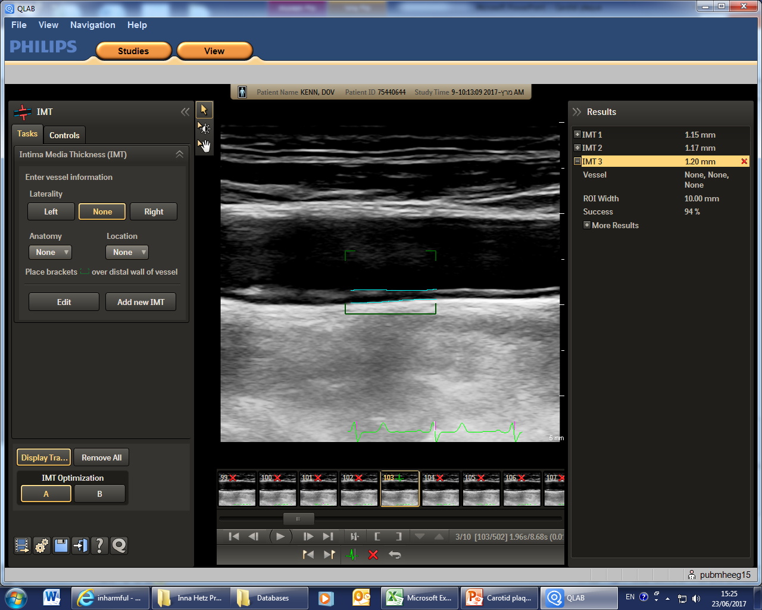
IMT = Intima-Media Thickness
Notes:
The next parameter is IMT - Intima-Media Thickness
From the name you can understand that is measures the blood vessel wall thickness. Normal thickness is under 1mm, and above 1.5 that it is considered as plaque. It depends on the artery size and changes with systole and diastole, thus it is important to make the measurements at the same point of the cardiac cycle.
The patient’s measurements that you see here are pretty high, though it is still not considered a plaque, but they are definitely not of a healthy artery.

Slide 15
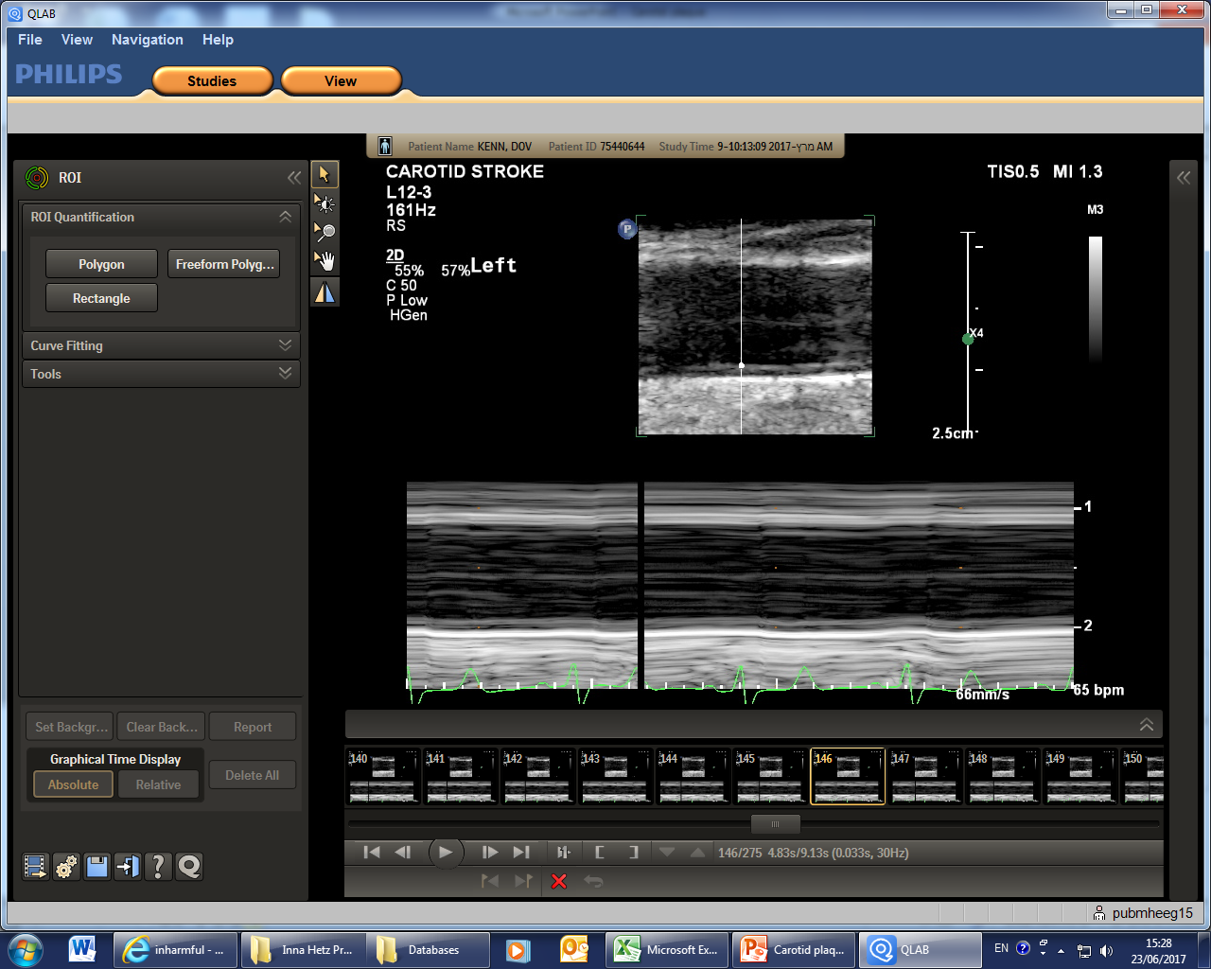
Distensibility
Notes:
Distensibility – the measurement of the arterial stiffness.
Arterial stiffness is associated with future CV events, so this parameter gives us the extent of the distention of the vessel during systole. It is also depend on the blood pressure and the pulse, which we take during this procedure.
If you look closely, you can see the fluctuations of the lines between systole and diastole, this is what we measure.

Slide 16
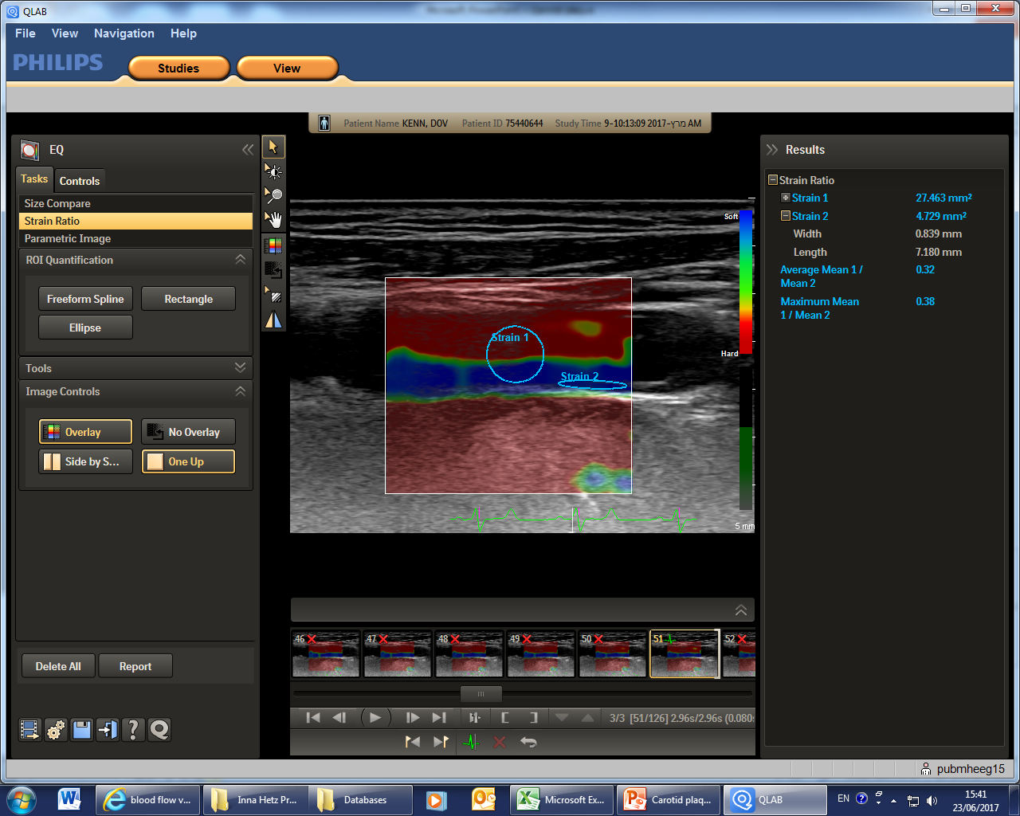
Shearwave Elastography
Notes:
Elastography – gives the ability to differentiate between tissue types, for example calcified tissue or tissue containing hemorrhage or thrombus.
Which gives us another parameter of the plaque or blood vessel consistency.

Slide 17
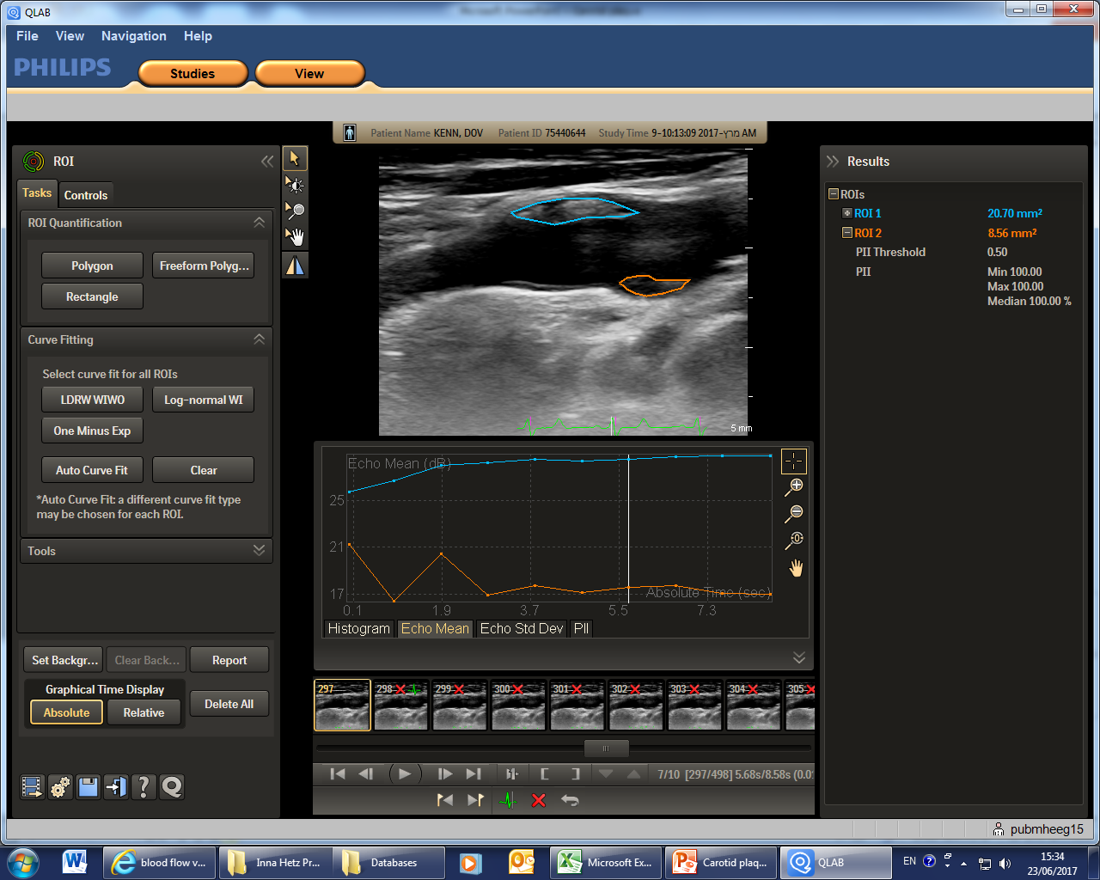
2D plaque
2D Plaque
Notes:
Plaque measurements – this is the 2D plaque measurement – the plaques have to be selected manually, as you can see here

Slide 18
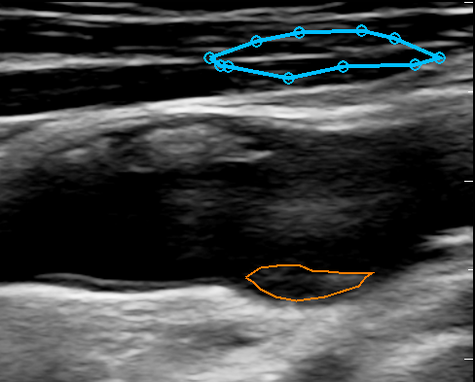
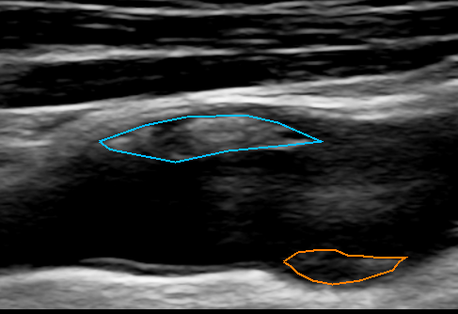
US 2D Plaque evaluation
Notes:
Of course the problem here could be, that it is examiner –dependent and also that you cannot see the whole plaque, but only the specific section. And because it is 2D we cannot measure the entire volume of the plaque.

Slide 19
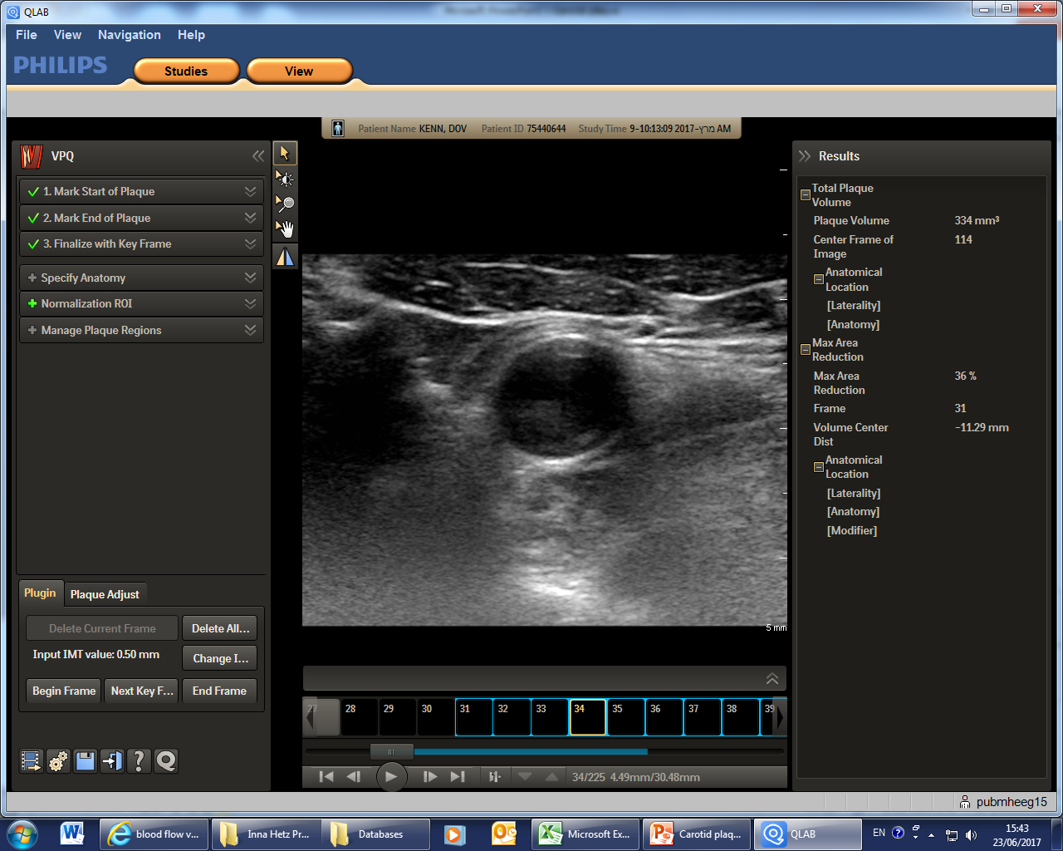
3D Plaque
Notes:
So here you can see the 3D measurement of the same plaque. It is semi-automatic – the examiner still has to mark the blood vessel where the plaque begins and where it ends, which can also be challenging sometimes, but the program recognizes the plaque itself. It can be corrected if needed.

Slide 20
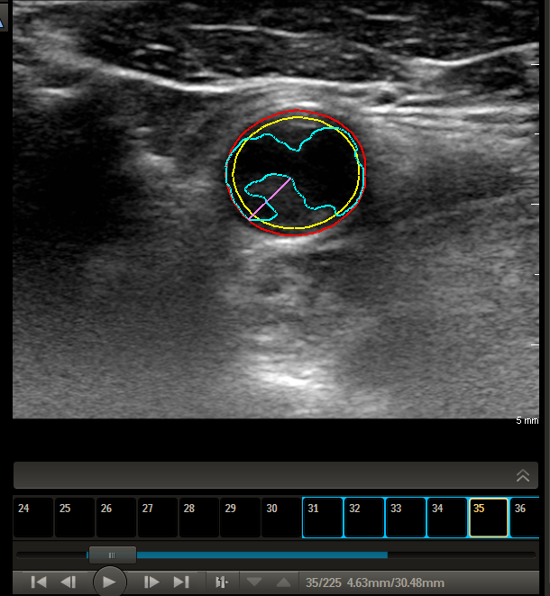
US 3D Plaque evaluation
Notes:
So this way we get the more precise information regarding the plaque including its volume, also according to the calculated echogenicity we can characterize plaque composition – thus its potential stability.

Slide 21
Data Analysis
Notes:
Here you can see partial analysis of the US data and the medical history that we gathered.
So far we examined 8 patients – 4 presenting with STEMI and 4 with NSTEMI. Somehow all of them happened to be men.
Here we chose to show some of the atherosclerosis risk factors such as diabetes, HTN, Smoking etc. and part of the Carotid US examination.
I’ve highlighted in red the risk factors and the “bad outcomes”, in green – “good” results and yellow – what’s in the middle.
Of course we cannot conclude anything here yet or perform the statistics, because there are only 8 patients yet.
But couple of interesting facts that We’ve paid attention to:
1. All the patients had plaques, and half of them are severe, whereas in general population of the same age plaques are found in about 30% using the same technique.
2. A little interesting anecdote– All 4 Smokers happened to had STEMI, whereas the 4 non-smokers had NSTEMI.. Also all 4 patients with HTN were from the NSTEMI group.
Again it’s just a anecdote for now, but it is interesting to see whether it will still be true in a large group.

Slide 22
Conclusions so far
Doppler Ultrasonography of the carotid arteries is a fast, easy, non-invasive and non-harmful test that can be used as an imaging marker for atherosclerotic disease and might be valuable to predict coronary artery disease.
There is still a lot to investigate

Slide 23
Acknowledgments
Dr. Salo Haratz
Bella Bruk
Lilia Brin
Dr. Silvia Koton
Chen Moshe
Noit Brown
Prof. David Tanne
Our Collaborators:
Prof. Shlomi Matetzky
Dr. Roy Beigel
Prof. Ilan Goldenberg

Slide 24


