Slide 1
ECG Changes in Diabetes while Driving
Initial results – 12 patients
Dr. Shai Tejman Yarden
Mey Gelbart

Slide 2
Study Design
Study parameters:
Glycemic status
Euglycemic
Hyperglycemic
Driving protocol
Urban (5 scenarios)
Highway (4 scenarios)
Different driving scenarios in each setting
Each subject is compared to his-/herself in the same setting & analyzed with the same mathematical parameters

Slide 3
Hypotheses
We can detect acute minor changes in HR in correlation to stressful events during driving.
A hyperglycemic state will effect the CV response to these events.

Slide 4
Results
No change
Hypersensitive
Non-responsive

Slide 5
No change

Slide 6
BGU4 – HIGHWAY
Euglycemic
Hyperglycemic

Slide 7
BGU5 - URBAN
Euglycemic
Hyperglycemic

Slide 8
BGU5 – HIGHWAY
Euglycemic
Hyperglycemic

Slide 9
BGU6 – HIGHWAY
Euglycemic
Hyperglycemic

Slide 10
Hypersensitive

Slide 11
BGU3 – URBAN
Euglycemic
Hyperglycemic

Slide 12
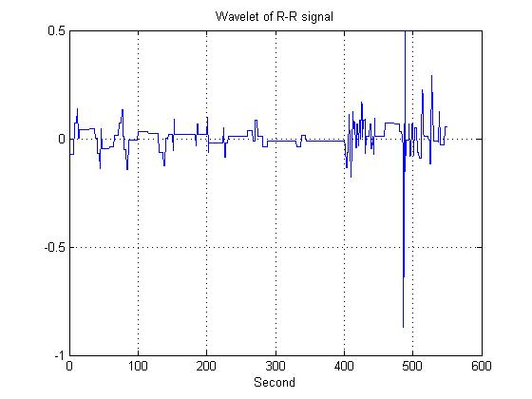
BGU10 - URBAN
Euglycemic
Hyperglycemic

Slide 13
BGU10 – HIGHWAY
Euglycemic
Hyperglycemic

Slide 14
BGU14 - URBAN
Euglycemic
Hyperglycemic

Slide 15
BGU14 – HIGHWAY
Euglycemic
Hyperglycemic

Slide 16
Non-responsive

Slide 17
BGU11 - URBAN
Euglycemic
Hyperglycemic
No response

Slide 18
BGU12 - URBAN
Euglycemic
Hyperglycemic
No response
No response

Slide 19
BGU13 - URBAN
Euglycemic
Hyperglycemic
No response

Slide 20
BGU13 – HIGHWAY
Euglycemic
Hyperglycemic
No response

Slide 21
BGU16 - URBAN
Euglycemic
Hyperglycemic
No response

Slide 22
BGU16 – HIGHWAY
Euglycemic
Hyperglycemic

Slide 23
Conclusions
The individual CV response to the road may be influenced by the levels of glucose in one’s blood.
Some subjects had a similar response in both euglycemic and hyperglycemic states (no change).
2 distinct types of change in HR response were observed:
Non–responsiveness
Hypersensitivity
These changes were significant.
These changes varied with setting (e.g. BGU14, BGU16).

Slide 24
Thank you!

