Slide 2
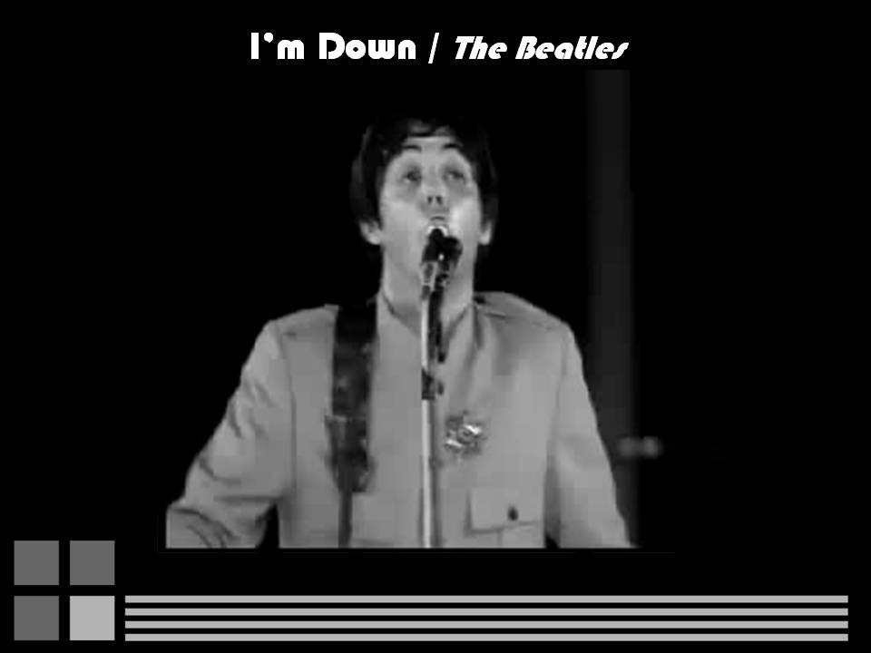

Slide 3
Notes:
What do you think they meant by using the expression ‘I’m down’? How do you think Paul McCartney felt when he wrote those words? What state of mind was he in? So we mentioned depression and we have all heard about this disorder and how common it is. And now I would like to elaborate on it.

Slide 4
Notes:
These are some examples of the different ways that depression looks like or is perceived by many people.
A depressive disorder is a mental illness that characterized by low mood, low self esteem and loss of interest in pleasurable activities. It means that something you once enjoyed before, you no longer find drive in it whatsoever. Depression is characterized not only by negative thoughts, moods, and behaviors but also by specific changes in bodily functions (for example: eating, sleeping and sexual activity). Depression is often confused with every day ups and downs, meaning, mood swings . You can hear a friend saying: yesterday I felt depressed, but I feel better now. The truth is that it’s not real depression. Depression is quite resilient and most of the time lasts eight months up to a year, and some times even longer.
Let’s talk about the causes for depression. First, there is the biological aspect–which is the lack of serotonin, lack of NA and lack of dopamine which are neurotransmitters are associated with pleasure. Then, we have the environmental aspect which includes increased stress from family or at the work place or recent death of close friend or relative. It’s unclear which aspect occurs first – the biological or the environmental one. Whether that be you don’t have chemical balance and the environmental event sets it off or the environmental aspect causes the neurotransmitters to get out of balance.
Let’s talk a little bit about statistics - In the U.S – about 3-5 percents of all male population will become depressed in their life time. The female rate is about double – 8-10 percents. We’re not really sure why the female rate is double the male rate – whether the cause is environmental or biological. Anyone who did experienced depression has 17 percents probability of a life time prevalence they would bottle with it again in their entire life. Most commonly depression sets in between the ages of 30 to 40. We also have suicide statistics – in the use three point four percents of the people suffering from major depression commit suicide. One last thing is the fact that suicide is the third leading cause of death from the ages ten to twenty four. This emphasizes by itself the importance of the subject.

Slide 5
Notes:
Back to the spatial metaphors - I’m not sure if you are all aware to the wide use of spatial metaphors in our everyday affective expressions, but if you think about it just for one moment (and remember the song you’ve listened to, five minutes ago), you will realize that this is an absolute truth. An interesting anecdote about the term depression is that it derives from the Latin verb deprimere, which means "to press down“. As I said, verbal expressions of emotional experiences often use spatial metaphors. Spatial metaphors may be related to emotions of happiness and sadness, and may be related many times to the vertical semantic field ,meaning upward-downward. “Feeling down” is only one example to describe being depressed, but there are many others, like: I hit rock bottom. As I mentioned, this claim is also true regarding positive emotions, euphoria and even mania. People use expressions that include the semantic field: upward, for example: elevated mood, feeling high, I’m on top of the world etcetera.

Slide 6
Notes:
These expressions I’ve just described appear to be somewhat universal as so Italian people might also say “Mi sento giù”, Arabic speakers would say: “بالأرض معنوياتي”, and even in Hebrew people use the term: “מצב רוחי ירוד“. The fact that this is a cross-cultural phenomenon may tell us that maybe there is something more to those spatial terms, something biological that made those terms related to emotions. But what is it? Where did it come from?

Slide 7
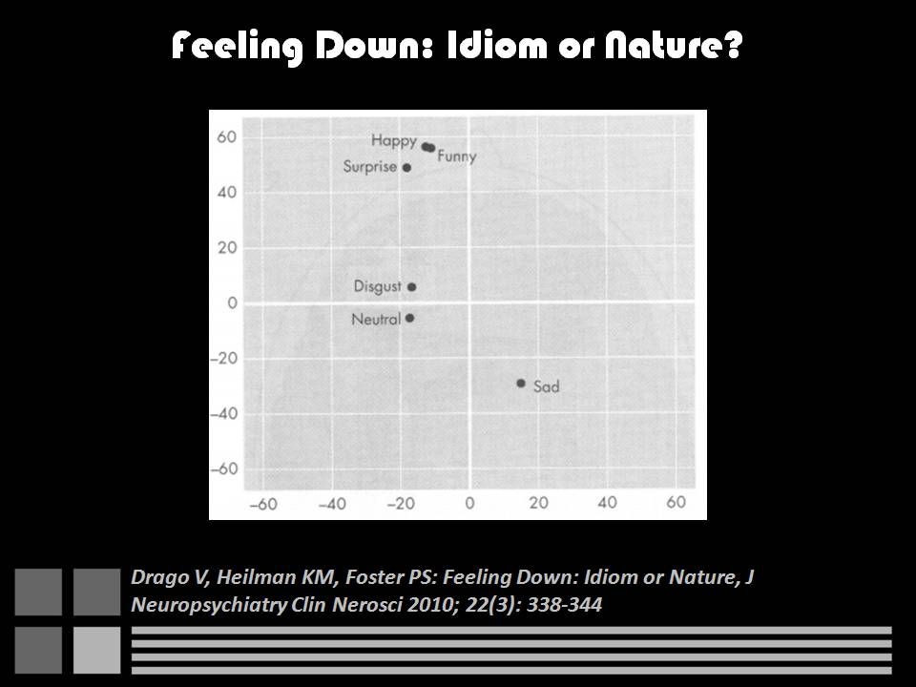
Notes:
It may sound weird, illogical or even made up, but there was a study that examined response to emotional evocations among healthy patients. In this study, healthy patients were asked to recall a series of emotional memories, each for one minute. For example: happy memory, meaning something that made that person feel happy or pleased him, funny memory etcetera. Then, the patients were asked to mark a blank piece of paper by placing an ‘X’ on the paper. The ‘X’ could be placed in any position they wished to place it. The study found that when the patients placed marks during the positive emotional memories, their marks were placed higher than the marks they made during negative and sad emotional memories. In this figure we can see the vertical and horizontal mark placement as a function of emotional memory. Those findings suggest that there is a vertical bias, associated with emotions, and that’s what we want to find out. We wanted to focus, first, on one emotion, so we chose depression, which reflect roughly a continuous state of sadness and other negative feelings.

Slide 8
Notes:
When we tried checking out the scientific basis of this phenomenon in the literature, we discovered some interesting findings. First of all, we focused on neglect.
Spatial Neglect is a state in which after damage to one hemisphere of the brain, there is a deficit in attention to and awareness of one side of a space. It is defined by the inability of a person to process and perceive stimuli on one side of the body or the environment. When patients with spatial neglect are asked to perform a variety of tasks in space, they most often neglect the hemispace contralateral to their lesion.
For example, when asked to draw a picture, they may fail to draw portions of the picture that are in contralesional hemispace. The same thing happens when they are asked to copy a picture. You can see it in the left upper picture. When asked to bisect a line, meaning, mark the middle of this line, they may quarter it instead. You can see it in the lower picture. They also may fail to cross out lines distributed over the page, like you can see in the right upper picture.
When this disorder was first described, patients with spatial neglect were depicted as failing to eat from one side of their plate. Patients with this type of neglect may also fail to read part of a word or a portion of a sentence. For instance: they may read the word “cowboy” as “boy”.
In addition to horizontal neglect, neglect of lower and upper vertical space and neglect of near and far radial space have been reported. The vertical neglect is the one that we are inetrested in.

Slide 9
Notes:
There are many theories regarding neglect, the attentional model is one of them. According to this theory, the human brain has a limited capacity to process information, and therefore, the brain must triage or select information based on its biological significance. In order to do that, one must recognize the stimulus and know its spatial location. To process information, the cortex has to be in a physiological state of readiness, called: arousal. The mesencephalic reticular system (or in short: MRF) mediates arousal. In addition, the MRF also causes a disinhibtion in the thalamus, allowing a sensory information that passes through the thalamus to get into the cortex.
Therefore, lesions of the MRF may induce neglect not only because the cortex is unprepared for processing sensory stimuli, but also because there is an inhibition from the thalamus, preventing the sensory information from getting into the cortex.

Slide 10
Notes:
The affective neuroscience field was founded by Panksepp. This field studies the neural mechanisms of emotions. Panksepp has isolated emotional circuits in the sub-cortical sections of mammalian brains to identify what he calls ‘primary affective systems’. He strongly believed that studies of emotional and other affective systems of animals will shed a profound light on the nature of our own feelings. He claimed that the circuitries of emotions originate from primitive parts of the brain, and in particular – the brainstem.
As a concept, it was proposed that a dysbalance between two dichotomic systems—the SEEKING system and the PANIC system – plays a major role in the clinical syndrome of depression. The SEEKING system promotes positive euphoric drive and anticipation of reward, while the PANIC system promotes the feeling of separation distress. According to this theory, depression is related to two different things:
The first thing is overactivity of the seperation-distress PANIC system that can, if prolonged, lead to a downward cascade of psychological despair.
The second thing is the despair phase that follows acute PANIC response, which characterized by abnormally low activity of the SEEKING system.

Slide 11
Notes:
As I said before, The SEEKING system is an emotional system that promotes a certain class of survival abilities. In humans, this may be one of the main brain systems that generate curiosity and connection to the outside world.
Regarding the circuitry of this system, there is the medial forebrain bundle, which is a tiny pathway of a multitude of nerve fibers that motivates us via the SEEKING system. This pathway originates from the ventral tegmental area (VTA) within the ancient midbrain, which is part of the brain stem. The mesolimbic and mesocortical dopamine pathways that are incorporated in the medial forebrain bundle (MFB), tend to energize and coordinate the functions of many higher brain areas that mediate planning and foresight (such as the amygdala, nucleus accumbens and frontal cortex).

Slide 12
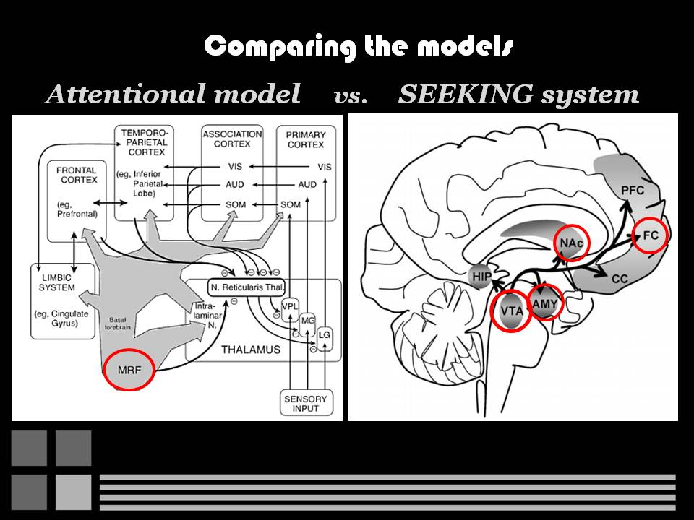
Notes:
If we compare the attentional model, I described earlier, to the SEEKING system - We can easily find both anatomical and functional connection between those two pathways. The attentional model pathway originates from the MRF, meaning: the midbrain, while the SEEKING system pathway originates from the ventral tegmental area, which is also in the midbrain. Moreover, those two pathways are functionally connected by influencing our attention. Therefore, we won’t be surprised to find out that any problem with one of those pathway might imply to a problem with the other. As I’ve already said – in depression there is a low activity of the SEEKING system. This abnormal pathway might interfere with the pathway of arousal, hence – causing some spatial bias. Since many studies examined an horizontal bias among depressed patients, ended with negative results, meaning: there is no such bias in patients with depression, we would like to find out whether there is a bias of the vertical axis. We raise the possibility that the emotional state may have altered the patterns of brain activation, and these alternation might have induced spatial attentional bias.

Slide 13
Notes:
And that is when we developed hypotheses to our study.
Our goal is to examine whether among depressed patients there is an alternation in the spatial processing systems in the brain that is expressed either in downward spatial bias or in a pattern of linguistic preference for a certain spatial semantic field that is different from non-depressed patients.
We assume that among patients with depression we would notice a significant downward spatial bias, while among healthy people, we wouldn’t see such bias, and maybe we would even notice an upward spatial bias.
In addition, we expect that patients with depression would show a different pattern of affective spatial linguistic associations, that would be unique only to them. For example: patients with depressive disorder may find the relation between negative emotions to the lower semantic field more natural, because for them – these emotions are daily routine. On the other hand, maybe because negative feelings are part of their daily routine, there would be some habituation that would cause this relation to be reduced.

Slide 14
Notes:
The depression group includes twenty patients - ten males and ten females. Those patients should have a diagnosis of depression in their medical record. As for the non-depression group – the size of the group is of course the same – 20 patients. Here, the initial requirement is not having a history of depression, psychiatric illnesses or neurological diseases. The people of the non-depression group are chosen according to the demographics of the depressed patients.
After gathering the potential patients for both groups - we ask the patients to answer the Beck Depression Inventory II. This is a questionnaire that includes 21 multiple choice questions, regarding the patient’s feeling in the past week. It is composed of items relating to symptoms of depression and is used for measuring the severity of depression. A total score of 10 and above means that the patient has depression, while a score that is up to 9 means there is no depression.
The cognistat test is another important test to our study. It is a cognitive screening test that assesses five cognitive ability areas. The perception of space area is the one that we are most interested in. This test lets us know whether the patient has some cognitive disabilities that might prevent him from participating in the study, and If so – we have to exclude him from both groups. Another general criteria for the selection of the patients for either group are: Speaking Hebrew and having the ability to complete the study assignments.
As for medication, it would have been best if we could examined the patients without them taking it. However, this isn’t the case. Instead, we make notes of each patient’s drugs and doses and we will take it into consideration while analyzing the results.

Slide 15
Notes:
Two methods were chosen for our study.
The first one is the line bisection task. And..
The second is the implicit association test.
Starting with the line bisection task.

Slide 16
Notes:
There are many tests for spatial neglect, one of the most common is the line bisection test. In this test a line of ten to thirty centimeters long is drawn on a sheet of paper that is placed before the patient. The patient is then asked to bisect this line, meaning: make a mark in the middle of the line. Healthy patients usually bisect those lines very close to the true center. However, patients with spatial neglect will usually displace their mark to the ipsilateral side of their lesion. That means they have contralesional neglect.
Neglect is indicated by consistent deviations of true center of at least 2% of the line's total length.

Slide 17
Notes:
Although most patients are tested with horizontal lines, vertical and radial neglect has been reported too. Therefore, lines can also be presented vertically or radially.

Slide 18
Notes:
In our study we decided using this test in order to examine the presence of a subtle neglect in the vertical space among patients with depression. We improved the test by using affective stimuli (sad and happy) and neutral stimuli, that include: words and images. Those stimuli would let us know whether the bias is caused by the emotional evocation of the stimuli, or by the state of mind of the patients, meaning: the depression. If we find out that the bias is related to the state of mind of the patients, those stimuli will let us know if this bias can change a little, meaning: decrease or increase, by affective or non-affective evocations.

Slide 19
Notes:
Now – for the IAT.. I would like to read passage of the author dostoyevski.
It is well known that people don't always 'speak their minds', and it is suspected that in some cases people don't always 'know their minds'. The Implicit association test, or for short: the IAT, is a new method that demonstrates the conscious-unconscious divergences much more convincingly than has been possible with previous methods.
Psychologists understand that people may not say what's on their minds either because they are unwilling or because they are unable to do so. For example, if asked "How much do you smoke?" a smoker who smokes 4 packs a day may purposely report smoking only 2 packs a day because they are embarrassed to admit the correct number. Or, the smoker may simply not answer the question, regarding it as a private matter. (These are examples of being unwilling to report a known answer.) But it is also possible that a smoker who smokes 4 packs a day may report smoking only 2 packs because they honestly believe they only smoke about 2 packs a day. (this time, they are giving unknowingly an incorrect answer, and this illustrates being unable to give the desired answer).
The unwilling-unable distinction is like the difference between purposely hiding something from others and unconsciously hiding something from yourself. The Implicit Association Test makes it possible to penetrate both of these types of hiding. The IAT measures implicit attitudes and beliefs that people are either unwilling or unable to report.
The IAT was designed by Tony Greenwald to detect the hidden contents of the mind. Its original application was to explore the group-based preferences, stereotype, and identities that may not be accessible to conscious awareness.
Since then, it has been used widely to study preferences, beliefs, and identity, and found applications in domains of health, education, business, government, the law and law enforcement. The test is currently available at 39 country sites, in 25 languages.

Slide 20
Notes:
A typical IAT procedure involves a series of seven tasks. In the first task, an individual is asked to categorize stimuli into two categories. For example, a person might be presented with a computer screen on which the word “Old" appears in the top left-hand corner and the word “Young" appears in the top right-hand corner. In the middle of the screen appears image, such as an old woman, that is typically associated with either the categories of “Old" or “Young." For each image that appears in the middle of the screen, the person is asked to sort the image into the appropriate category by pressing the appropriate left-hand or right-hand key.

Slide 21
Notes:
On the second task, the person would complete a similar sorting procedure with an attribute of some kind. For example, the word "Pleasant" might now appear in the top left-hand corner of the screen and the word "Unpleasant" in the top right-hand corner. In the middle of the screen would appear a word that is either pleasant or unpleasant. Once again, the person would be asked to sort each word as being either pleasant or unpleasant by pressing the appropriate key.

Slide 22
Notes:
On the third task, individuals are asked to complete a combined task that includes both the categories and attributes from the first two tasks. In this example, the words “Old/Pleasant" might appear in the top left-hand corner while the words “Young/Unpleasant" would appear in the top right-hand corner. Individuals would then see a series of stimuli in the center of the screen consisting of either a image or word. They would be asked to press the left-hand key if the image or word belongs to the “Old/Pleasant" category or the right-hand key if it belongs to the “Young/Unpleasant" category.
The fourth task is a repeat of the third task but with more repetitions of the images and words.

Slide 23
Notes:
The fifth task is a repeat of the first task with the exception that the position of the two target words would be reversed. For example, “Old" would now appear in the top right-hand corner of the screen and “Young" in the top left-hand corner.

Slide 24
Notes:
The sixth task would be a repeat of the third, except that the objects and subjects of study would be in opposite pairings from previous trials. In this case, “Old/Unpleasant" would now appear in the top right-hand corner and “Young/Pleasant" would now appear in the top left-hand corner.
The seventh task is a repeat of the sixth task but with more repetitions of the images and words.

Slide 25
Notes:
As for the results - If the categories under study (In our example: Old or Young) are associated with the presented attributes (In our example: Pleasant/Unpleasant) to differing degrees, the pairing - reflecting the stronger association, or in other words: the "compatible" pairing, should be easier for the participant. In the Old/Young-Pleasant/Unpleasant example, a participant will be able to categorize more quickly when Young and Pleasant are paired together than when Old and Pleasant are paired if he or she has more positive associations with Young people than with Old people (and vice versa if Old and Pleasant are categorized more quickly). This specific example found a gap in reaction times between old participants to young one – the old participants reacted faster to the combination Old/Pleasant, while the young participants reacted faster to the combination Young/Pleasant.

Slide 26
Notes:
Once all the subjects finish the entire task, the data about the reaction times is collected in one excel file. Afterwards, all the data is processed using special scripts in SPSS software. The software analyses the data by calculating the time differences between the subject’s reactions in the third and fourth tasks compared to the sixth and seventh tasks. In our example, the comparison will be between the time reactions of the combination Old-Pleasant to the combination Young/Pleasant.

Slide 27
Notes:
In order to find an implicit association between emotions, and in our study: sad emotions, to spatial metaphors, we chose to use the IAT. In the IAT we compare between images of positive or negative moods to words that represent the upper and lower semantic field. For example: the word “sky” is perceived as something high, therefore – is categorized as “up”. In the same way – happy smiley will be categorized as “happy”.

Slide 28
Notes:
Back to the computer screen display – Subject will need to classify images or words to the right category, while the combination options are: up/happy and down/sad.

Slide 29
Notes:
After that, the combinations change and subject will have to classify the word or the image according to the new combinations: down/happy and up/sad.

Slide 30
Notes:
When we analyze the results, we compare between the subject’s reaction times to those two combination: Up/Happy and Down/Sad.
As we said earlier, we expect that patients with depression would show a different pattern of affective spatial linguistic associations, that would be unique only to them. For example: patients with depression may find the relation between negative emotions to the lower semantic field (Down/Sad) more natural, because for them – these emotions are daily routine. On the other hand, maybe because negative feelings are part of their daily routine, there would be some habituation that would cause this relation to be reduced.
As for the combination up/happy – assuming these two words are so far-fetched from their daily routine, it is possible that depressed subjects will have much faster reaction times than normal subjects. On the other hand, remember the habituation that might blur their thinking and cause the opposite reaction.
These are all speculations, and we can’t be sure until we finish our study.

Slide 31
Notes:
Let’s talk about the theoretical consequences of our study.
There is a theory that is called “Sapir Whorf hypothesis”. This hypothesis states that language and culture are so closely connected that one defines the other. Here's an example that you might find amusing - in a certain part of New Guinea, people live a hand-to-mouth existence as they always have done. Therefore, they have no wealth and no reason to count things. Their language has a word for one and another word for two. That's the extent of their counting system. Today, because of contact with the outside world, they had to adapt their language. They use the word “dog” to indicate the number four (possibly because a dog has four legs). So, in order to indicate the number five they the phrase “dog and one”. If so, the hypothesis is that we must be able to think of some phenomenon before we can name it or experience it.
This hypothesis raises an alternative explanation to the vertical bias I presented before you earlier. According to this theory, the reason for a significant vertical differences between the negative and positive emotions might be related to the use of an arbitrary spatial notation system used to express the emotional experiences, while positive is up, and negative/sad is down.
On the other hand, a more significant bias in certain affective situations proves a real association between this bias and biology. Since depression is a biological state based on biological tracts in the brain, even with environmental influence, we believe that the biology and the neuronal pathways in the brain play a major role.

Slide 32
Notes:
Looking into the future - our study and its results should be considered preliminary. There were few studies that showed vertical bias affected by emotions, but none of them examined the association of this bias with depression. In addition, the use of spatial metaphors was never examined.
As for the anatomy aspect – further studies using functional imaging are required to fully understand the neuronal pathways that are involved in this phenomenon.
Another way to rule out or to prove this bias is by using depressed patients as a result of brain damage. These patients might help us to better understand the processes that occur in the brain and its association with the bias.
Regarding Mania – it is interesting to know whether there is an attentional bias also in mania, and which pathways lead to that.

Slide 33
Notes:
With this study we hope to better understand the pathogenesis of depression and the pathways related to attention. At the moment, clinical use of our findings sounds a little bit far. However, we hope to create a reliable tool for a clinical use.
Today’s diagnosis is based on clinical symptoms and emotions related to depression, such as hopelessness and despair, therefore, is not objective. In some cases even a patient is unaware of his feelings. We hope our hypothetical clinical tool would be more objective and reliable and could be of help in those cases. Moreover, it is possible that the spatial changes and the differences in the use of metaphors may appear earlier than the clinical symptoms, thus – allowing earlier diagnosis.
If we could really find a differences in the use of metaphors and a spatial bias, we could use it as a marker for the disease.
If we use this tool for surveillance – we may be able to check the efficiency of the treatment earlier than it is today. In addition, there is a possibility we could better evaluate whether there is a change in the course of the disease for better or worse.

