Slide 1


The Transgender Adolescent

Slide 2



Cisgender man - a person assigned male sex at birth who identifies as a man
Cisgender woman- a person assigned female sex at birth who identifies as a woman
A transwoman - a person assigned male sex at birth who identifies as a woman
A transman - a person assigned female sex at birth who identifies as a man
Genderqueer – A person with a nonbinary gender identity,
identifying as both a man or a woman or as neither sex
Gender identity - One’s sense of oneself as male, female, or outside these categories
Notes:
ציסגנדר male הוא מי שסומן כזכר בלידה וגם הזהות המגדרית שלו היא של זכר
ציסגנדר woman - היא מי שסומן כנקבה הזהות המגדרית שלה היא של אישה
אשה טרנסגנדרית היא מי שהוגדרה כזכר בלידה, אך הזהות המגדרית שלה היא של אשה
איש טרנסגנדר הוא מי שנולד נקבה אך הזהורת המגדרית שלו הוא של זכר
Some concepts are evolving, and usage may vary

Slide 3

Gender Dysphoria
A significant incongruence between gender identity and physical phenotype is known as Gender Identity Disorder (GID)
The experience of this state as a source of chronic suffering is known as gender dysphoria
Notes:
כשקיימת חוסר הלימה בין הפנוטיפ הפיזי לבין הזהות המגדרית זה בעצם GID
אם המצב מביא לסבל זה נקרא gender dysphoria

Slide 4
Epidemiology
The prevalence of gender identity incongruence is largely unknown as transgender people are a diverse group:
  Some live with their gender incongruence, but decide not to transition
  Some make a social transition only, without accessing any gender-affirming health care
  Some buy hormones from non-medical providers (or on the internet), or visit their local doctors rather than attending specialized clinics
  In many parts of the world, stigma discourages transgender people from making their transgender status known or accessing health care of any sort

Slide 5
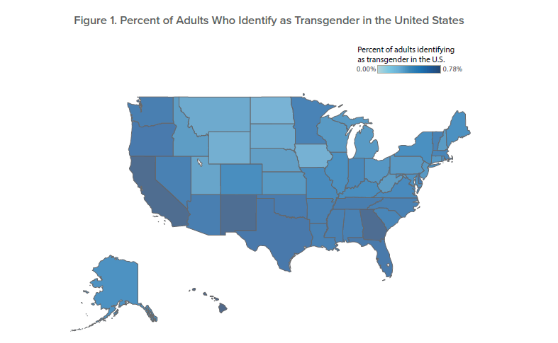
Percent of Adults who identify as Transgender in the United states
The Behavioral Risk Factor Surveillance System (BRFSS) is an health-related telephone surveys that
collect health-related data about U.S residents
> 400,000 adults are interviewed each year, making it the largest conducted health survey system in the world
In total, 0.52% of BRFSS respondents identified as transgender
  Hawaii, California, Georgia, New Mexico (0.8%), Texas and Florida (0.7%)
  North Dakota, Iowa, Wyoming, Montana and South Dakota (0.3%).
• Young adults are more likely than older adults to identify as transgender
  Among adults ages 18 to 24, 0.7% identify as transgender; ages 25 to 64 yrs, 0.6%; and>65 yrs 0.5%
Notes:
he Behavioral Risk Factor Surveillance System (BRFSS) is the nation's premier system of health-related telephone surveys that collect state data about U.S. residents regarding their health-related risk behaviors, chronic health conditions, and use of preventive services. Established in 1984 with 15 states, BRFSS now collects data in all 50 states as well as the District of Columbia and three U.S. territories. BRFSS completes more than 400,000 adult interviews each year, making it the largest continuously conducted health survey system in the world
Appendix: Methodology and Credible Intervals of Population Estimates
Methodology
The Behavioral Risk Factor Surveillance System (BRFSS) collects state-specific data on health-related factors
across the 50 states, the District of Columbia, and the territories of the United States. The survey is designed to
be representative within each state. The survey is conducted by an interviewer via landline and cellular telephone.
The national response rate for the 2014 BRFSS was 48.7% for landline telephones and 40.5% for cellular telephones
(American Association of Public Opinion Research, Response Rate calculation 4).
The BRFSS contains optional module questionnaires in addition to its standard questionnaire for each state.9 The
2014 BRFSS had 19 optional modules that states were able to opt-into. One of the modules contained the following
question:
Do you consider yourself to be transgender?
Yes
No
[If Yes] Do you consider yourself to be male-to-female, female-to-male, or gender non-conforming?
If the interviewer is asked for a definition of transgender, they respond:
Some people describe themselves as transgender when they experience a different gender
identity from their sex at birth. For example, a person born into a male body, but who feels female
or lives as a woman would be transgender. Some transgender people change their physical
appearance so that it matches their internal gender identity. Some transgender people take
hormones and some have surgery. A transgender person may be of any sexual orientation –
straight, gay, lesbian, or bisexual.
Since this question is included in an optional module, some states did not ask this question while others did. The
19 states that did ask this question include: Delaware, Hawaii, Idaho, Indiana, Iowa, Kansas, Kentucky, Louisiana,
Maryland, Minnesota, Montana, Nevada, New York, Ohio, Pennsylvania, Vermont, Virginia, Wisconsin, and Wyoming.
In total, 0.52% of BRFSS respondents in these states identified as transgender, and 151,456 respondents answered
this question.
To estimate the population by state, we relied on multilevel regression and post-stratification.10 The method fits
multilevel logistic regression to the data to predict the likelihood that an individual identifies as transgender relying
on demographic attributes about the respondents (e.g., race and ethnicity; age cohorts; and educational attainment).
State and regional characteristics were accounted for and state-level characteristics were included to add information
about how states differ from one another (e.g., racial composition, median income, percentage of households that are
of same-sex couples, and percentage of the population that identifies as Evangelical). This method has been applied
to measure statewide political attitudes11 and to measure Jewish populations.12 Further, the estimation strategy has
undergone rigorous evaluation by other scholars, and these evaluations often show the method produces reliable
and valid estimates.13 While the estimation approach is not without its criticisms,14 the method remains the best
available approach to perform this estimation procedure. A recent research grant was awarded by the National
Science Foundation to further refine and build upon the method.15
We extend the application of the estimation technique by incorporating all of the states in the BRFSS, even though
respondents in only 19 states received the gender identity question. By doing so, we impute the states that did
not ask the gender identity question by modeling the probability that a respondent identifies as transgender. The
hierarchical model still incorporates the statewide covariates to increase precision in the estimation.16 All models were
estimated using a Hamiltonian Monte Carlo as implemented by the Stan probabilistic programming language.17 The
model was evaluated for appropriate diagnostics before results were presented. In the tables below, 95% credible
intervals are provided for both the population estimates and the population estimates by age. A credible interval is a
Bayesian equivalent of a confidence interval. A 95% credible interval represents the upper and lower bounds where
there is a 0.95 probability an estimate falls between them.

Slide 6
Population Studies
 |  |  |  |  | Prevalence of transgender people by birth-assigned sex
Author/year | Place | No | subjects | Measure | Male | Female | All
Coron (2012) | USA | 28,176 | adults | Identification as transgender | 0.5% | 0.4% | 0.5%
Glen (2012) | UK | 9,950 | adults | Identification as transgender | 0.4% | 0.4% | 0.5%
Kuyper (2014) | Netherlands | 8,064 | adults | Identification on gender spectrum | 1.1% | 0.8% | 0.9%
Van Caenegen (2015) | Belgium | 1,832 | adults | Identification on gender spectrum | 0.7% | 0.6% | 0.6%
Clark (2014) | New Zealand | 7,729 | High-school students | Identification as transgender | 1.3% | 1.2% | 1.2%
Winter S et al. Transgender people: health at the margins of society. Lancet. 2016,23;388(10042):390-400.

Slide 7


Notes:
The best thing about being a girl is, now I don’t have to pretend to be a boy,” declares the brand new cover for National Geographic magazine’s January 2017 issue. The quote is flanked by a confident Avery Jackson, a 7-year-old transgender girl.

Slide 8
Adolescents Referred to Specialized Gender Identity Clinics for Gender Dysphoria
Pediatric Endocrine clinic in Indiana University School of Medicine, Indianapolis, Indiana
Between 2002 and 2015:
A total of 38 patients (81.6% Caucasian) aged 14.4 ± 3.2 years
16 natal males & 22 natal females (p = .33)
with 74% presenting since 2013
  31 (82 %) were Tanner stage IV or V at baseline
  6 (16 %) were prepubertal
  1 (2 %) was in early puberty
  Chen et al. J Adolesc Health. 2016 Mar; 58(3): 369–371.

Slide 9
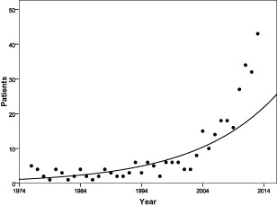
Number of Patients Assessed by Year (1975-2013) - Toronto Canada
328 adolescents, 13–19 years of age referred between 1976 and 2013. Mean age was 16.7±1.7 years
Aitken M et al , J Sex Med. 2015 ;12(3):756-63
Notes:
כמעט 4 עשורים
corresponding shift in the sex ratio, from one favoring natal males to one favoring natal female

Slide 10
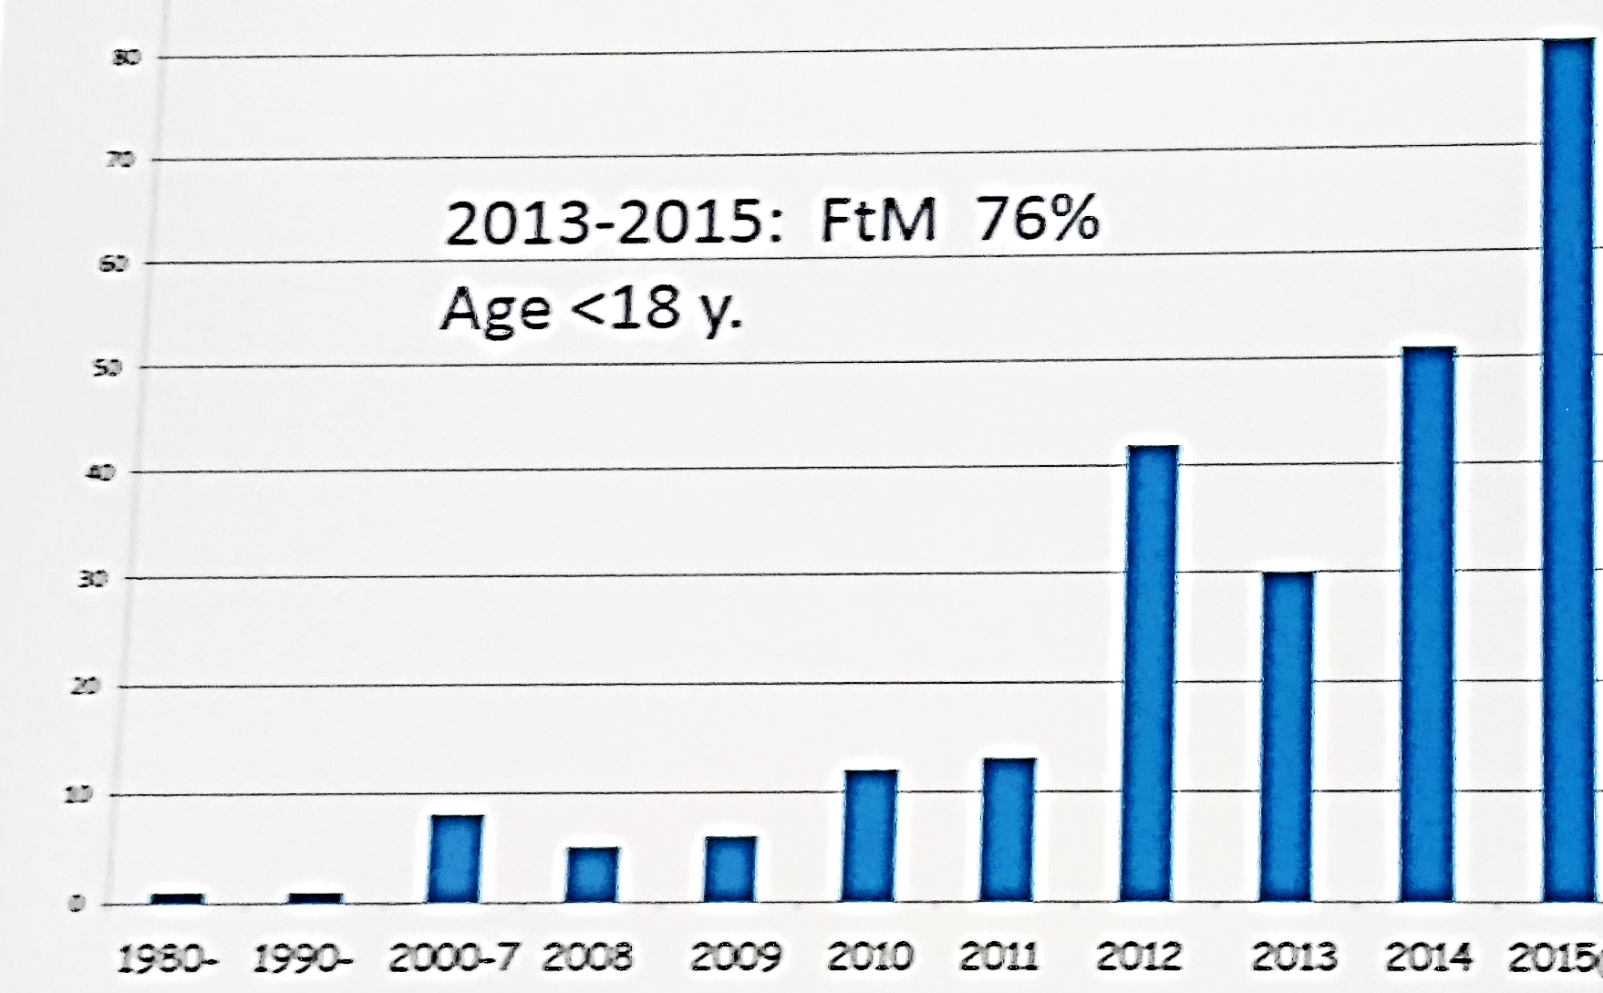
Referrals of Transgender Youth to Karolinska Center
1980-2015
Söder O. ESPE 2016

Slide 11
The Dutch Experience- Single Clinic Amsterdam 1987-2011
Children under 12 years
Adolescents from 12 to 18 years
de Vries AL¹, Cohen-Kettenis PT. J Homosex. 2012;59(3):301-20.

Slide 12
Age at Referral
de Vries AL¹, Cohen-Kettenis PT. J Homosex. 2012;59(3):301-20.

Slide 13
Male to Female, Female to Male, & Age of Onset
Among transgender adults
  A male:female ratio (according to assigned sex at birth) of 3:1 is common throughout the Western countries
  but not elsewhere (Japan, Serbia)
In adolescents the ratio is 1:1
In about 66% of transgender persons, onset was early in childhood
Notes:
The subsequent increase in the male female ratio is explained by the higher frequency of men with late-onset gender identitiy disorder

Slide 14

Diagnosis-
Perspective of Developmental Trajectories
In the diagnosis of gender dysphoric children & adolescents,
one must take the perspective of development into account
Gender variant behavior and even the wish to be of the other
gender can be either a phase or a normal developmental variant without any adverse consequences
Only 6-25% of gender dysphoric children become transsexual
at a later age
The World Professional Association for Transgender Health. 7th Version | www.wpath.org
Notes:
More recent
studies show a variation from 12 to 27% (Cohen-Kettenis, 2001; Drummond,
Bradley, Peterson-Badali, & Zucker, 2008; Wallien & Cohen-Kettenis, 2008).
לפני שנכנס לקרטריונים של אבחנה בילדות , להזכיר שבחלק לא מבוטל מהילדים יש פאזה בה הם רוצים להיות במין השני , וזה נקרא gender variant behavior
רק חלק קטן מהילדים האלו הם אנשים טרנסגנדרים

Slide 15

Adolescents with Gender Dysphoria
In contrast to what happens in children-
gender dysphoria rarely changes in adolescents who had been gender dysphoric since childhood and remained so after puberty

Slide 16


Diagnosis
A. Strong and Persistent Cross-gender Identification
In children, it is manifested by 4 (or more) of the following:
  1. Repeatedly stated desire to be, or insistence that he or she is, the other sex
  2. In boys, preference for cross-dressing or simulating female attire
  in girls, insistence on wearing only stereotypical masculine clothing
  3. Strong and persistent preferences for cross-sex roles in make-believe play or
  persistent fantasies of being the other sex
  4. Intense desire to participate in the stereotypical games of the other sex
  5. Strong preference for playmates of the other sex
Notes:
הילדים מתעקשים שהם בני המין השני
מתלבשים כבני המין השני
משחקים/ תפקדים של בני המין השני
חברים מבני המין השני

Slide 17
Diagnosis-
B. Persistent discomfort with his or her sex or sense of inappropriateness in the gender role of that sex
In children, the disturbance is manifested by any of the following
  1. In boys
    assertion that his penis or testes is disgusting or will disappear
    assertion that it would be better not to have a penis
    aversion toward rough-and tumble play and rejection of male stereotypical toys, games, & activities
  2. In girls
    rejection of urinating in a sitting position
    assertion that she has or will grow a penis
    assertion that she does not want to grow breasts or menstruate
    marked aversion toward normative feminine clothing
Notes:
טענה

Slide 18
Diagnosis - in Adolescents & Adults
Persistent Cross-gender Identification
  a stated desire to be the other sex
  frequent passing as the other sex
  desire to live or be treated as the other sex
  the conviction that he or she has the typical feelings &reactions of the other sex
B. Preoccupation with getting rid of primary and secondary sex characteristics
● request for hormones, surgery, or other procedures to physically alter sexual characteristics to simulate the other sex
  belief that he or she was born the wrong sex
C. ● The disturbance is not concurrent with a physical intersex condition
D. ● The disturbance causes clinically significant distress or impairment in social, occupational, or other important areas of functioning

Slide 19
Primary Goals of Medical Intervention in Adolescents
Completely reversible
  Prevention of the development of unwanted secondary sex characteristics of the biologic sex
Reduction
in dysphoric
feelings
anxiety,
depression,
suicidality
improving
quality of life
Partially reversible
  Real-life experience stage
  Promotion of the development of desired secondary sex characteristics of the affirmed sex
Completely irreversible
  Gender reassignment surgery

Slide 20
Prevention of the Development of Unwanted Secondary Sex Characteristics
Adolescents are considered eligible for puberty suppression when they
  are diagnosed with gender identity dysphoria (GID)
  live in a supportive environment
  have no serious psychosocial problems interfering with the diagnostic assessment
It is important to exclude other reason such as: confusion about homosexuality or transvestic fetishism
General & psychological functioning should be assessed
Psychiatric problems or other issues that could hinder a correct assessment or
future treatment compliance should be excluded
Notes:
ראשית מי זכאי לטיפול

Slide 21
Prevention of the Development of Unwanted Secondary Sex Characteristics
Early medical intervention may prevent psychological harm
Avoiding irreversible physical changes
-in females large breasts
-in males Adam’s apple, low voice, large Jaws, male hair pattern
Suppression should start at Tanner stage 2-3
i.e in boys testicular volume ≥4 ml, in girls the starting of breast buds
Suspend the development of secondary sex characteristics
with GNRH analogue treatment alone
This intervention is reversible and allows additional time for gender exploration
Notes:
The reason for this is that we assume that experiencing one’s own puberty is diagnostically useful because right at the onset of puberty it becomes clear whether the gender
dysphoria will desist or persist

Slide 22
Primary Goals of Medical Intervention in Adolescents
Completely reversible
Prevention of the development of unwanted secondary sex characteristics of the biologic sex
Partially reversible
Real-life experience stage
Promotion of the development of desired secondary sex characteristics of the affirmed sex
Gender reassignment surgery
Completely irreversible
Reduction
in dysphoric
feelings
(anxiety,
depression,
suicidality)
& improving
quality of life

Slide 23

Real-life Experience (RLE)
The period in which transgender individuals live full time in their preferred gender role
The purpose of the RLE is to confirm that a given transgender person can function successfully as the wanted gender in society, as well as to confirm that they are sure they want to live as that gender for the rest of their life
A documented RLE is a requirement of some physicians before prescribing hormone replacement therapy
It is a requirement of most surgeons before performing genital reassignment

Slide 24

Promotion of the Development of Desired Secondary Sex Characteristics of the Affirmed Sex
Induction of puberty
  It is suggested that pubertal development of the desired, opposite sex be initiated at the age of 16yr, using a gradually increasing dose of cross-sex steroids
  In many countries 16-y old are legal adults with regard to medical decision making
J Clin Endocrinol Metab. 2009,94(9) 3132-3254

Slide 25


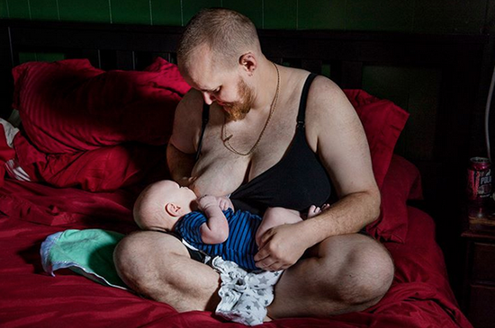

Slide 26
Options for Fertility
All referred subjects who satisfy elicriteria for endocrine treatment,
at age 16 or as adults, should be counseled regarding the effects of hormone treatment on fertility
The occurrence & of potentially irreversible effects should be emphasized
  Prolonged exposure of the testes to estrogen has been associated with testicular damage
  The effect of prolonged treatment with exogenous testosterone upon ovarian function is uncertain
  Reports of an increased incidence of polycystic ovaries
Cryopreservation of sperm is readily available
Techniques for cryopreservation of oocytes, ovarian & embryos tissue are being improved
Because early adolescents may not feel qualified to make decisions about fertility, consent should include parents & mental health professional

Slide 27
Promotion of the Development of Desired Secondary Sex Characteristics of the Affirmed Sex
Induction of female puberty with oral 17- estradiol, increasing the dose every 6 months:
  5 μg/kg/d
  10 μg/kg/d
  15 μg/kg/d
  20 μg/kg/d
  Adult dose: 2 mg/d
Induction of male puberty with intramuscular testosterone esters, increasing the dose every 6 months:
  25 mg/m² per 2 wk IM
  50 mg/m² per 2 wk IM
  75 mg/m² per 2 wk IM
  100 mg/m²per 2 wk IM

Slide 28
Promotion of the Development of Desired Secondary Sex Characteristics of the Affirmed Sex
Treatment with GnRH analogs be continued during treatment with cross-sex steroids to maintain full suppression of pituitary gonadotropin levels & gonadal steroids
When puberty is initiated with a gradually increasing schedule of sex steroid doses, the initial levels will not be high enough to suppress endogenous sex steroid secretion
GnRH analog treatment is advised until gonadectomy

Slide 29


Height
In assigned female at birth, suppression of puberty may halt growth spurt
  To achieve maximum height, introduction of androgens will mimic pubertal growth spurt
  In a relatively short patients, oxandrolone – a growth stimulating anabolic steroid-is given
In assigned male at birth, extreme tall stature is a genetic probability
  Estrogen doze may be increased by more rapid increments, or started before age 16

Slide 30
Adults Treatment - Birth Assigned Female to Male
Regimens to change secondary sex characteristics follow the general principle of hormone replacement treatment of male hypogonadism
Target blood levels are for the desired gender
Testosterone treatment results in increased muscle mass & decreased fat mass, increased facial hair, acne, male pattern baldness, increased libido, clitoromegaly, temporary or permanent decreased fertility, deepening of the voice, & usually, cessation of menses
Cessation of menses may occur within a few months with testosterone treatment alone, although high doses of testosterone may be required
If uterine bleeding continues:
  addition of a progestational agent
  endometrial ablation
  considered GnRH analogs
  depot medroxyprogesterone
Notes:
Sustained supraphysiological levels of testosterone increase the risk of adverse reactions
עקרונות הטיפול דומים למתן טיפול תחליפי בהיפוגונדיזם
י

Slide 31
Adults Treatment - Birth Assigned Male to Female
The hormone regimen for birth assigned male to females is more complex with the combination of antiandrogen and an estrogen
The antiandrogens shown to be effective reduce endogenous testosterone levels, ideally to levels found in adult biological women, to enable estrogen therapy to have its fullest effect
Spironolactone has antiandrogen properties by directly inhibiting testosterone secretion and by inhibiting androgen binding to the androgen receptor
Cyproterone acetate, a progestational compound with antiandrogenic properties is widely used in Europe
Notes:
male to female יותר מורכב

Slide 32

Medical Conditions that can be Exacerbated by Cross-sex Hormone Therapy
Transsexual female : Estrogen
Thromboembolic disease
A 20-fold increase in venous thromboembolic disease was reported in a large cohort of Dutch transsexual This increase may have been associated with the use of ethinyl estradiol )Diane, Estelle)
Macroprolactinoma
Severe liver dysfunction
Breast cancer
Coronary artery disease
Cerebrovascular disease
Severe migraine headaches
Transsexual male: Testosterone
Erythrocytosis (hematocrit 50%)
Severe liver dysfunction
Breast or uterine cancer
Notes:
Very high risk of serious adverse outcomes Thromboembolic disease
Thombophilia screening of transsexual persons initiating hormone treatment should be restricted to those with a personal or family history of venous thromboembolism
(94). Monitoring D-dimer levels during treatment is not recommended (95).

Slide 33
Primary Goals of Medical Intervention in Adolescents
Completely reversible
Prevention of the development of unwanted secondary sex characteristics of the biologic sex
Partially reversible
Real-life experience stage
Promotion of the development of desired secondary sex characteristics of the affirmed sex
Gender reassignment surgery
Completely irreversible
Reduction
in dysphoric
feelings
(anxiety,
depression,
suicidality)
& improving
quality of life

Slide 34
Referring Adolescents for Surgery
It is recommended to refer hormone-treated adolescents for surgery when
  1) the real-life experience (RLE) has resulted in a satisfactory social role change
  2) the individual is satisfied about the hormonal effects
  3) the individual desires definitive surgical changes
It is suggested to defer surgery until the individual is at least 18 yr old
Threshold of 18 should be seen as an eligibility criterion and not an indication in itself for active intervention

Slide 35
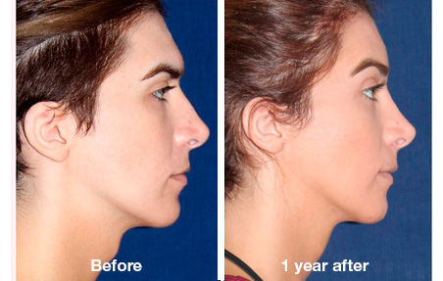

Surgery
Birth Assigned male
Birth Assigned Female
Face feminizing
Neck feminizing
Vocal cord
Breast augmentation
Orchiectomy
Vaginoplasty
Mastectomy
Oophorectomy
Hysterectomy
Metoidioplasty
Scrotoplasty
Phalloplasty

Slide 36
General Health Care
Transgender youth are likely to experience societal discrimination resulting in
  Economic marginalization
  Social isolation
  Physical abuse leaving them at higher risk for drug abuse
  Suicide
  Depression
  Violence
  Human immunodeficiency virus & other sexually transmitted infections

Slide 37

Take Home Message
Being transgender, or gender nonconforming is a matter of diversity, not pathology
It is recommended that adolescents who fulfill eligibility criteria for gender reassignment will initially undergo treatment to suppress pubertal development at Tanner stages 2–3
Opposite sex treatment should be initiated at about the age of 16 yr, using a gradually increasing dose schedule of cross-sex steroids
It is recommended to refer hormone-treated adolescents for surgery when the real-life experience (RLE) has resulted in a satisfactory social role change at least at 18 years

Slide 38


תודה על ההקשבה

Slide 39
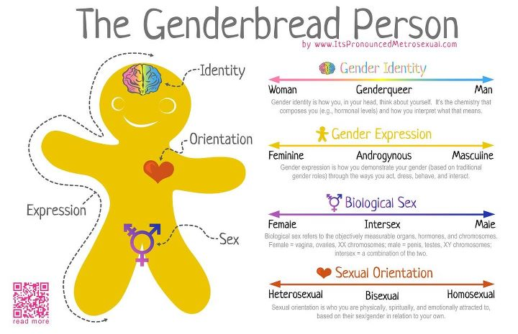

Slide 40


