Slide 1
What can we learn from the parents of children affected with MPS III in Israel ?
Shiri liber Academic supervisor:
Prof. Annick Raas-Rothschild
Arrow Project presentation
Institute of Rare Diseases, The Danek Gertner Institute of Human Genetics

Slide 2
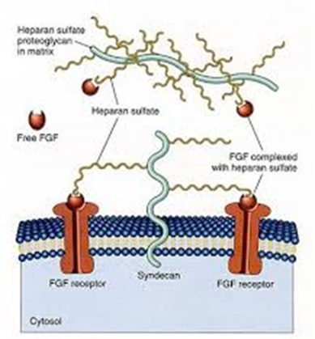
MPS III or Sanfilippo syndrome
Mucopolysaccharidosis type III is a group of five autosomal recessive lysosomal storage disorders leading to tissue accumulation of heparan sulfate
In the USA estimated incidence types combined is 1 in 70,000 newborns.

Slide 3
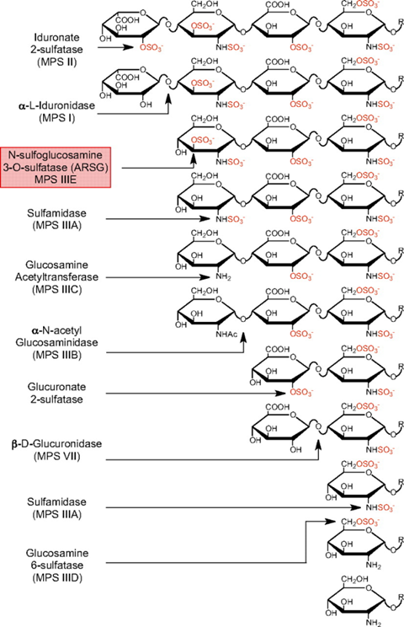
MPS III subtypes
Sulfamidase (MPS IIIA);
α-N-acetylglucosaminidase (NAGLU, MPS IIIB);
Heparan acetyl CoA (HGSNAT, MPS IIIC);
N-acetylglucosamine 6-sulfatase (GNS, MPS IIID);
N-glucosamine 3-O-sulfatase (arylsulfatase G or ARSG, the currently putative MPS IIIE)
Notes:
The subtypes are caused by the deficiency of:

Slide 4
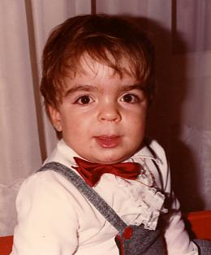
Known clinical symptoms
Progressive disorder
Mental retardation
Hyperactivity
Sleep disorders
Coarse facial features
Degenerative joint disease
Hepatosplenomegaly
Macrocephaly
Inguinal hernia
Hearing loss
Delgadillo et al. Orphanet Journal of Rare Diseases 2013, 8:189
Notes:
coarse facial fea-
tures with broad eyebrows, dark eyelashes, dry and rough
hair, and skeletal pathology that affects growth and causes
degenerative joint disease, hepatosplenomegaly, macrocra-
nia, and hearing loss. 19–22

Slide 5
Delgadillo et al. Orphanet Journal of Rare Diseases 2013, 8:189

Slide 6
Study objectives
Perspective of parents of MPS III affected children.
Understanding the natural history of MPSIII affected in Israel
Discovering the common subtypes and genetic mutations of MPSIII in Israel

Slide 7
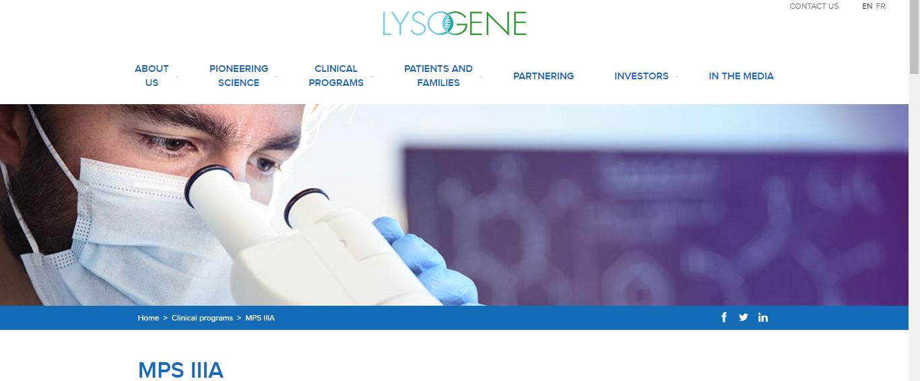
Challenges
Limited knowledge of natural history
Better understanding of the symptoms- allowing better treatment option and better quality of life.
Effectiveness:
What are the outcomes?
What is a meaningful change ?

Slide 8
METHODS
Retrospective questionnaire study
Self-made questionnaire based on the literature
Families were interviewed by using a detailed questionnaire that covered different aspects of the disease: neurological, behavioral, Immunological, congenital malformation, etc…

Slide 9
METHODS
Inclusion criteria: Children diagnosed with MPS III by Laboratory Studies and known mutation by genetic sequencing
Exclusion criteria: Unknown genetic Mutation

Slide 10
Study population
Table a
Mutational analysis of MPS III patients (N=7)
Ethnic Origin Maternal Paternal | Mutation | MPS III | Birth Year | M/F | #
Iran,Egypt Lybia,Iraq | homozygote SGSH gene(Q365X) | A | 2011 | F | 1
Iran,Egypt Lybia,Iraq | homozygote SGSH gene(Q365X) | A | 2006 | M | 2
Uzbekistan Lybia Lybia | heterozygote SGSH (R433W & c.1080 del C) | A | 2009 | M | 3
Uzbekistan Lybia Lybia | heterozygote in SGSH gene (R433W & c.1080 del C) | A | 2004 | M | 4
Bedouin Bedouin | homozygote in SGSH (C.267C>A):P.Tyr89*(STOP) | A | 2011 | F | 5
Bedouin Bedouin | homozygote SGSH (C.267C>A):P.Tyr89*(STOP) | A | 2013 | M | 6
Bedouin Bedouin | homozygote SGSH (C.267C>A):P.Tyr89*(STOP) | A | 2016 | M | 7

Slide 11
Results Diagnosis
Average age of diagnosis (first sibling) 6.166 years
In every family the first born MPS III child lead to diagnosis of his younger siblings
The time range from the beginning of Medical Inquiry to diagnosis for the first born MPS III child was 2.583 years

Slide 12
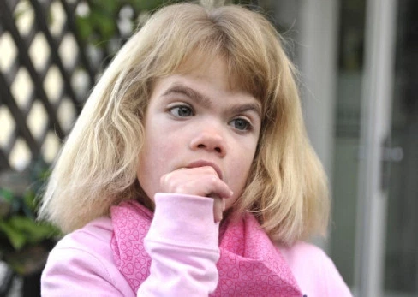
Results Early clinical manifestations
Table 1
Early clinical manifestations leading to parents' suspicion of illness (N=6)
n(%) | Status
5(83.3%) | Speech delay
5(83.3%) | coarse facial features
3(50%) | hyperactivity
1(16.7%) | sleep disruption

Slide 13
Results Main cause for medical inquiry
Table 2
Main cause for medical inquiry (N=7)
n(%) | Status
4(57.14%) | Developmental delay
3(42.86%) | sibling diagnosis

Slide 14
Results Symptoms as observed by parents
Table 3
Symptoms as observed by parents (N=7)
Delgadillo et al. 2013 | n(%) | Status
44% | 7(100%) | Sleep Disorders
65% | 7(100%) | Hyperactivity
50% | 3(42.86%) | Diarrhea
 | 7(100%) | Recurrent Infections
46% | 4(57.14% | Recurrent Ear Infections
 | 6(85.7%) | Recurrent Pneumonia
85% | 6(85.7%) | Speech Delay
7% (Inguinal hernia) | 3(42.86%) | Hernia
 | 7(100%) | General Developmental Delay
 | 2(28.57%) | Skeletal abnormalities
78% | 5(71.42%) | Coarse facial features
Delgadillo et al. Orphanet Journal of Rare Diseases 2013, 8:189

Slide 15
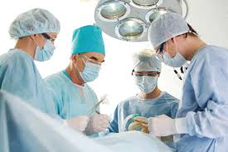
Results Surgeries

Slide 16
Results Sleep Disorders
Table 4
Sleep Disorders (N=7)
n(%) | Status
7(100%) | Sleep Disorders
7(4.785 h) | Average length of uninterrupted sleep
Table 5
Onset of sleep Disorders (N=7)
n(%) | Status
4(57.14%) | Since Birth
3(42.82%) | Between the ages of 3-4Y

Slide 17
Behavioral
Table 6
Behavioral (N=7)
n(%) | Status
7(100%) | Hyperactivity
2(28.57%) | Aggressive behavior towards others
1(14.28%) | Aggressive behavior towards one’s self
7(100%) | Smile a lot
4(57.14%) | Cry for no apparent reason
3(42.86%) | Timid or fearful (compared to siblings)

Slide 18
Psychomotor development milestones
Average Age walking 13.6 months (5/5)
None of the children are currently Toilet trained 0/6
Previously only one child was toilet trained 1/6

Slide 19
CONCLUSIONS
The time from first medical inquiry till diagnosis should be shortened (2.583 years in average)
General Developmental delay, Recurrent infection, Sleep disorders, Hyperactivity and decreased hearing were observed in all diagnosed children
Otorhinolaryngology surgeries are extremely common

Slide 20
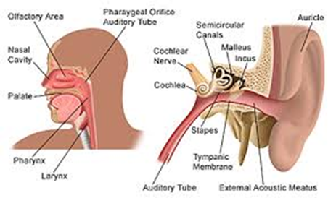
Discussion
There is a need for earlier diagnosis for adequate and timely genetic counseling.
MPS III children frequently undergo ENT surgeries; ENT physician might be key for early diagnosis
There is a lot of similarity in the clinical manifestation between affected kids and yet differences even within the same family.

Slide 21
Future Goals
Interviewing families from northern districts.
Analyzing the data for a future article and a possible case study of the new MPS IIIA mutation first described here.

Slide 23
What I learned
How to design a questionnaire study
About the workings and proceedings of the Helsinki committee.
Team work
How a amazing and strong parents can be

Slide 24
Thanks
Prof. Raas-Rothschild
Dr. Pode-Shakked
Ms. Levi
Prof. Achiron
Ms. Rot

