Slide 1
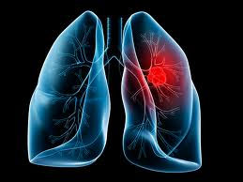
Nano analysis of exhaled breath for lung cancer early detection
Ori Liran
5th year med student
Mentor: Prof. Nir Peled
Thoracic Cancer Research and Detection Center
Sheba Medical Center

Slide 2
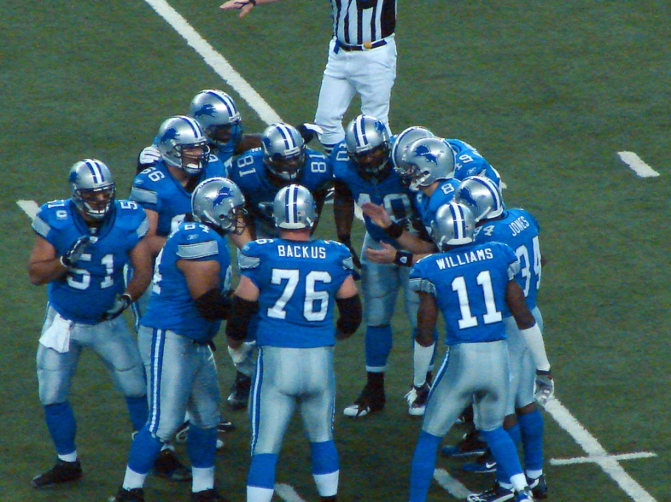

Game plan
Introduction & background
Method
Results
Conclusions & vision
Notes:
Our game plan today includes introduction and background about lung cancer, study’s method, results, and study’s conclusions and vision.

Slide 3
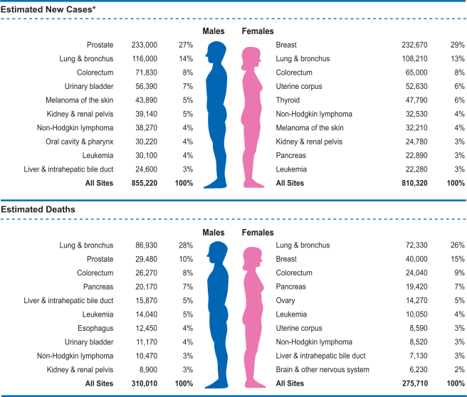
Introduction & Background
Notes:
Lung cancer is the leading cause of cancer death in the united states with more than 159,000 estimated deaths in 2014.
It is the second most prevalent cancer in both men and women.
According to this, lung cancer is responsible for more than one quarter of all cancer deaths.
The average 5 year survival is 16.8% and varies according to the disease’s stage – The earlier the stage is, the better the prognosis.

Slide 4
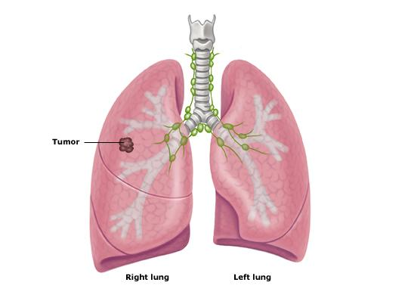
Stage I
Primary tumor in the lung
No lymph nodes involved.
Notes:
The disease is divided into 4 stages:
Stage I is a localized one, the primary tumor is in the lung, without any lymph nodes involvement.

Slide 5
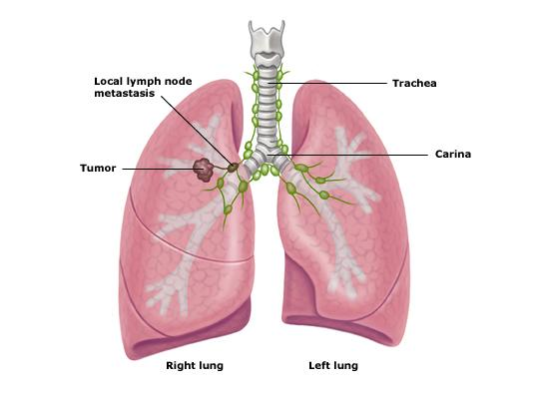
Stage ii
Primary tumor in the lung and lymph nodes within the lobe or hilum.
Notes:
Stage II shows an involvement of lymph nodes inside the lung.

Slide 6
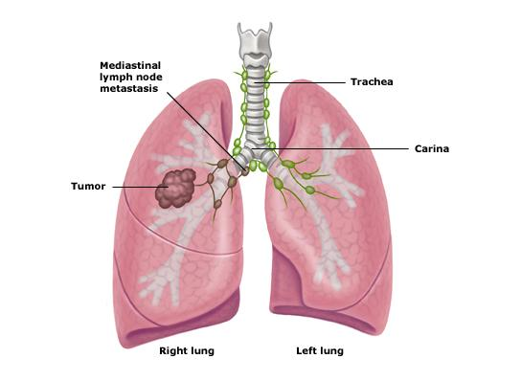
Stage iii
Locally advanced disease.
Mediastinal LN.
Primary tumor invades local structures (spine, etc).
Notes:
Next stage shows a more extensive lymph node involvement – now the lymph nodes are outside from the lung, In the mediastinum.

Slide 7
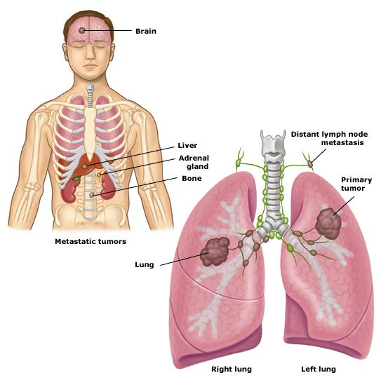
Stage iv
Cancer spread to the other lung or outside the chest.
Pleural effusion.
Notes:
Stage IV indicates a disease which involving other organs, or making a pleural effusion.
Why is there a pleural effusion in advanced disease ? Because the lymph nodes are blocking the pleural fluid from being absorbed.

Slide 8
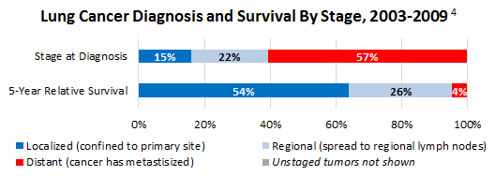
Introduction & Background
* U.S. National Institutes of Health. National Cancer Institute. SEER Cancer Statistics Review, 1975-2010.
Notes:
An important slide.
Shows the percentage for each staging at diagnosis.
The lower row shows the 5 year survival for each stage.
This slide indicate the absolute need for an effective early detection method.

Slide 9
How can we diagnose ?
Notes:
So how can we diagnose lung cancer today ?

Slide 10
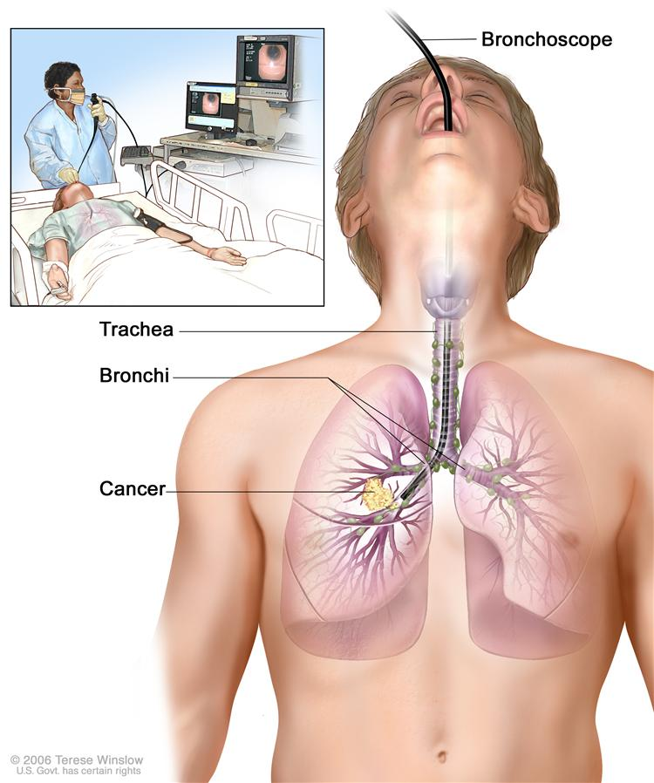
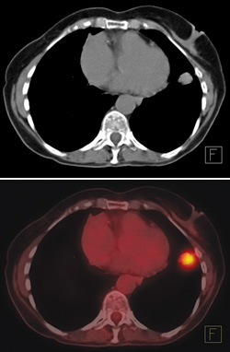
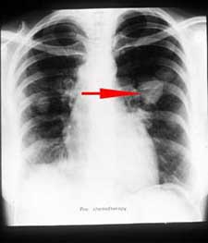
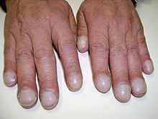
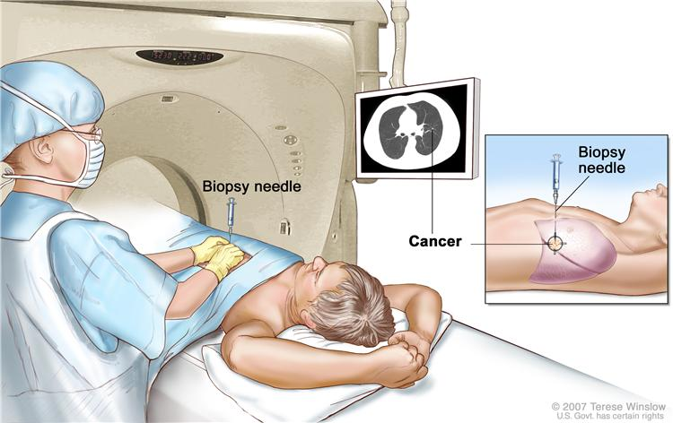
Diagnosing Lung Cancer
Symptoms – not specific !
Cough, weight loss, Dyspnea, hemoptysis, clubbing.
Chest Radiograph
PET-CT
CT
Bronchoscopy
CT guided biopsy
Notes:
The diagnosing tools include the first suspicion of a lung disease – with these non specific symptoms.
Afterwards, the patients will go through a series of imaging tests, including a chest xray, CT, sometimes Pet-CT, and eventually will go through a biopsy (here we can see a bronchoscopic biopsy).
These are all time consuming, grueling, invasive procedures…
What if there was a much more simple way for an early detection of lung cancer ? Something very simple ? Something simple like breathing ?
Infact – lets try it all together

Slide 11

Notes:
Everyone – close their eyes and take a deep breath – inhale and exhale. (It’s good for you)
What if this simple task was our screening and detecting method ?

Slide 12
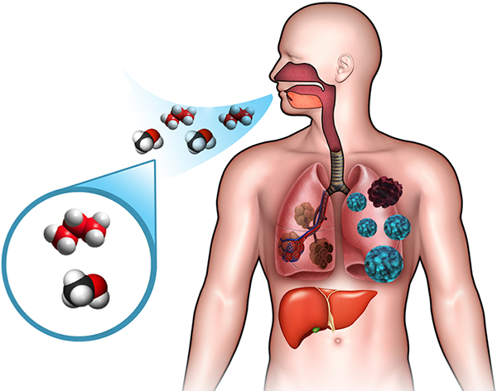
Volatile Organic Compounds (VOCs)
Notes:
Now I would like to talk about Volatile Organic Compounds..
VOCs are organic chemicals that have a high vapor pressure at ordinary room temperature. Most scents that we smell are VOC’s.
The hypothesis is that malignant tumors may influence the VOC’s pattern and change it from a normal one.

Slide 13
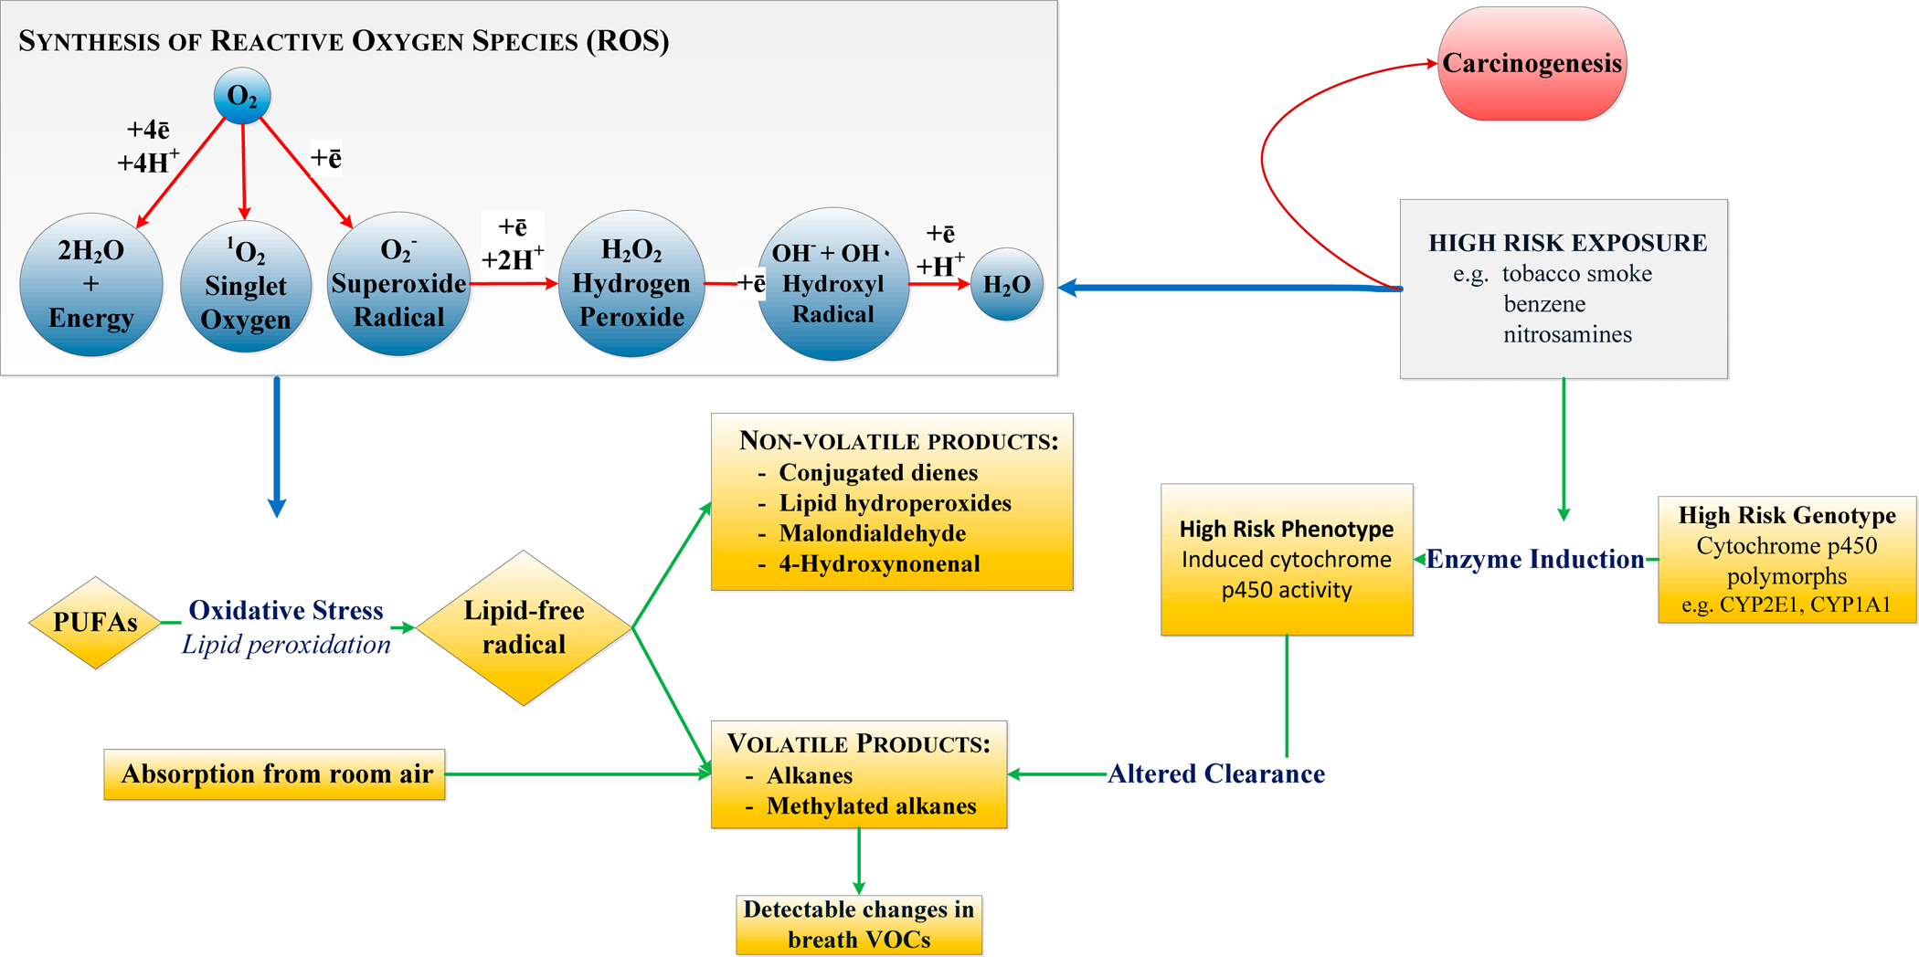
Suggested mechanism
Notes:
This is a Hypothetical mechanism for the alteration in VOC’s in malignancy.
Explanation:
During oxidative stress, ROS and free radicals are excreted from the Mitochondria in the cell, generating volatile Alkanes that are emitted in the breath.
In addition, high risk exposure induces cytochrome p450 activity, thus changing the clearance of the VOCs..
Carcinoma cells produce ROS at elevated rates.
The main goal is to detect the early changes in the VOC’s combination.

Slide 14
VOCs detection ?
Notes:
So how can we distinguish between VOCs of healthy patients vs. lung cancer patients ?
In order to do so, we’ll have to be with an extra ordinary sense of smell.
In fact, some mammals have an excellent sense of smell, and what would happen if we can harness their special ability for medical purpose ?

Slide 15
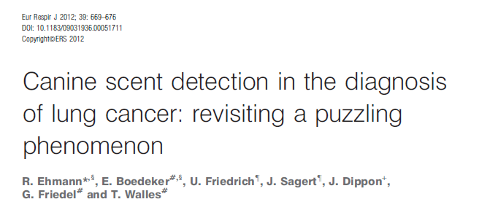
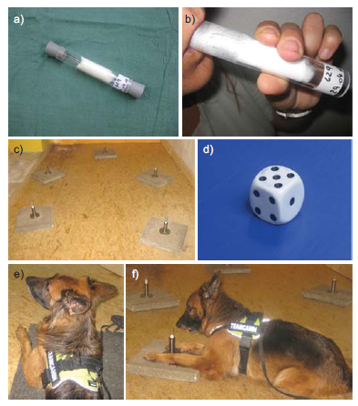
Results:
Lung cancer was identified with an overall sensitivity of 71% and specificity of 93%.
Notes:
In one anecdotal study, researches used trained wolf dogs to detect lung cancer. They trained them that if they would sniff a lung cancer tube – they will wait beside it and wait for the operators’ instructions.
The result were not so bad – Lung cancer was identified with an overall sensitivity of 71% and specificity of 93%.
But of course, we are trying to detect VOC’s in a more accurate way….
We use 2 main methods: GC-MS and a Na-nose.

Slide 16
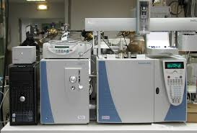
Gas Chromatography –
Mass Spectrometry (GC-MS)

Slide 17
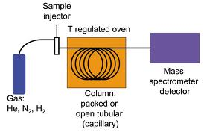
GC-MS
Notes:
How does the GC-MS works ?
It uses the gas chromatograph here to bind to the compounds. Then, they go through an Ion generator wire which breaks the compounds to smaller molecules. Every single compound has its own breakage pattern – allowing the detector to accurately asses what was the original compounds’ composition.

Slide 18
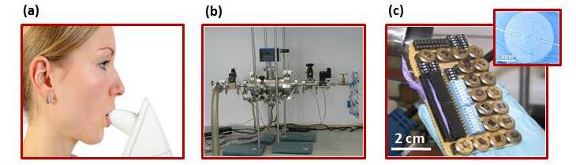
The Nanoscale Artificial NOSE (™NA-NOSE)
Notes:
This is a nanomaterial-based artificial olfactory system developed by Prof. Haick from the Technion.
(a) A lab prototype of a hand-held device that collects exhaled breath from cancer patients. (b) Exposure chamber with inlet for breath samples. (c) Array of cross-reactive molecularly capped metal nanoparticle chemiresistors for the diagnosis of breath samples— see inset for a scanning electron microscopy image of the sensor’s template.
The Nanoparticles (in this case – gold nanoparticles) change their electric proporties which are detected by the sensors.

Slide 19
Objective
This study evaluates the potential of exhaled breath analysis in lung cancer detection
Distinction between early and advanced disease stages.

Slide 20
Method
Breath samples were taken from untreated LC patients and matching controls.
Patients were enrolled in Israel, Colorado and Florida.
Analysis was performed by NaNose® system and GC-MS.

Slide 21
Patients
A total of 358 patients participated in this study (Israel: 174; Florida: 73; Colorado: 111).
213 patients had LC and 145 patients did not have cancer.

Slide 22
Preliminary Results - Israel

Slide 23


 | Sensitivity | Specificity | Accuracy
Control / Early LC | 81.25% | 90.32% | 85.11%
Control / Advanced LC | 81.25% | 87.10% | 82.11%
Early LC /Advanced LC | 80.26% | 75% | 78.75%
Control and Early LC
Notes:
ROC, receiver operating characteristic; AUC, area under the curve.

Slide 24
Preliminary Results - Florida

Slide 25
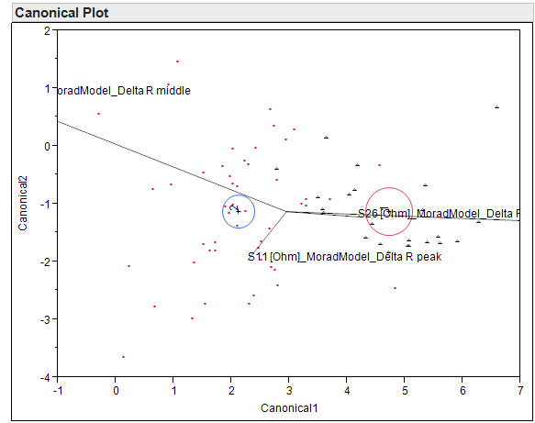
 | Sensitivity | Specificity | Accuracy
Control / LC | 93.87% | 95.65 %% | 94.44%
Early LC /Advanced LC | 83.33% | 91.66 % | 89.58%
Notes:
ROC, receiver operating characteristic; AUC, area under the curve.

Slide 26
Conclusions
Breath analysis discriminated lung cancer from matched controls.
Breath analysis discriminated early stage patients from advanced disease patients.

Slide 27
Future goals
Finish current analysis
Discover distinctive VOC’s for Lung cancer
Prospective study phase
Improve early detection and improve prognosis

Slide 28


Technion’s team
Notes:
These are the analysis leaders in the Technion – Prof. Hossam Haick, and Manal abbud chemical engineer.

Slide 29

Thank you…
Notes:
I would like to thank my mentor Prof. Nir Peled and you for listening ☺

