Slide 1
Novel Surgical Simulator – Knot Tying Force Measurement
Imri AMIEL md – surgery b department
MOTI CORDOBA
In collaboration with MSR

Slide 2
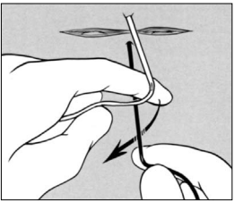
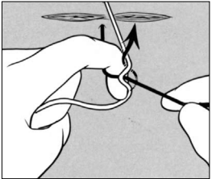
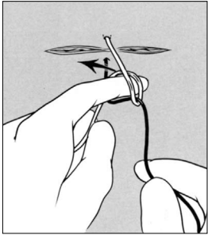
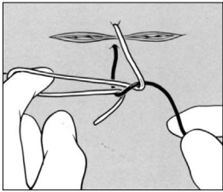
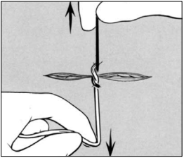

Slide 3
Surgical Knot Tying – An Important Aspect of Outcome
Faulty knots can result in complications and poorer outcome:
Infections
Bleeding
Leakage
Impaired wound healing

Slide 5
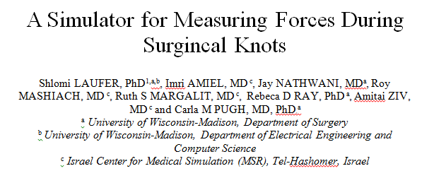
METHODS
The experiment is approved by Sheba Medical Center Helsinki committee.
Feasibility wise, the simulator has already underwent a proof of concept, as was published by Laufer et al (2016).
Goal: to process the data and demonstrate that there is an inverse linear relation between experience and applied force, during knot tying.

Slide 6
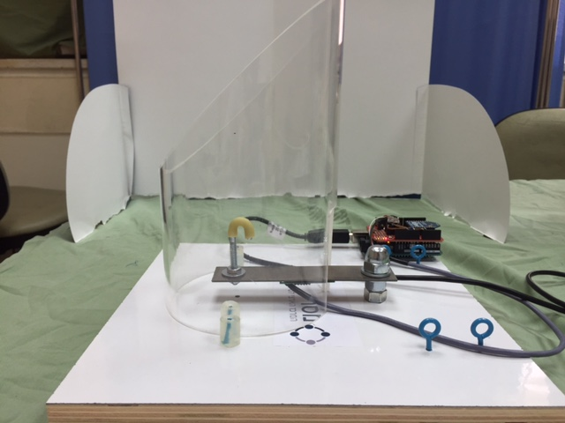
THE SIMULATOR
A hook on which the knot is tied.
A sensor that measures vertical forces.
A plastic tube that simulates “deep” tying.
A webcam (not shown)

Slide 7
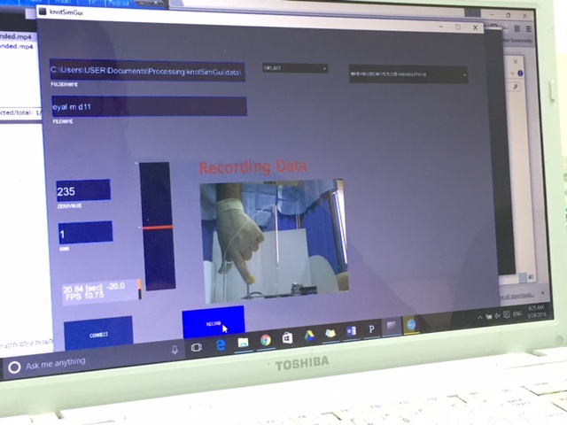
THE RECORDED DATA
Maximal pushing and pulling forces that are being applied.
The total force applied – area under the curve.
The average force.
Duration of tying time.

Slide 8
METHODS
Data is being collected from three groups, according to experience:
Junior residents - novices (surgical Boot-Camp)
Senior resident (3rd year minimum)
Specialists (more than 100 laparotomies)
Each group consists of 35 individuals.

Slide 9
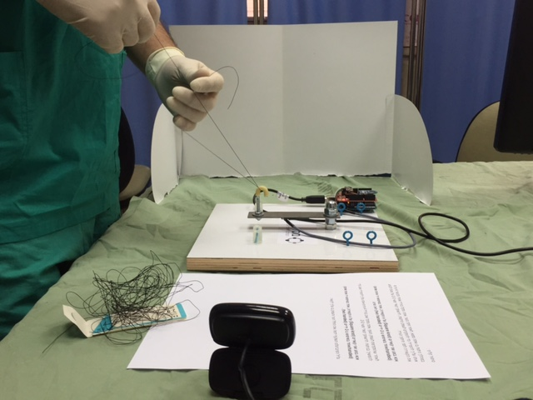
THE EXPERIMENT
Average measurement takes ~10 minutes.
The participant is required to perform 8 square knots in total:
2 one handed knots
2 two handed knots
2 deep one handed knots
2 deep two handed knots

Slide 11
Results –Total Time

Slide 12
Results – Total Force

Slide 13
Results – Maximal Force

Slide 14
FUTURE PLANS
Apart from showing a quantifiable difference in applied force between the groups, we would aim to establish an optimal range of force that should be maintained during a surgical knot application.
Using that number, we’ll redesign the simulator to include a feedback mechanism –and by that to create a simple-to-use practice simulator.

Slide 15
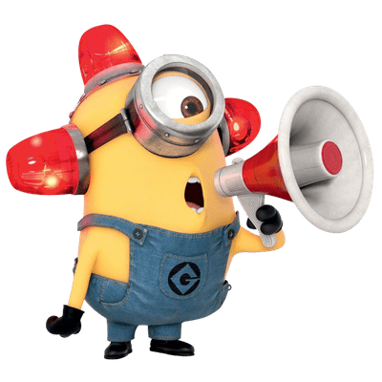
The Importance Of The Research
Recent discussions of medical error and risk reduction strategies have highlighted simulation as an important tool in improving the safe delivery of medical care.
To learn basic skills such as knot tying, applying an appropriate magnitude of force in the desired direction is essential.
Notes:
due to increasing use of minimally invasive approaches, and widespread use of energy devices.

Slide 16
Would The Answers Have Clinical Value?
As mentioned, the skill of tying secure knots in open surgery is an important skill for all surgeons.
A proper knot means less bleeding, infections, and other surgery-related complications.

Slide 17
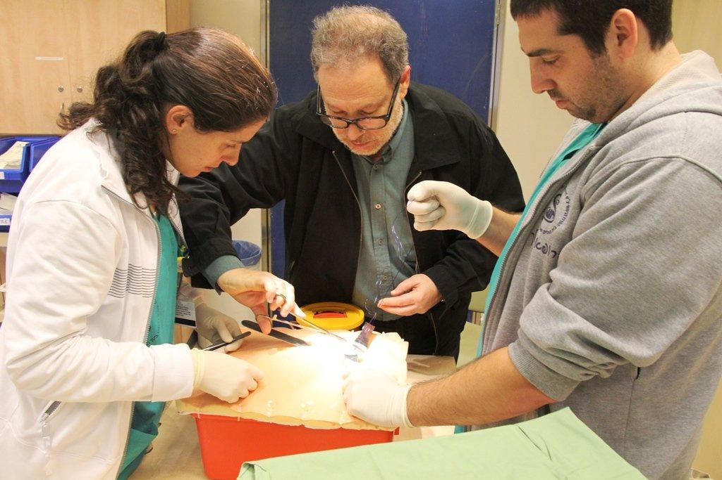
Would The Answers Have Clinical Value?
By creating a user-friendly simulator, we’ll allow novices to improves their surgical skill acquisition.

Slide 19
Repetitio Est Mater Studiorum

