Slide 1

Obstetrical Outcome among Pregnancies Conceived after Preimplantation Genetic Diagnosis (PGD)
Raoul Orvieto
Baruch Feldman
Marine Wiesel
Department of Obstetrics and Gynecology,
Chaim Sheba Medical Center, Ramat Gan, Israel

Slide 2
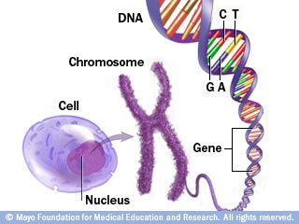
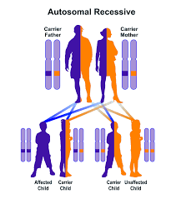
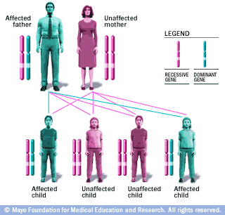
Genetic disorders
Autosomal dominant inheritance pattern
Notes:
Disorders may have a dominant or recessive inheritance pattern. Dominant inheritance means that only one copy of the gene (from either the mother or the father) needs to have a mutation for the trait or disease to be expressed. Recessive inheritance means the trait or disease will only occur if both copies of the gene (one from the mother and one from the father) are mutated.

Slide 3
Pre-implantation genetic diagnosis (PGD)
PGD allows patients who are carriers of single-gene disorders or carriers of structural chromosome abnormalities (balanced translocations) to select unaffected embryos for transfer, and reduce the transmission of genetic disorders to the offspring.

Slide 4
Pre-implantation genetic diagnosis
PGD is considered in a similar fashion to prenatal diagnosis.
PGD refers to the genetic profiling of embryos prior to implantation.
PGD is an adjunct to assisted reproductive technology, and requires in vitro fertilization (IVF) to obtain oocytes or embryos for evaluation.

Slide 5
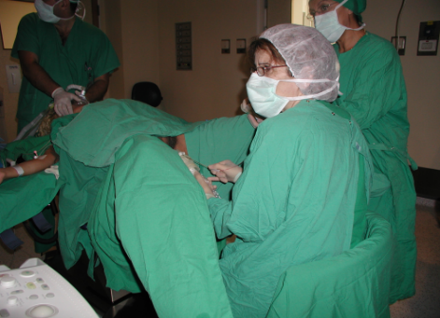
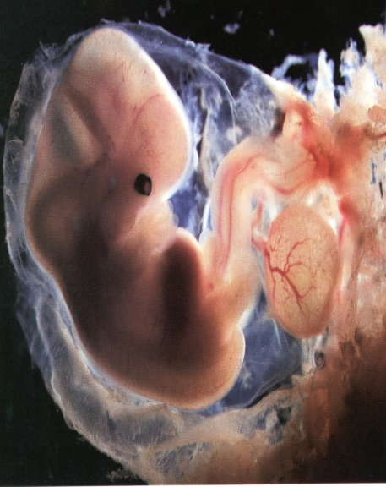

IVF cycle
OPU
hCG
ET
antagonist administration
gonadotropin administration
gonadotropin administration
agonist administration
pre-treatment cycle
treatment cycle

Slide 6
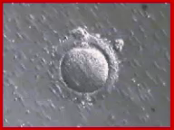

Fertilization
IVF
ICSI

Slide 7
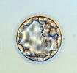


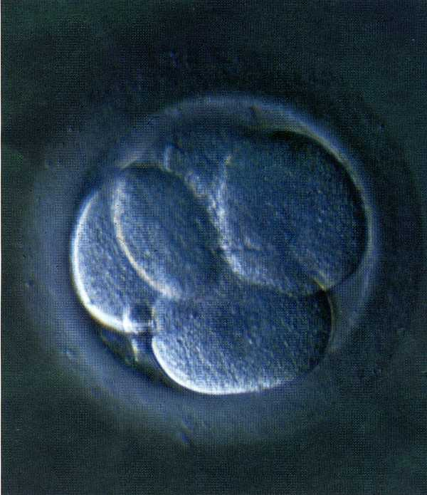
IVF

Slide 8
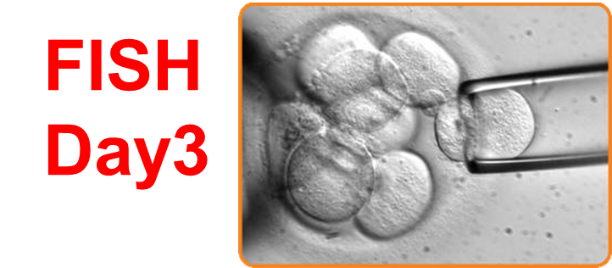
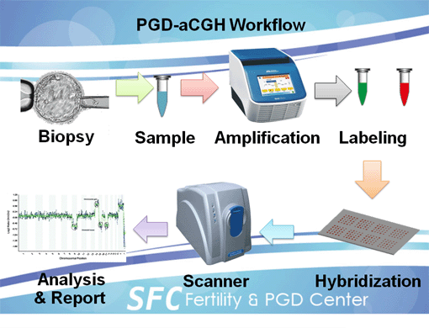
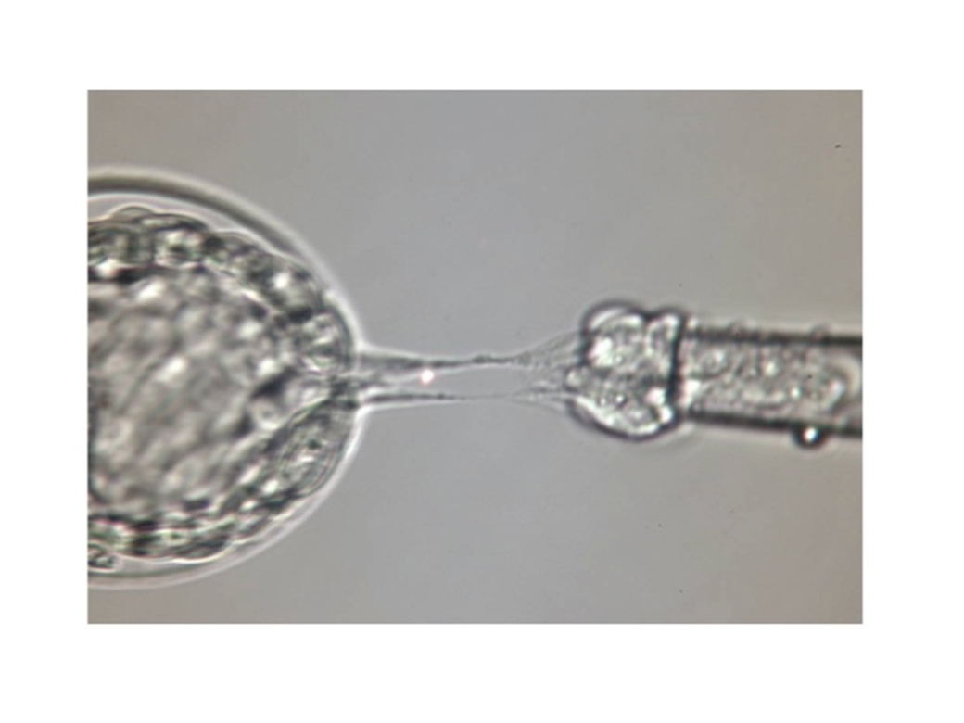

Slide 9
Pregnancy outcome
995 children
No differences regarding mean term, prematurity (term <32 w and <37 w), mean birthweight, very low birthweight (<1500 g), perinatal death, major malformations and neonatal hospitalizations in singletons and multiples born following PGD versus ICSI were observed.
Notes:
Patient(s): 242 children born after PGD, 242 children born after intracytoplasmic sperm injection (ICSI) (158 singletons and 42 twins
pairs in each group), and 733 children born after a spontaneous conception (SC) (493 singletons, 120 twins pairs), matched for maternal
age, parity, and body mass index.
Intervention(s): None.
Main Outcome Measure(s): Gestational age, birth weight, prematurity (<37 and <34 weeks), low birth weight (<2,500 g, very low
birth weight, <1,500 g), and intrauterine growth restriction (<10th percentile for gestational age).
Result(s): For singletons, the mean birth weight was higher after SC compared with ICSI but not compared with PGD. Mean gestational
ages were lower after PGD and ICSI compared with SC. The low birth weight and intrauterine growth restriction rates were 4.4%, 12.0%,
and 5.7% and 5.1%, 9.5%, and 5.5% for PGD, ICSI, and SC, respectively. Similar results were found when controlled for the number of
embryos transferred and cryopreservation. The results for twins exhibited similar but less statistically significant trends. Polar body and
blastomere biopsies provided similar outcomes.
Embryo biopsy itself did not cause intrauterine growth restriction or low birth weight compared with SC, despite lower
gestational ages with PGD. The worsened outcomes in ICSI compared with PGD pregnancies
may be due to the infertility itself.

Slide 10
242 children born after PGD, 242 after ICSI and 733 after a spontaneous conception (SC).

Slide 11
Notes:
The results demonstrated a lower risk of PTB [unadjusted odds ratio (OR) 0.68, 95% CI: 0.46–0.99] and LBW (OR 0.56, 95% CI: 0.37– 0.85) following PGD compared with autologous IVF cycles. There was no significant difference in the risk of early PTB (OR 0.52, 95% CI: 0.20–1.40) and very LBW (OR 0.50, 95% CI: 0.19–1.30) following PGD compared with autologous IVF but the number of events were small particularly in the PGD group

Slide 12
2016
Notes:
Compared with spontaneously conceived children (n ¼ 909,624), children born after PGD with IVF due to parental chromosomal aberrations (n ¼ 67) did not have increased risks of either obstetric or neonatal outcomes except for a higher risk of placenta previa (ORa 8.4; 95% CI 2.0, 34.6). Compared with children born after standard IVF (n¼18,823), children born after PGD due to parental chromosomal aberrations (n ¼ 67) had overall comparable obstetric and neonatal outcomes (data not shown). In fact, children born after PGD due to parental chromosomal aberrations were born with a higher mean birth weight (MD 155 g; 95% CI 1, 310 g).
In contrast, compared with spontaneously conceived children (n ¼ 909,624), children born after PGD with ICSI due to parental monogenetic disorders (n ¼ 58) had significantly shorter gestation (MD 6.3 days; 95% CI 9.5, 3.2 days), lower birth weight (MD 178 g; 95% CI 311, 45 days), lower birth length (MD 1.1 cm; 95% CI 1.7, 0.4 cm), and increased risk of low birth weight (ORa 2.3; 95% CI 1.1, 4.5), preterm primary rupture of membranes (<37 weeks) (ORa 2.1; 95% CI 1.1, 3.7), placenta previa (ORa 9.4; 95% CI 2.3, 38.7), higher risk of cesarean section (ORa 1.6; 95% CI 1.1, 2.5), and longer neonatal admission (MD 31 days; 95% CI 24, 38 days). Similarly, children conceived after PGD due to parental monogenetic disorders (n ¼ 58) had significantly shorter gestation (MD 5.1 days; 95% CI 9.1, 1.1 days), increased risk of low birth weight (ORa 2.0; 95% CI 1.1, 3.9), cesarean section (ORa 1.9; 95%CI 1.1, 3.4), lower birth length (MD 0.9 cm; 95% CI 1.8, 0.1 cm), and longer neonatal admission (MD 30 days; 95% CI 22, 39 days) compared with children conceived after standard ICSI (n ¼ 14,782).

Slide 13
700 PGD pregnancies
Oocyte- IVF/ICSI-Day3/4/5Bx- FISH/PCR/CMA
Oocyte/embryo quality
Pregnancy (maternal and neonatal) outcomes- ……Incomplete

Slide 14

THANK YOU
14
Notes:
14
14

