Slide 1
Chemotherapy and the pediatric brain: assessing changes in cerebral glucose metabolism following chemotherapy of non-CNS malignancies
Sam Rose¹; Gadi Abebe-Campino ²; Tima Davidson ³ and Shai Shrot⁴
¹ Sackler School of Med, TAU
² Pediatric Hemato-Oncology Department, Sheba Medical Center
³ Department of Nuclear Medicine, Sheba Medical Center
⁴ Department of Diagnostic Imaging, Sheba Medical Center

Slide 2
Background
Recent advances in the diagnosis and treatment of cancers are reducing mortality of NHL diagnosis
However some patients report experiencing cognitive changes associated with chemotherapy
Changes may persist for years post-treatment, and can seriously affect their quality of life

Slide 3
Treatment of NHL
“Combination chemotherapy” is common practice for non-Hodgkin lymphoma and Burkitt’s lymphoma
Often includes
Alkylating agents
Antitumor antibiotics
Molecular targeted therapies

Slide 4
Imaging of the “chemo-brain”

Slide 5
Imaging Modality: FDG-PET
Uses radioactive glucose isotope injected (fluorodeoxyglucose, FDG)
Tissues absorb FDG like glucose
Radioactivity is measured (positron emission tomography, PET)
Amount of signal reflects metabolism in that tissue

Slide 6
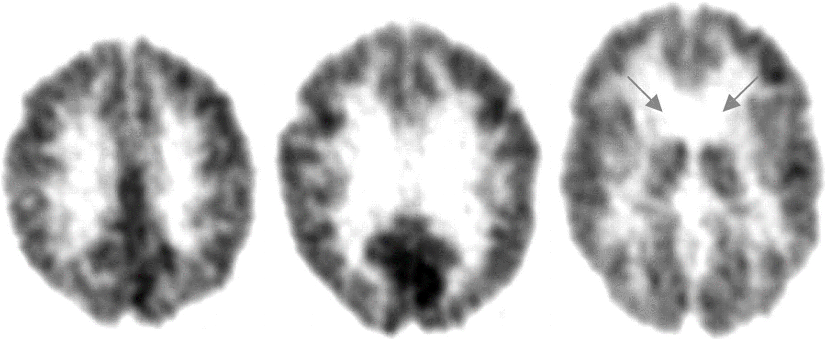
FDG- PET brain images
Daniel H.S. Silverman; J Nucl Med April 1, 2004 vol. 45 no. 4 594-607

Slide 7
Why FDG-PET?
Metabolic changes can be more sensitive than anatomical changes (e.g. dementia)
Metabolic change can precede structural changes
This greater sensitivity will allow us to better assess changes during treatment
FDG-PET is the modality of choice for surveillance of lymphoma patients in clinical practice

Slide 8
“We demonstrated that patients with malignant
lymphoma of the body exhibited abnormal regional
cerebral glucose metabolism, which improves after chemotherapy.”

Slide 9
Our Questions
How does systemic cytotoxic chemotherapy affect pediatric brain?
What is the time curve of these changes (if they occur)?
Does the baseline imaging/brain of pediatric lymphoma patients differ from normal brains? (following Nonokuma et al, 2014)

Slide 10
Methods
Retrospective cohort study
Previously acquired FDG-PET scans acquired during the course of patient treatment for NHL and Burkitt’s lymphoma

Slide 11
Population – cases (n=24)
Inclusion
Sheba Medical Center
Burkitt's lymphoma or non-Hodgkin lymphoma
Dx before age of 18
Received standard chemotherapy
Have baseline and follow-up PET scans in Sheba PACS system
Exclusion
Patients with CNS involvement
Comorbidities that affect the brain
Invasive CNS biopsies

Slide 12
Population – controls (n=20)
Pediatric patients at Sheba
Non-malignancy diagnosis
Imaging studies conducted at Sheba for non-malignancy condition
Will help show if baseline imaging studies from cases are representative of pediatric population

Slide 13
Imaging Follow-up on cases
Baseline imaging prior to chemotherapy with sequential follow-up studies
Follow-up imaging every 1-2 months
baseline F/U #1 ... F/U # X
time
dx start tx

Slide 14
Controls
Are the lymphoma patients representative of the pediatric population at baseline?
baseline F/U #1 ... F/U # X
time
dx start tx
controls

Slide 15
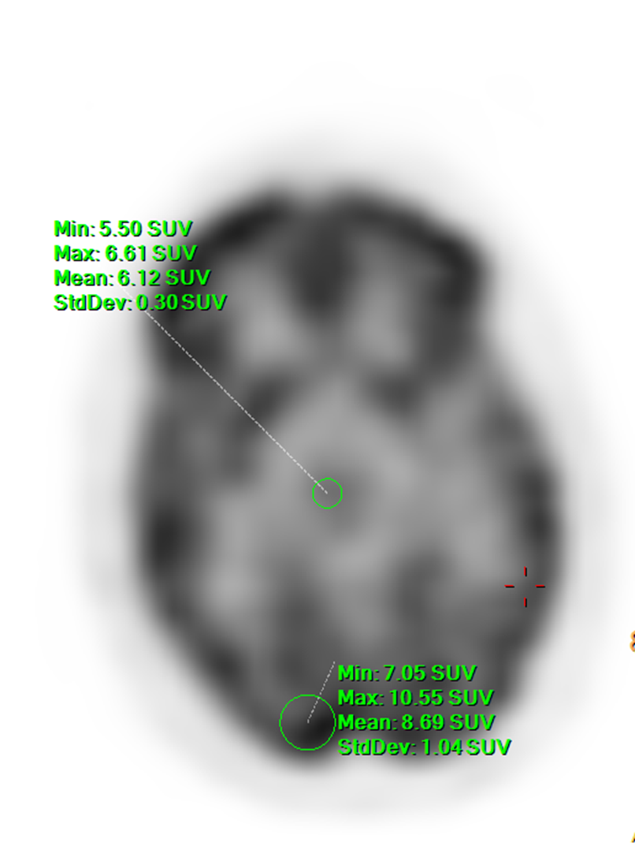
Quantification
Density analyzed using voxel-based method
Currently working with specialists to optimize voxel-based protocol

Slide 16
SPM Analysis
Statistical parametric mapping - statistical analysis methodology used for measuring differences in brain activity in each voxel
Accounts for within-subject and between-subject variation
Will allow for composite 3D modelling of brain activity changes in our population

Slide 17
Thanks
Questions?

