Slide 1
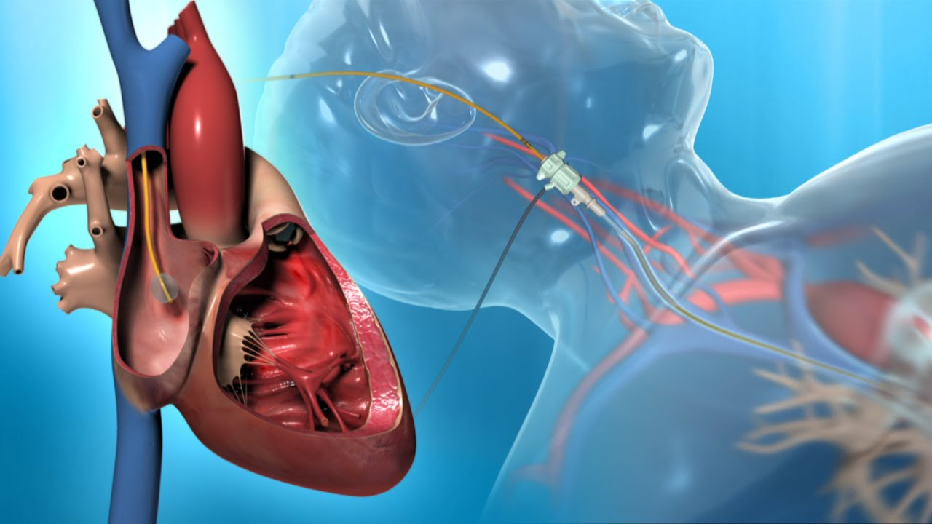
The Effect of Exercise on Pulmonary Capillary Wedge Pressure
Shaham Lital
Mentor: Dr. Fefer Paul
Arrow Project,
Sheba Medical Center 2017

Slide 2
Heart failure with preserved ejection fraction (HFpEF) is a clinical syndrome characterized by the triad of:

Slide 3
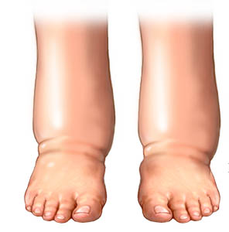
Signs and symptoms of heart failure

Slide 4
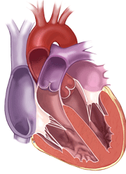
2) Preserved left ventricular ejection fraction (LVEF>50%)

Slide 5
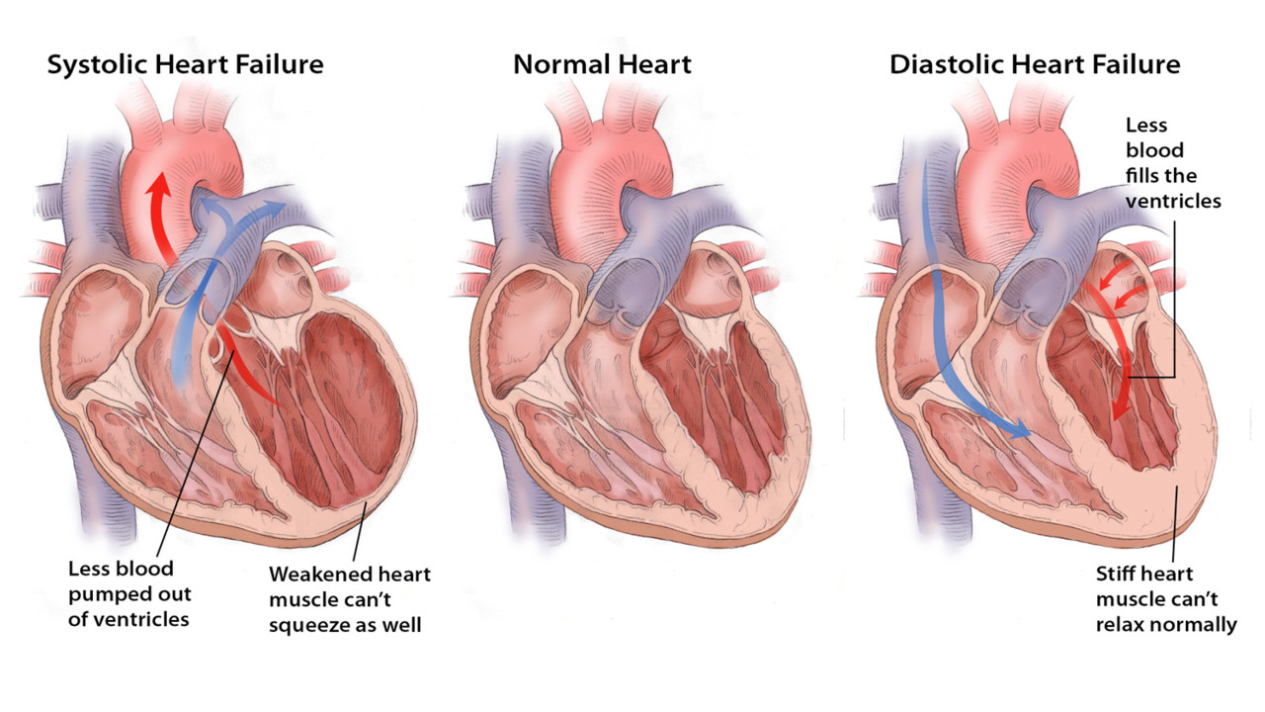
3) Evidence of diastolic dysfunction (HFpEF):

Slide 6
3) Evidence of diastolic dysfunction
PHT

Slide 7
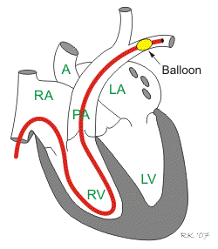
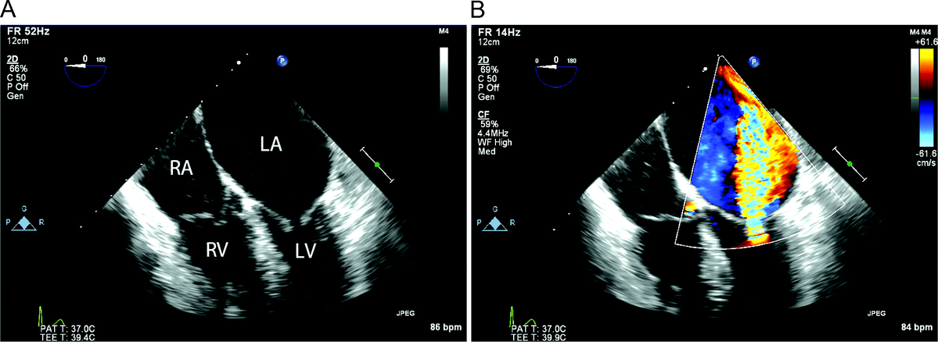
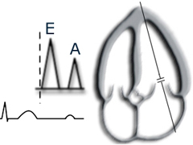
3) Evidence of diastolic dysfunction (HFpEF):
“Gold-standard”- elevated resting values of invasively measured:
PCWP - pulmonary capillary wedge pressure.
Non-invasive echocardiographic parameters:
Measuring the blood flow → Left atrium to ventricle
E/e` ratio, E/A, DT

Slide 8
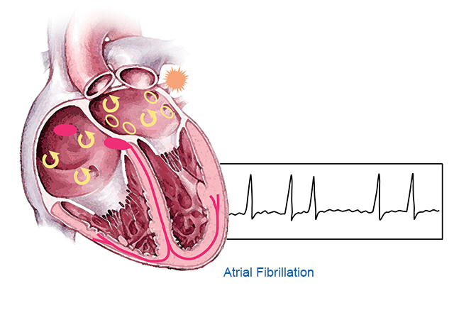
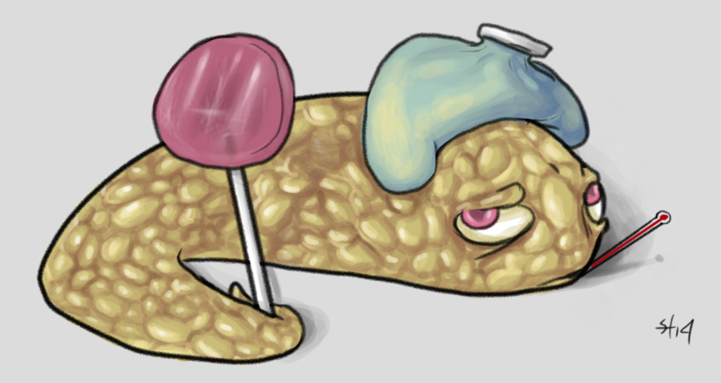
Over 50% of new heart failure cases are attributable to HFpEF:

Slide 9
Morbidity and survival rates among patients with HFpEF are as worrisome as for their counterparts with reduced ejection fraction.
However, no significant improvements in therapeutic strategies for HFpEF have been established.

Slide 10
Whether or not we can diagnose these patients earlier?
Does normal resting PCWP rule out HFpEF?
A number of studies have shown that exercise PCWP can uncover diastolic dysfunction.
A normal resting PCWP does not rule out HFpEF!

Slide 11
However…
The normal range of values for exercise PCWP has not been established.
The purpose of this study was to:
Present a report on PCWP at rest and in response to exercise in a large and varied group of patients undergoing right heart catheterization.
→ Defined the cutoff values for diagnosis of HFpEF patients using exercise PCWP ????

Slide 12
150 patients Included in the study:
150 patients
Right Heart Catheterization
ECHO
Symptom limited exercise
Rest
Rest

Slide 13
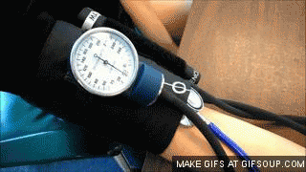
Study population?
Mean age=63±17y
Female=66%
HTN=62%
Mean BMI=28.5±6
DM=31%
AF=32%
Obesity=39%
CTD =16%
PE=15%

Slide 14
The patients were divided into 3 groups based on mean PAWP at rest and during exercise:
Normal PCWP group:
Rest PCWP ≤15 mmHg
Exercise PCWP ≤15 mmHg
No evidence of HFpEF
?-Early stage of HFpEF group:
Rest PCWP ≤15 mmHg
Exercise PCWP >15 mmHg
Suspected for
Early stage of HFpEF
HFpEF group:
Rest PCWP >15 mmHg
Overt HFpEF

Slide 15
Baseline Characteristics
HFpEF n=83 | p2 | ?-Early stage HFpEF n=33 | p1 | N-PCWP n=34
65.3±14 | 0.87 | 64.8±16.3 | 0.04* | 54.1±21.7 | Age, y
39.8 | 0.11 | 24.2 | 0.63 | 29.4 | Male sex, %
30.2±6.4 | 0.07 | 27.9±5.6 | 0.03* | 25.2±4.4 | BMI
50.6 | 0.047* | 30.3 | 0.22 | 17.6 | BMI>30, %
22.9 | 0.97 | 22.6 | 0.52 | 16.1 | Ischemic heart disease, %
21.7 | 0.51 | 16.1 | 0.48 | 23.3 | Chronic lung disease, %
10.8 | 0.32 | 22.6 | 0.56 | 16.7 | Pulmonary emboli, %
25.3 | 0.29 | 16.1 | 0.42 | 6.7 | Obstructive sleep apnea, %
14.5 | 0.75 | 9.7 | 0.08 | 26.7 | Connective tissue disease, %
33.7 | 0.88 | 32.3 | 0.27 | 20 | Diabetes mellitus, %
65.1 | 0.3 | 75 | 0.01*> | 40 | Hypertension, %
43.4 | 0.086 | 25.8 | 0.08 | 6.7 | Atrial fibrillation, %

Slide 16
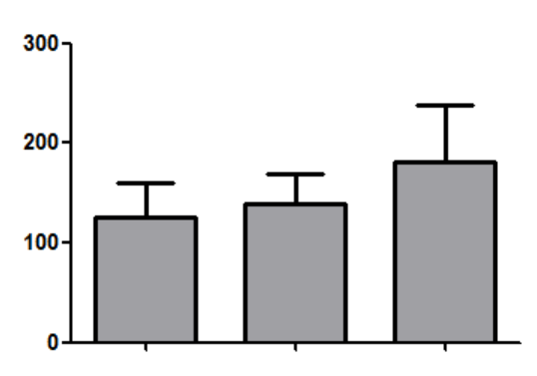
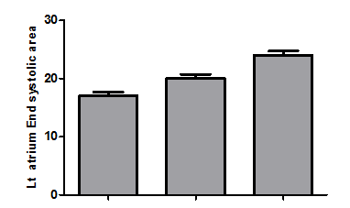
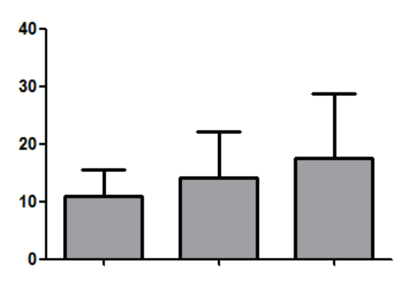
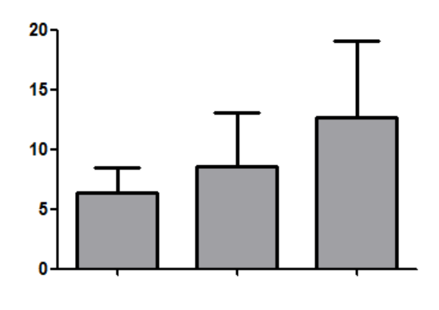
Echocardiographic data
*
*
*
Left atrium End
systolic area, mm²
Left ventricle mass, mg
Normal
PCWP
HFpEF
Normal
PCWP
?-Early stage
HFpEF
?-Early stage
*
E/e' lateral, ratio
E/e' septal, ratio
Normal
PCWP
?-Early stage
HFpEF
Normal
PCWP
?-Early stage
HFpEF

Slide 17
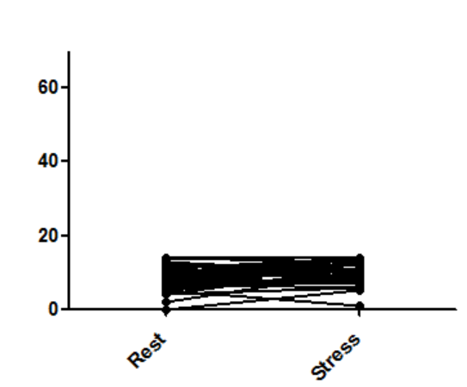
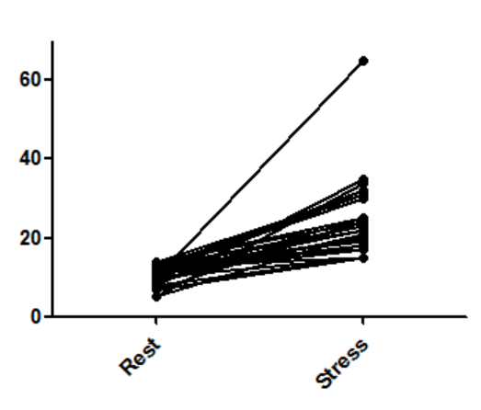
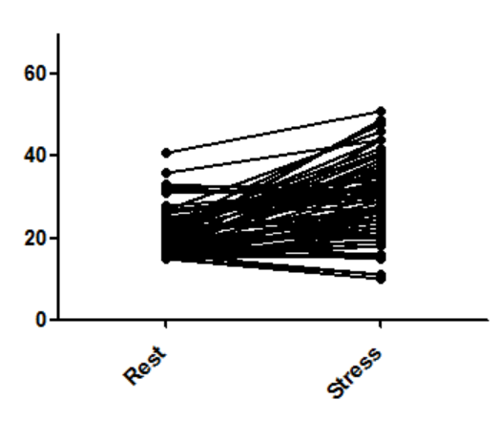
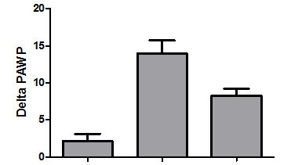
Hemodynamic data-PCWP
A
Normal PCWP
B
?-Early stage
C
HFpEF
PCWP, mmHg
PCWP, mmHg
PCWP, mmHg
Rest
stress
Rest
stress
Rest
stress
*
*
D
Delta PCWP
Normal
PCWP
?-Early stage
HFpEF

Slide 18
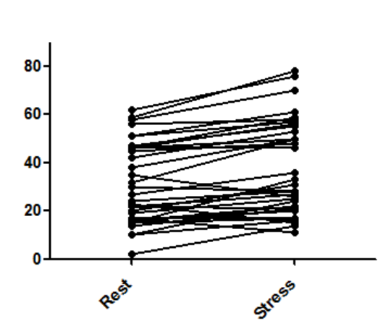
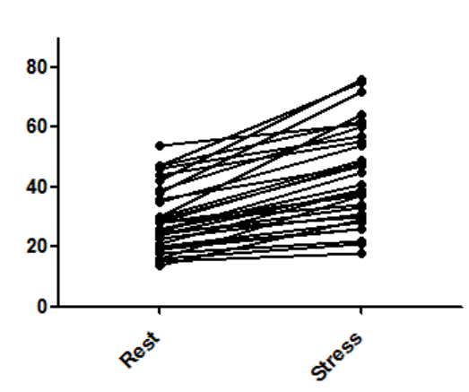
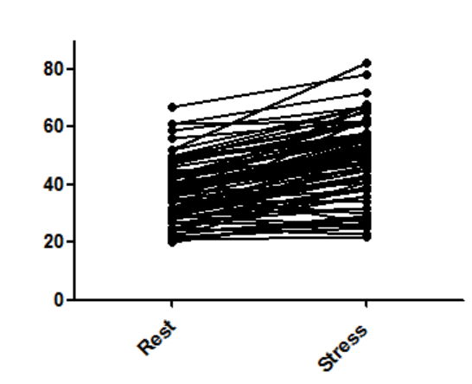
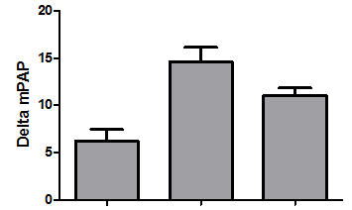
Hemodynamic data-PAP
A
B
C
Normal PCWP
?-Early stage
HFpEF
mPAP, mmHg
mPAP, mmHg
mPAP, mmHg
Rest
stress
Rest
stress
Rest
stress
D
*
*
Delta PCWP
Normal
PCWP
?-Early stage
HFpEF

Slide 19
Summary & Discussion
The need for early diagnosis of diastolic dysfunction led to search for more sensitive measurements as exercise PCWP.
The normal range of values for exercise PCWP has not been established.
We evaluated PCWP at rest and in response to symptom limited exercise in a wide range of patients undergoing right heart catheterization.

Slide 20
We were able to define 3 fairly distinct groups.
The groups were different in all evaluated parameters: characteristics, echo and hemodynamic at rest and during exercise.
The group which was suspected for Early stage of HFpEF was located in the range between the normal PCWP and the overt diastolic dysfunction groups.

Slide 21
This may indicate that these patients indeed represent a separate group of patients at early stage of the disease.
Diagnosis at an early stage using exercise PCWP may allow better treatment of the disease and improve prognosis.

