Slide 1
"Metabolic Modifications and Mitochondrial Activation as a potential therapy in Lung Cancer"
RONEN SHAVIT
2nd Year Medical Student, 4-Year Program
Nir Peled lab
Sheba Medical Center, Tel-Aviv University

Slide 2
Lung Cancer
Lung cancer is the leading cause of cancer related deaths in the United States with an overall 5-yr survival for all stages of ~16%
NSCLC (~90%)
SCLC
(~10 %)
Notes:
Clinically, the two main subtypes of lung cancer include small cell lung cancer (SCLC; ~10% of cases) and non-small
cell lung cancer (NSCLC; ~ 90% of cases).
NSCLC includes

Slide 3

Lung cancer –risk factors
Smoking
Exposure to asbestosis fibers
Radon
Familial predisposition
Air pollution

Slide 4
Lung cancer- symptoms
may be Asymptomatic
Shortness of breathing
Cough
Hemoptysis
Fatigue
Weight loss

Slide 5
Lung cancer-treatment
Stage 1,2- surgery
Stage 3- debate – chemotherapy/ radiation therapy
Stage 4- systemic chemotherapy

Slide 6
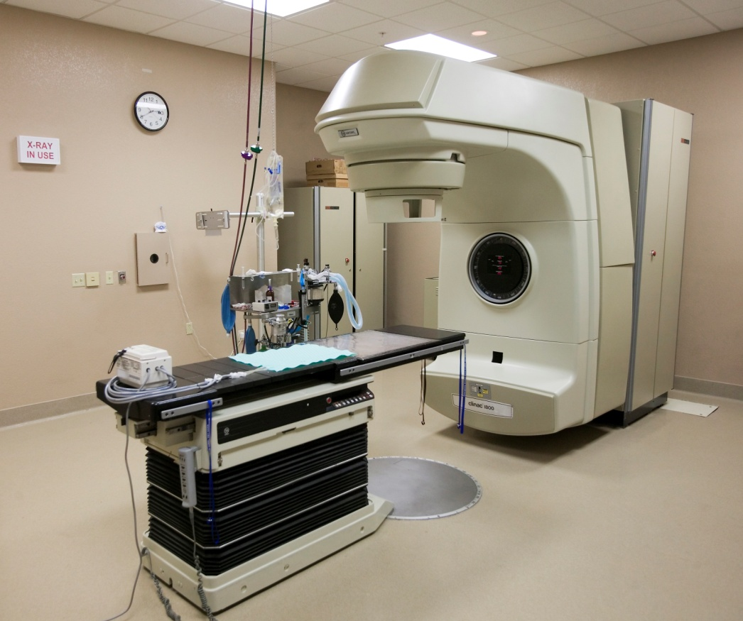
Radiation Therapy (RT)
RT is a common treatment in lung cancer
1. adjuvant (stage 1,2)
2. neo-adjuvant (stage 1,2)
3. curative (stage 3)
4. palliative (stage 4)
Notes:
RT is a common treatment in lung cancer. It is given as:
an adjuvant therapy after surgery in order to eliminate tumor remmants.
neo-adjuvant- before surgery in order to reduce tumor mass so it will be operable
palliative- for symptoms relief.

Slide 7

Radiation Therapy (RT) mechanism
Double strand DNA breaks
Chromosomal aberrations
Mitotic catastrophe
Cell death
Notes:
The mechanism in which RT kills tumor cells (which by the way, all cells but since tumor cells are more proliferative it affects them more) is by causing double strand DNA breaks which in turn leads to chromosomal aberration. in the next proliferation cycle the cell gets into what called mitotic catstrophe and subsequently to apoptosis.

Slide 8
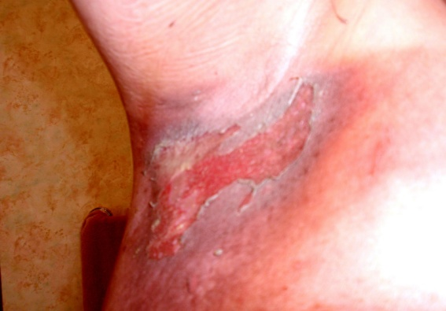
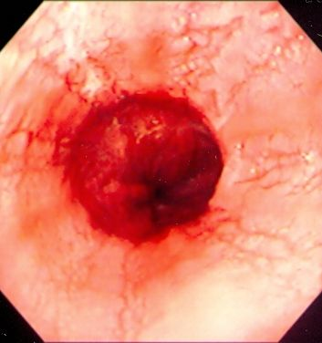
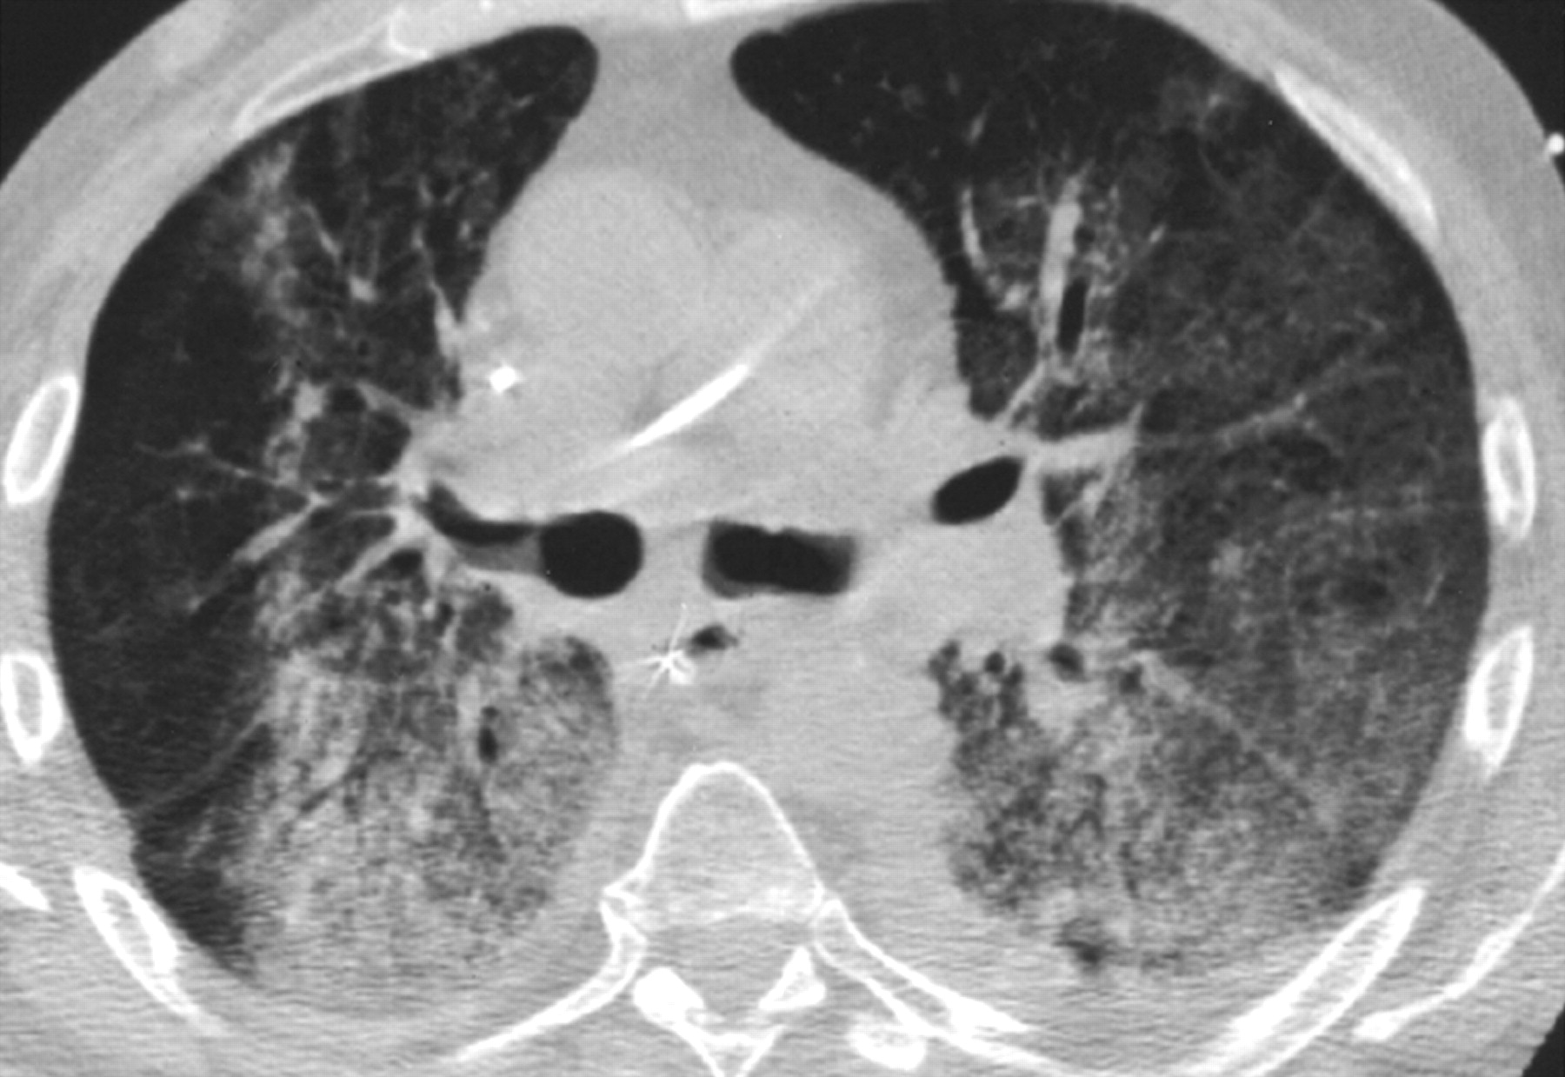
problems
Tumor cells develop resistance to apoptosis.
High radiation doses causes sides effects:
-fatigue
- cough
-shortness of breathing
-skin irritations
-esophagitis
-radiation pneumonitis
-pulmonary fibrosis
-secondary cancers

Slide 9
What can be done?

Slide 10
Metabolic intervention

Slide 11
Glycolysis vs Glucose oxidation
Aerobic conditions
Anaerobic conditions
Glucose oxidation
glycolysis
36 ATP
2 ATP

Slide 12
Warburg effect
In 1929, Warburg first observed that cancer cells use glycolysis for energy production, even when oxygen is present.

Slide 13
Warburg effect- why?
Warburg suggested: “mitochondrial failure”
Today’s theory -proliferation advantages:
  cancer cells increase glucose uptake as compensation.
  production of lactate-provides acidic environment which protects the tumor from the immune system.
  early adaption to hypoxic microenvironment in carcinogenesis .
  Resistance to apoptosis.

Slide 14
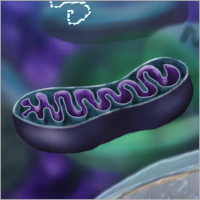
Warburg effect-resistance to apoptosis
Pro-apoptotic mediators (cytochrome C ,apoptosis- inducing factors) are released from the mitochondria through MTP pore
MTP pore opening and ROS production, are dependent on the flux of electrons down the electron transport chain (ETC).
however

Slide 15
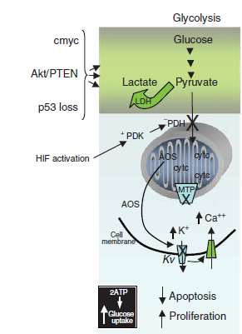
HIF activation in tumor cell leading to PDK over expression
PDK Inhibit PDH- leading to inhibition of Krebs cycle and ETC
MTP pore stays closed
ROS and pro- apoptotic factors stays in mitochondria
Apoptosis inhibition

Slide 16
Hypothesis-mitochondrial activation=apoptosis
Tumor cells have low mitochondrial activity profile.
Tumor cells develop resistance to apoptosis.
Increasing mitochondrial activity by metabolic intervention will increase apoptotic profile.

Slide 17
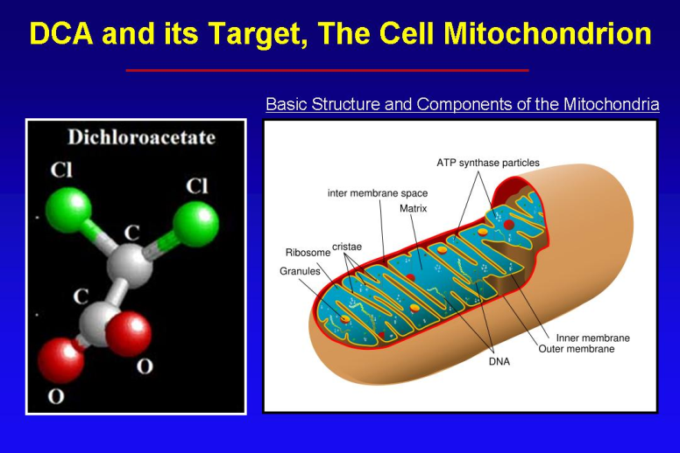
Dichloroacetate (DCA)
Small molecule (150 Da)
High bioavilabilty
Mitochondria-targeting small molecule.
Preclinical studies showed- DCA induces apoptosis in lung, breast, glioblastoma, endometrium and prostate cancer cell lines

Slide 18
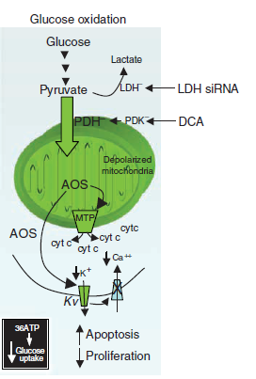
Dichloroacetate (DCA)
Mitochondria-targeting small molecule.
Inhibits PDK, allowing activity of PDH.
activation of Krebs cycle and ETC.
MTP pore opens
Release of pro-apoptotic factors
Induction of apoptosis

Slide 19
Goal of study
Exploring whether the increase of mitochondrial activity (using DCA), increases the sensitivity of lung cancer cells to radiation.
Comparing result between two cell lines of NSCLC.
Find the optimal combined radiation dose and drug concentration.

Slide 20
Methods
We used two cells lines:
  H1299- Human NSCLC derived from lymph node.
  A549 -adenocarcinomic alveolar basal epithelial cells.

Slide 21

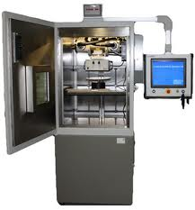

Methods-Clonogenic assay
Seed 100,200 ,400 H1299 And A549 cells
24 h
Treat cells with DCA (ic 12.5,25)
Irradiate cells with 0,2,4 Gy
48 h
Remove DCA
Incubate cells
10 days
Fixation and analysis

Slide 22
methods
Test group: combined treatment
Control groups:
  -untreated cells
  -Cells treated only with radiation.
  - Cells treated only with DCA.

Slide 23
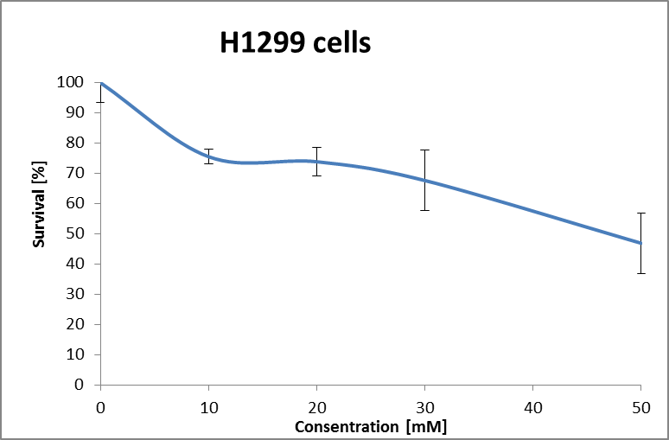
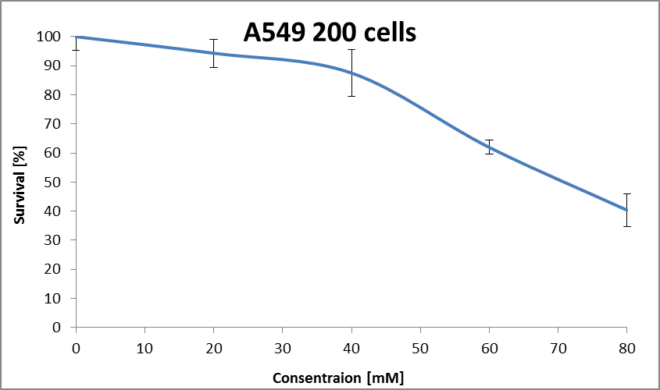
Results- DCA ,UNIRRADIATED

Slide 24
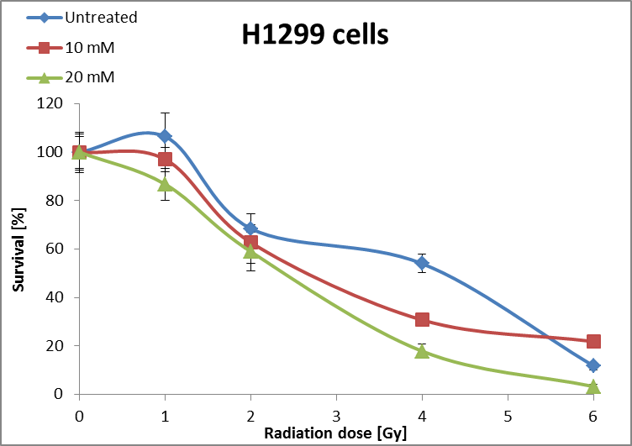
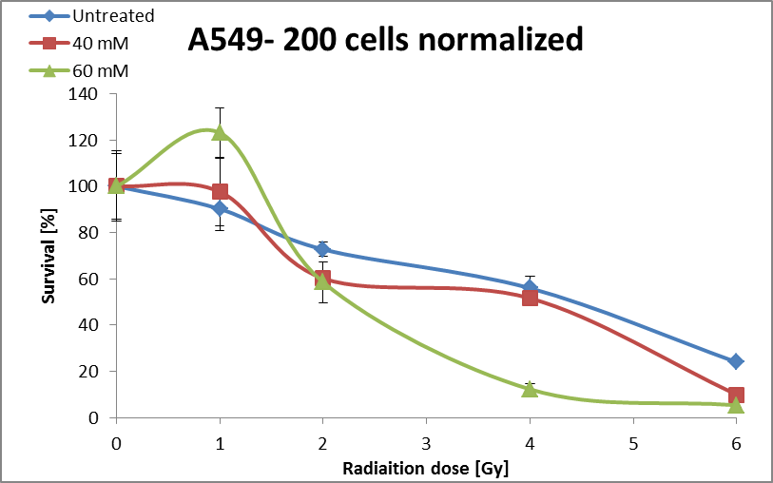
Results

Slide 25
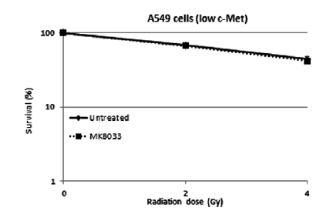
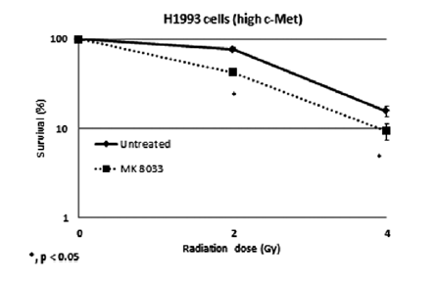
My results- using D CA
Bhardwaj et al (journal of thoracic oncolgy 2012) reesults-using c-MET inhibitor

Slide 26
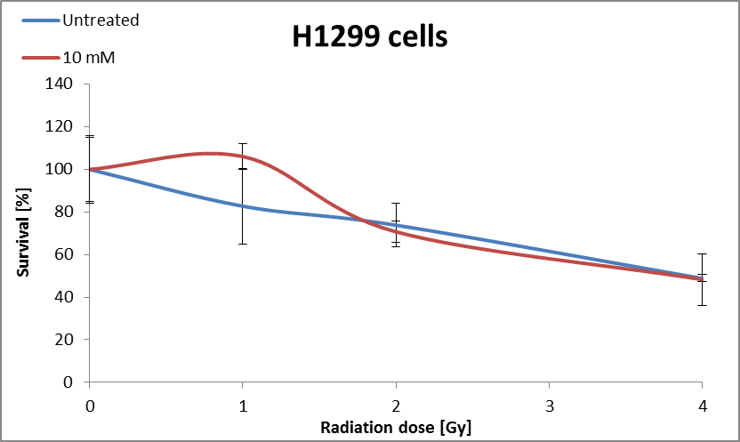
Results
DCA- before irradiation

Slide 27

Loewe Additively model
Quantitatively asses synergistic effect
Given by the equation:
X- percentage of inhibition
l- interaction index
Radiation dose in combined treatment
DCA concentration in combined treatment
DCA concentration when administrated alone
Radiation dose when administrated alone

Slide 28
 | Only DCA [mM] | Only radiation [Gy] | Combined treatment [mM],[Gy] | Interaction index
H1299 | ~50 | ~4 | ~10,2 | ~0.7
A549 | ~80 | ~5 | ~40,2 | ~0.9
Table 1: Loewe additivity model at inhibition level of 50%-60%. For both cell line interaction index<1

Slide 29
Conclusions
DCA radio sensitizes A549 and H1299 NSCLC cells.
A549 are much more resistant to DCA and to combined treatment compared to H1299 cells.
Optimal results obtained in 4 [Gy] and 10 mM DCA for H1299 cells and 4 [Gy] and 60 mM DCA for A549 cells

Slide 30
Acknowledgments
I would like to thank:
-Nir Peled, MD PhD FCCP Head, Thoracic Cancer Research and Detection Center.
-Dr Yaacov Richard Lawrence MBBS MA MRCP
Director, Center for Translational Research in Radiation Oncology.
Maya Ilouze, Phd, post doc.Thoracic Cancer Research and Detection Center.

Slide 31
Thank you

