Slide 1
Medical simulation with actors for training students and residents in basic skills in psychiatry
Doron Amsalem, Raz Gross, Alexandra Dorman

Slide 3
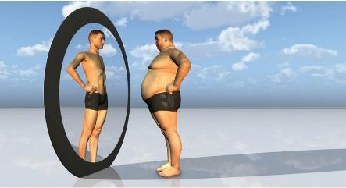
Why video?
Why actors?

Slide 5
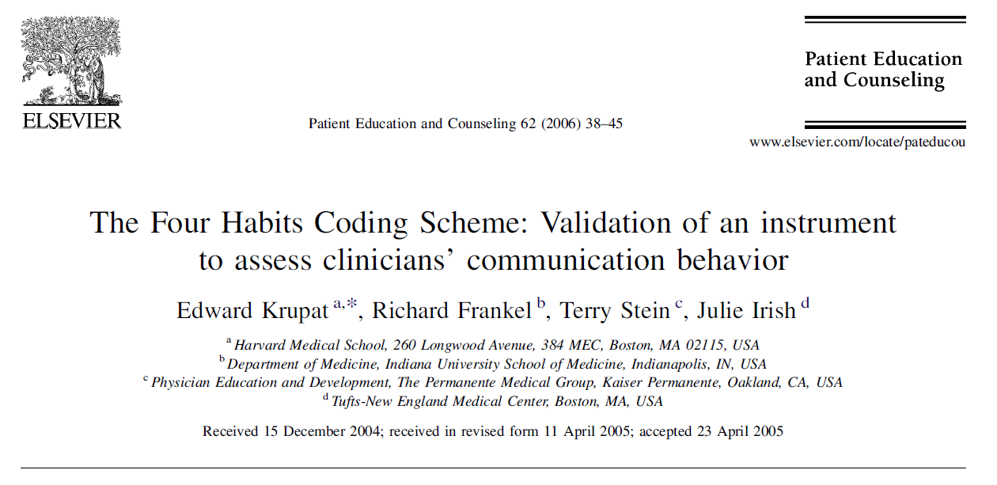

Slide 6
Four habits model, 23 items
Invest in the Beginning
Elicit the Patient’s Perspective
Demonstrate Empathy
Invest in the End

Slide 7
Invest in the Beginning
Familiarity
Greetings
Small talk
Question Style
Expansion of concerns
Eliciting the full agenda

Slide 8
Invest in the Beginning
Familiarity
Greetings
Small talk
Question Style
Expansion of concerns
Eliciting the full agenda

Slide 9
Small talk
5. Clinician makes non-medical comments, using these to
put the patient at ease.
3. Clinician makes cursory attempt at small talk (shows no
great interest, keeps discussion brief before moving on).
1. The clinician gets right down to business without any
attempt at small talk (or cuts patient off curtly and abruptly, or if later in visit, shows only passing interest).

Slide 10
Elicit the Patient’s Perspective
Eliciting the patient’s understanding of the problem
Eliciting the patient's goals for the visit
Attention to Psychosocial Issues

Slide 11
Demonstrate Empathy
Expression of emotion
Acceptance of feelings
Identification of feelings
Nonverbal empathy

Slide 12
Invest in the End
Using patient's concerns as frame of reference
Allowing patients to absorb information
Clarity of information
Explanation of treatment plan and/or tests
Testing for comprehension
Patient involvement
Acceptability of treatment plan
Implementation
Additional questions
Plans for follow-up

Slide 13
Inter-rater reliability
Inter-rater reliability was established by having the three coders independently rate randomly selected visits
Their scores were compared for each individual rating within category and overall using Pearson

