Slide 1
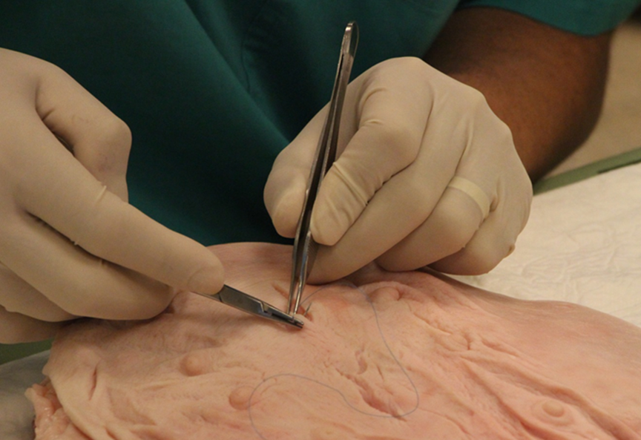
Surgical Education
Arrow project meeting 5.1.18
Dr. Imri Amiel M.D
MSR, the Israel Center for Medical Simulation
Department of General Surgery B, The Chaim Sheba Medical Center
The Talpiot Medical Leadership Program

Slide 2
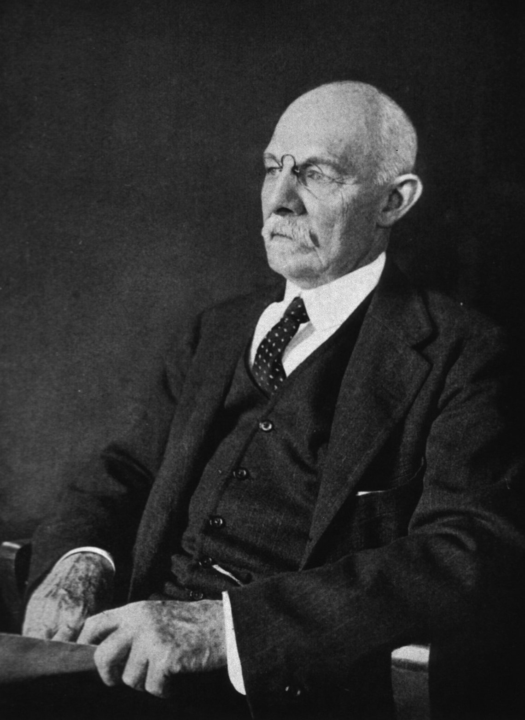
The Surgical Residency
See one,
Do one,
Teach one….
Kill one!!!
William Stewart Halsted, M.D. (1852 –1922)

Slide 3
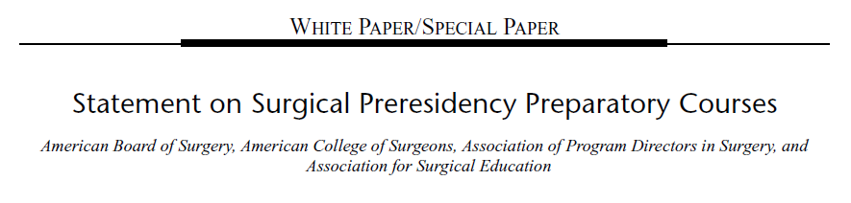
Statement on surgical pre-residency preparatory courses – Nov 2014
39 US medical schools reported implementation of this course in 2014.
55 institutions have committed to deliver this course in 2015.

Slide 4
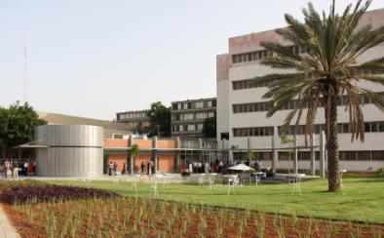
Single center comprehensive multi-disciplinary pre-residency course
Built by surgical resident from different specialties in the Sheba Medical Center – November 2013
Generic course – for all specialties
On the basis of the American/Canadian model

Slide 5

Surgical Bootcamp

Slide 6
So far… 2014-2017
6 courses (ever 6 months)
73 residents (22 females and 51 males)

Slide 7
The MSR Surgical Bootcamp
5 days long
Website with pre-requisite materials
www.msr-surgery.com
Hands-on only!!!
Basic principals of open and laparoscopic surgery
Exercise on animal tissue and models
Practical final exam - OSATS

Slide 8
DAY 1: OR conduct – topic list
OR Orientation
Surgical Checklist
Scrubbing
Gowning and Gloving
Patient Positioning
Patient Prepping & Draping
Instruments Identification & handling (catalog)

Slide 9
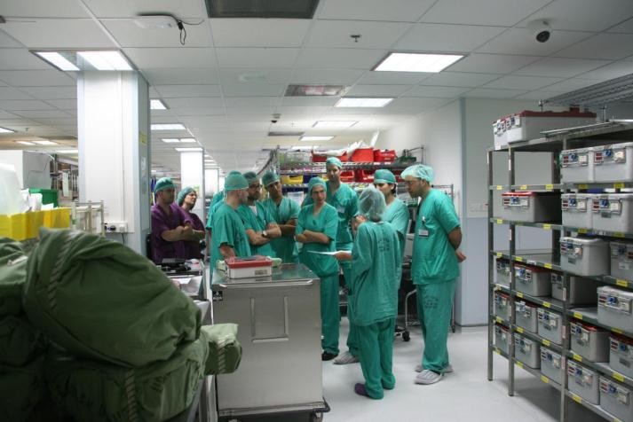
OR Orientation

Slide 10
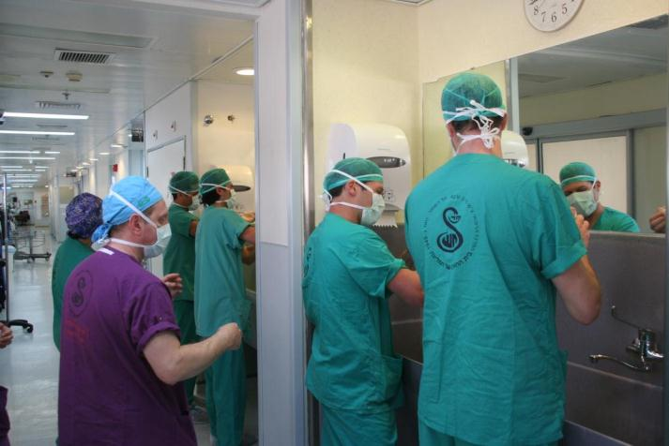
Scrubbing

Slide 11
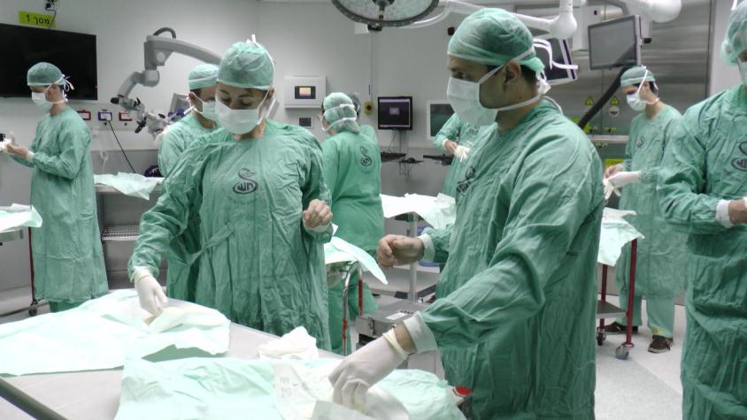
Gowning and Gloving

Slide 12
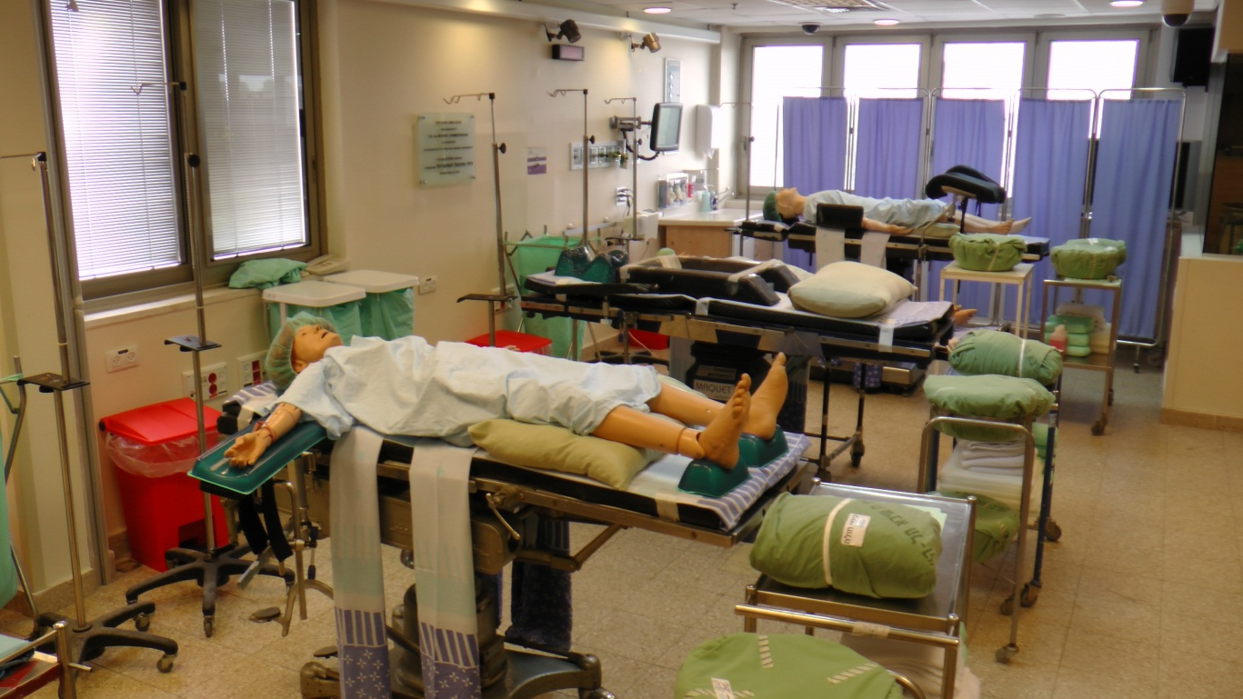
Patient Preparation & Positioning
Supine
Prone
Lateral
Lithotomy

Slide 13
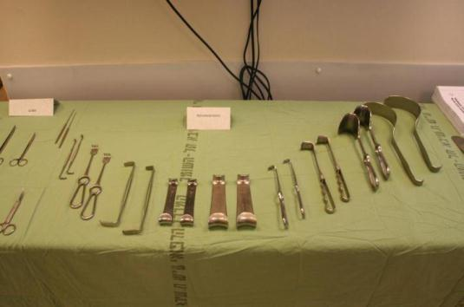
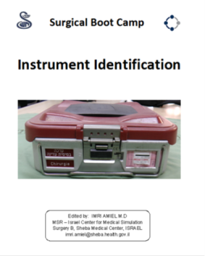
Instruments Identification

Slide 14
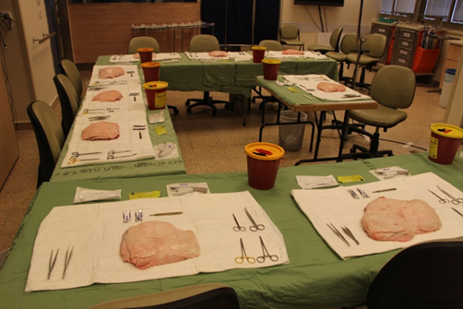
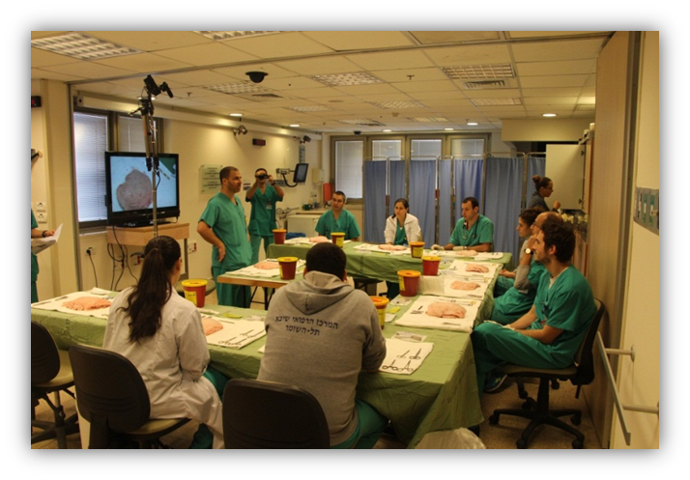
DAY 2: Suturing & Knot tying skills
All materials
All techniques
Animal tissues
Small groups
Personal tutoring
Repetitions
Final exam
Personal suturing kit

Slide 15
DAY 3: Surgical Procedures
Abdominal wall closure
Vessel ligation
Central line insertion – US guided
Abscess I&D
Lipoma excision – Basics of soft tissue dissection
Tracheostomy
Chest Drain insertion
Sterile technique of urinary catheter

Slide 16
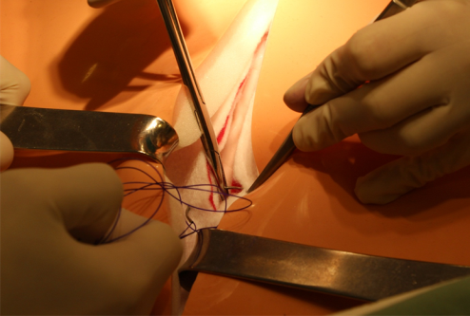
Abdominal wall closure

Slide 17
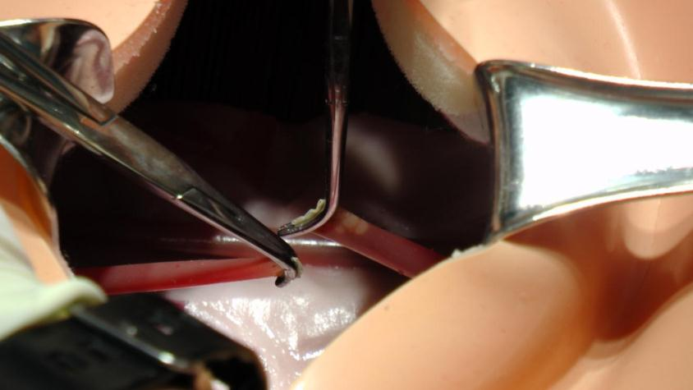
Vessel ligation

Slide 18
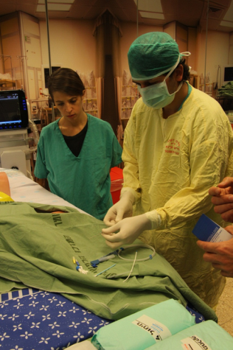
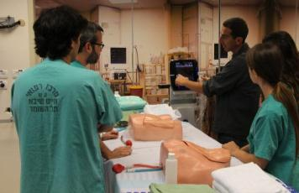
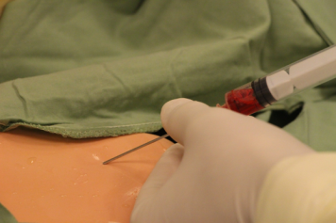
Central line insertion – US guided

Slide 19
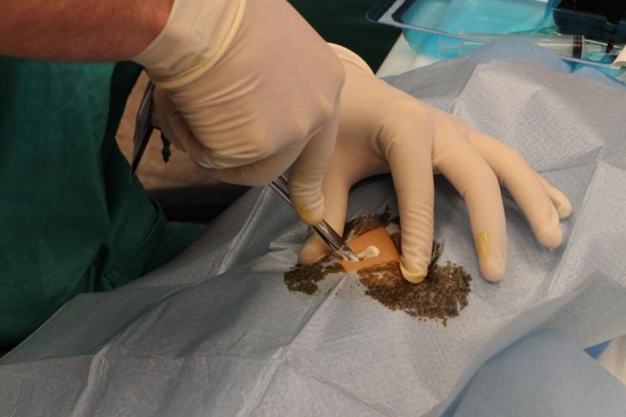
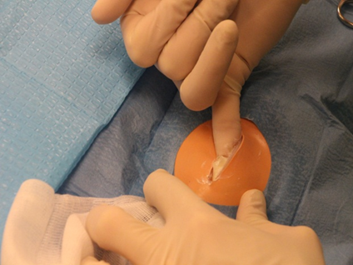
Abscess I&D

Slide 20
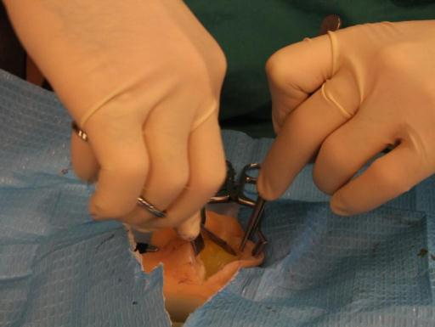
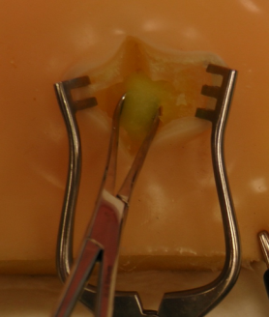
Lipoma excision

Slide 21
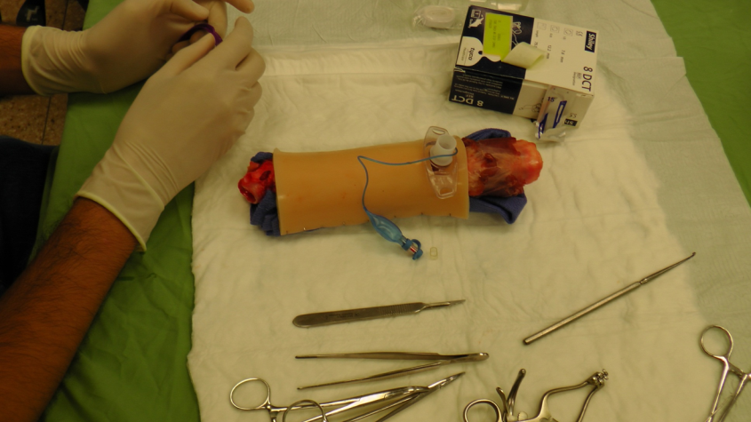
Tracheostomy

Slide 22
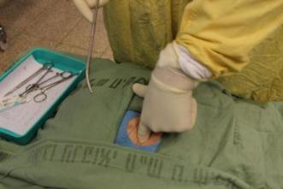
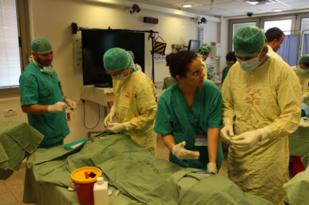
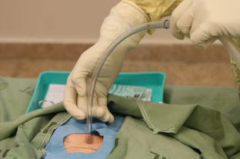
Chest Drain insertion

Slide 23
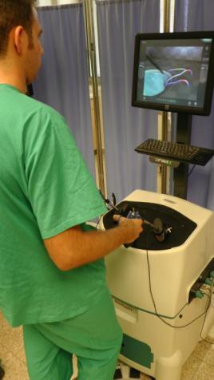
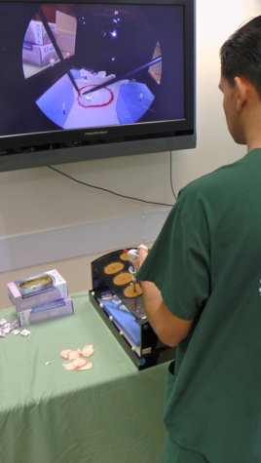
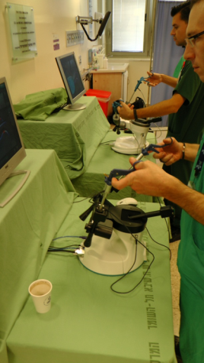
DAY 4: Basic Laparoscopic Surgery

Slide 24
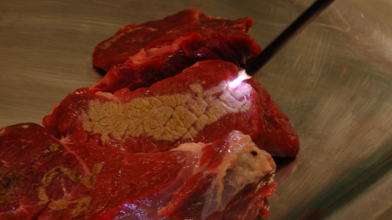
Basics of electro-cautery

Slide 25
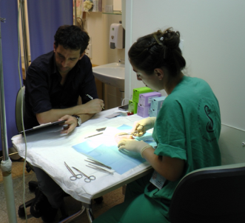
DAY 5: Practical Final Exam
7 skills station
15 min. each
3 min. personal feedback
Video recording
OSATS assessment tool

Slide 26
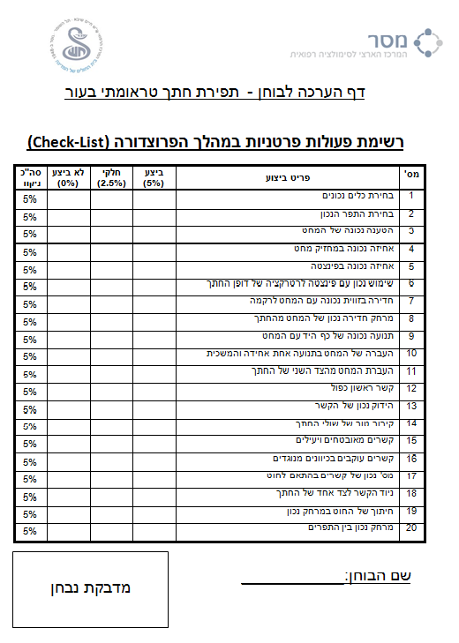
OSATS
Objective Structured Assessment of Technical Skill
Validated assessment tool
In use for 2 decades
Reznick et al. – 1997
University of Toronto Part A: Global rating scores
Part B: Procedure specific check lists

Slide 27
OSATS Pre-test and Post-test scores –
Checklist (N=30, P-value<0.05)
Marked difference was found between the pre-test and the post-test results in all skill stations
All differences were statistically significant

Slide 28
OSATS Pre-test and Post-test scores –
Global Rating Score (N=30, P-value<0.05)
Statistical significance was seen in both assessment tools (Checklist and Global Rating Score)

Slide 29
OSATS Post-test and Retention test scores – Checklist (N=30, P-value>0.05)
Retention test was performed 3 months after the Bootcamp
No statistical difference was found in terms of skills

Slide 30
OSATS Post-test and Retention test scores – Global Rating Score (N=30, P-value>0.05)
The residents all well-preserved their surgical skills 3 months after the end of the Bootcamp

Slide 31
The Future…
Turning the “Surgical Bootcamp” a mandatory course in the surgical residency in Israel.
Research in basic surgical skills.

Slide 32
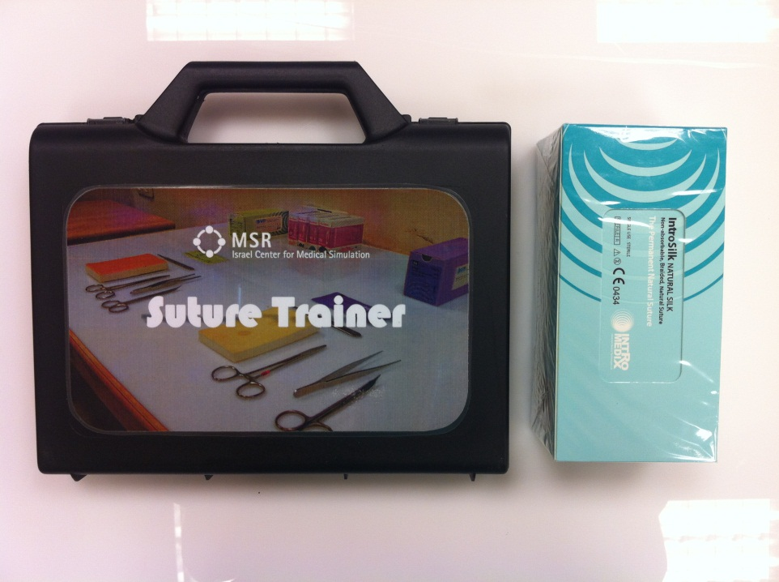
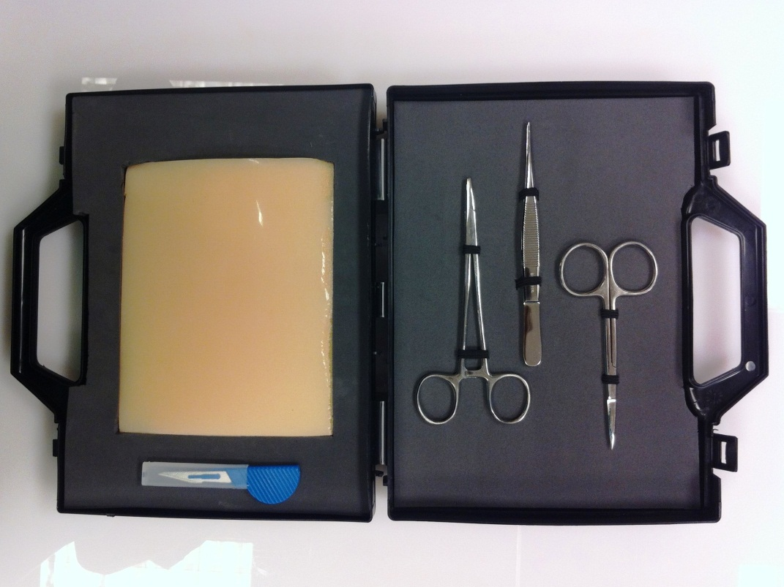
Suture Trainer

Slide 33
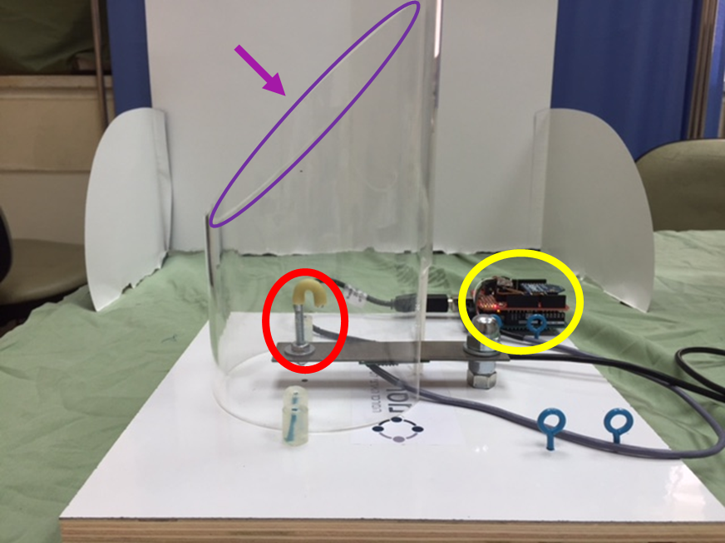
Knotting Trainer – “Knotti”
A hook on which the knot is tied.
A sensor that measures vertical forces.
A plastic tube that simulates “deep” tying.
A webcam (not shown)

Slide 34
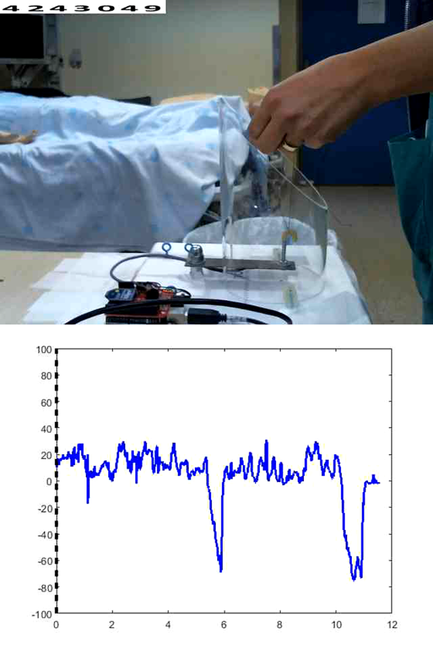
Validating the simulator
Maximal pushing and pulling forces that are being applied.
The total force applied – area under the curve.
The average force.
Duration of tying time.

Slide 35
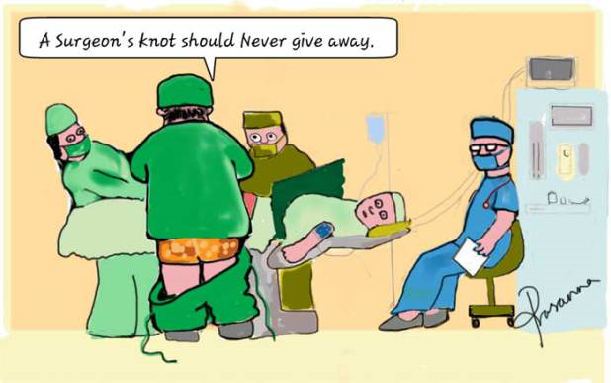
Thank you for listening…

