Slide 1
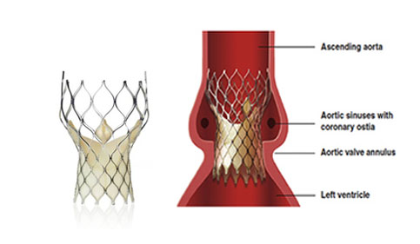
The Effect of Rapid Pacing on Outcomes Following Transcatheter Aortic Valve Implantation [TAVI]
Tutor: Dr. Paul Fefer
Student: Scott Kohen

Slide 2
TAVI: What is It?
An alternative procedure to conventional/standard open heart surgery for valve replacement, via catheter
Main indication: Aortic stenosis
Off label indications: Aortic regurgitation/ degenerated bioprosthesis
Used as an alternative procedure when the patient is stratified by a cardiologist and cardiothoracic surgeon as high risk:
≥ 1 in 5 (20%) chance of death with an open heart surgery

Slide 3
Indications

Slide 4
Absolute Contraindications
Absence of a Heart Team
No Cardiac Surgery on-site
Appropriateness of TAVI not confirmed by the Heart Team
Estimated life expectancy < 1 year
Comorbidity that suggests a lack of improvement in quality of life
Inadequate annulus size < 18 mm, >29 mm
Active Endocarditis
Symmetric valve calcification
Short distance between the annulus and coronary ostium
Plaques with mobile thrombi in the ascending aorta

Slide 5
Relative Contraindications
Inadequate vascular access for transfemoral or subclavian approach (transapical approach an alternative)
Hemodynamic instability
Severe LV dysfunction

Slide 6
How is it Done?
Cannula is inserted into an artery in the wrist in order to monitor Blood Pressure
Drip is inserted into a vein in the neck so fluids and medications can be infused
Special X-rays with contrast dye and echocardiography are used to guide the new valve into the correct position
Heart Rate is sped up (paced) to a very high rate with a pacing wire placed temporarily in the heart
Reduces blood pressure and motion of the heart facilitating the procedure in a more fluid manner

Slide 7
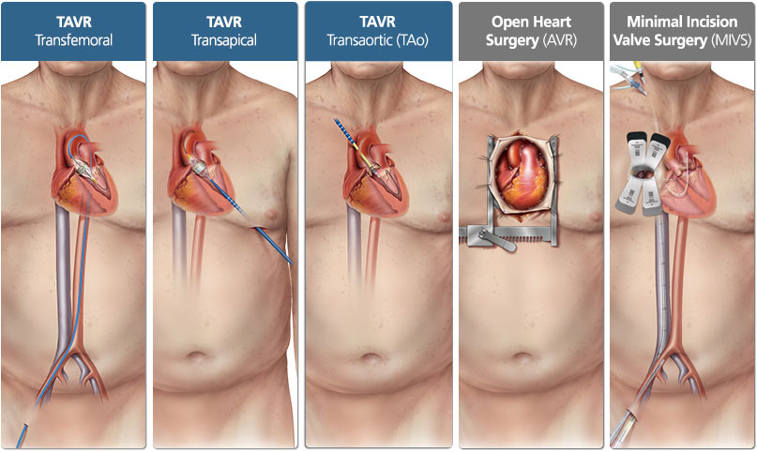
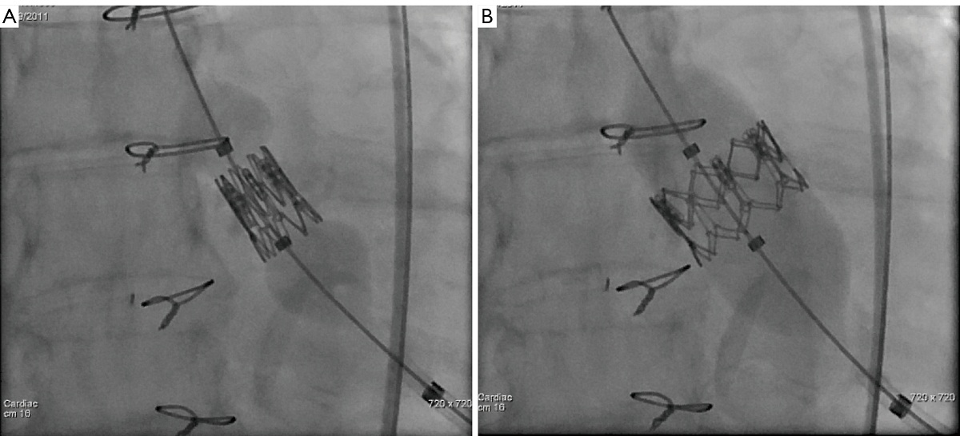

Slide 8
What Research Has Shown so Far (Partner Trial)
TAVI was demonstrated to be superior to medical therapy in the treatment of inoperable patients
TAVI was demonstrated to have similar outcomes for mortality in the period of 1-5 years after the procedure, in high risk patients with aortic stenosis, to those who have surgical aortic valve replacement

Slide 9
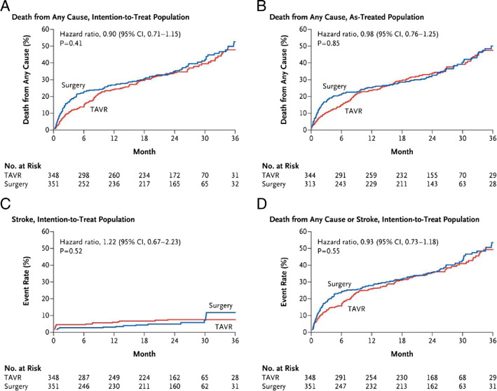

Slide 10
Core Valve Pivotal Trial: High Risk Study
Superior survival after two years demonstrated
Lower stroke rate
Superior Hemodynamics

Slide 11
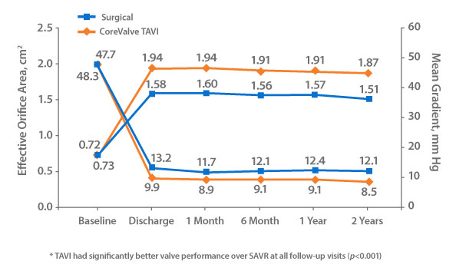
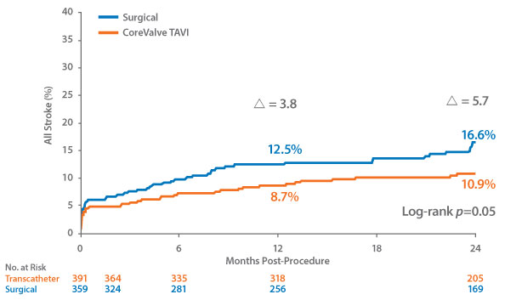

Slide 12
Rapid Pacing?
Reduces cardiac output (systolic BP < 40 mmHg)
Balloon movement is minimized, so stented valve can be placed accurately, and trauma to the aorta/ventricle is prevented more effectively
Decrease the afterload, minimizing risk of damage to the myocardium, which has a higher chance of occurring if the heart is not paced

Slide 13
Issues with Rapid Pacing
Sustained low blood pressure after pacing
Ensuing Tachyarrhythmia's (VF)
Asystole
Microcirculatory arrest and then delayed recovery of microvascular flow

Slide 14
Study Aim
Assess the effect of rapid pacing in conjunction with TAVI, on real-world clinical cohorts for adverse clinical outcomes
Data is in the process of being obtained and analyzed on over 400 patients

Slide 15
What is Being Measured?
Pacing Parameters:
Number of pacing episodes
Duration of longest pacing episode
Sum duration of all pacing episodes
Outcome Measures:
Death:
-In Hospital
-Long-Term
Prolonged Hypotension
Brady/Tachyarrythmias
Need for prolonged pacing

Slide 16
Method
Manual Review of ECG data and Hemodynamic measures (i.e. blood pressure)
Combining above data with existing procedural and outcome data from ongoing Sheba TAVI registry

Slide 17
Significance?
Understanding the clinical significance of rapid pacing
Guiding future TAVI procedures re rapid pacing
Should it be avoided if possible?
If done:
is there an upper limit to the length of a pacing episode?
How many pacing episodes can be performed safely?

Slide 18
Thank You

