Slide 1
Ustekinumab in Crohn’s disease
Is there a place for Therapeutic drug monitoring?
Prof. Uri Kopylov, Sheba Medical Center, Tel Hashomer, Israel

Slide 2
Mechanism of Action

Slide 3



Ustekinumab Background
IM-UNITI
3
IL-12
IL-23
  IL-12 & IL-23 are key cytokines in the pathogenic immune cascade of Crohn’s disease
Ustekinumab is a fully human IgG1k monoclonal antibody binding the p40 subunit of Interleukins-12 & 23
Inhibits IL-12- and IL-23-mediated signaling, cellular activation, and downstream cytokine production
p40
p35
p19
p40
ustekinumab
IL-12Rβ1
IL-12Rβ2
IL-23R
IL-12Rβ1
NK or T cell
membrane
No IL-12 or IL-23
Intracellular signal
¹ Sandborn W, et al. Oral presentation. CCFA 2015 and
Rutgeerts P, et al . Oral presentation. ECCO 2016.
² Feagan B, et al. Oral presentation. ACG and UEGW 2015.
Sandborn W.J., et al. DDW 2016. Presentation 768.

Slide 5
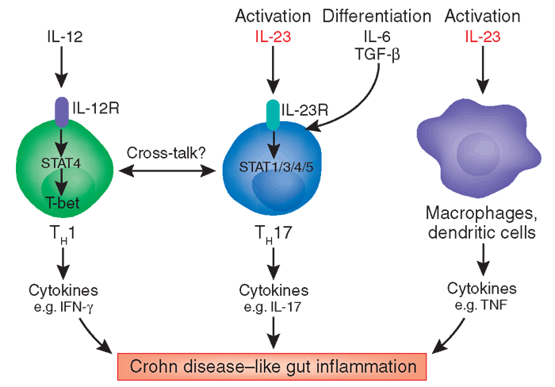
Blocking Il12/Il23 in Crohn’s disease

Slide 6
Therapeutic indications of Ustekinumab
Crohn’s Disease
UST is indicated for the treatment of adult patients with moderately to severely active Crohn’s disease who have had an inadequate response with, lost response to, or were intolerant to either conventional therapy or a TNFα antagonist or have medical contraindications to such therapies.

Slide 7
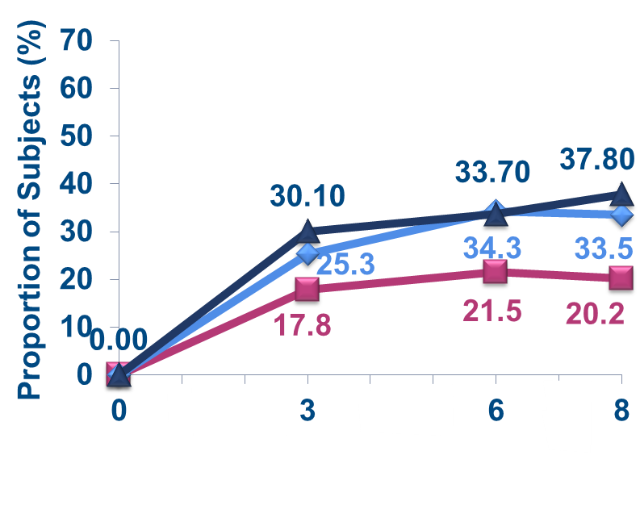
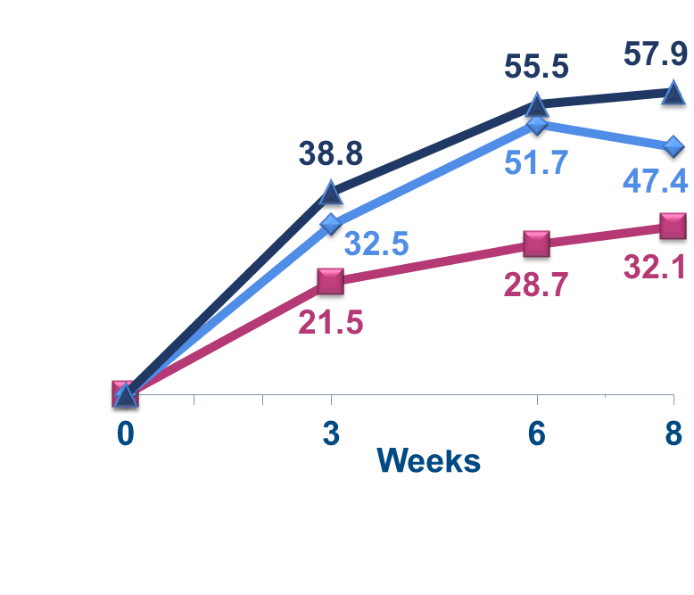



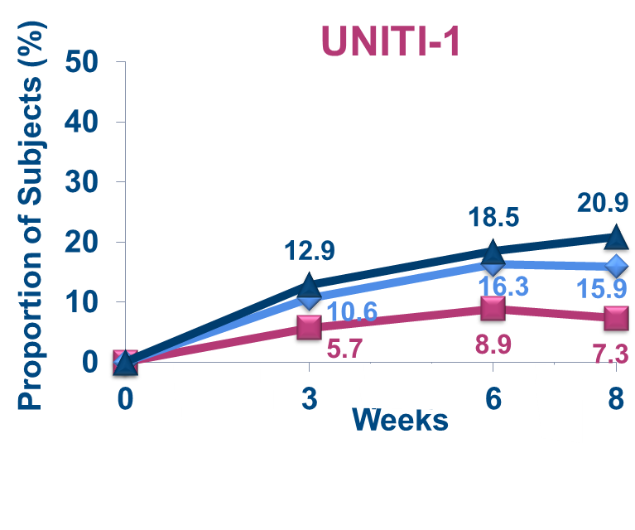
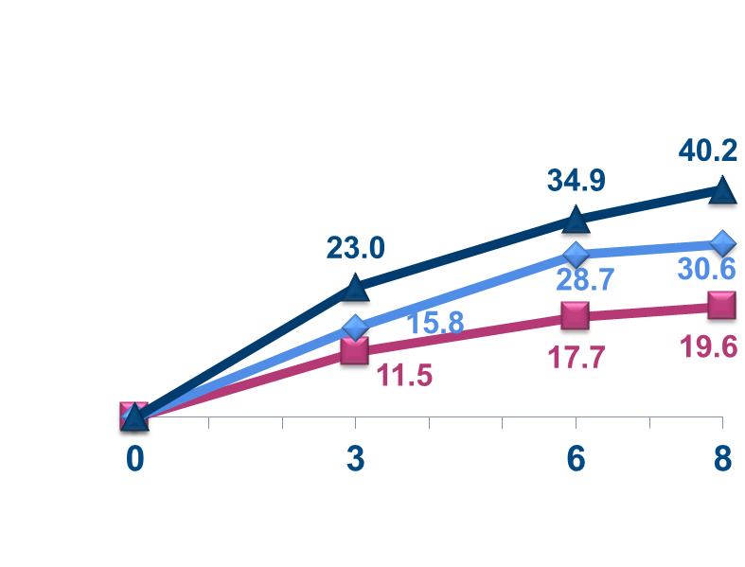

Clinical Response and Remission Through Week 8
UNITI-1 & UNITI-2
7
Clinical Response
(anti-TNF Failure)
(Conv. Failure)
Clinical Remission
UNITI-2
(anti-TNF Failure)
(Conv. Failure)
Sandborn W.J., et al. DDW 2016. Presentation 768.
Notes:
TEFCREM02 visits Weeks 3, 6, 8

Slide 8
Primary Endpoint: Clinical Remission at Week 44
IM-UNITI
8
Number of Subjects in Clinical Remission**,† at Week 44;
Randomized Subjects Excluding Those Enrolled Prior to Study Re-start
p=0.040
p=0.005
Δ 12.9%
Δ 17.2%
Proportion of Subjects (%)
Ustekinumab
*Subjects who were in clinical response to ustekinumab IV induction dosing and were randomized to placebo SC on entry to this maintenance study
**Subjects who had a prohibited CD-related surgery, had a loss of response, had prohibited concomitant medication changes, or discontinued study agent due to lack of efficacy or due to an adverse event indicated to be of worsening CD prior to the designated analysis timepoint are considered not to be in clinical remission, regardless of their CDAI score †Subjects who had insufficient data to calculate the CDAI score at the designated analysis timepoint are considered not to be in clinical remission
Sandborn W.J., et al. DDW 2016. Presentation 768.
Notes:
TEFCREM01a: Number of subjects in clinical remission at Week 44

Slide 9
Real –world experience with ustekinumab

Slide 10
The McGIll Experience
38 anti-TNF resistant CD patients
Dosage – SC UST 90 mg wk 0,1,2 , continued q8w (75% of the patients)
Initial (3 months ) response achieved in 28/38 (73.7%) of the patients.
80% of the responders with follow-up data maintained response for 6 months
73.3% were able to discontinue corticosteroids
SAE- 1 case of C.diff
JCC 2014

Slide 11
The GETAID experience
Long-term extension (ECCO 2017) - Ustekinumab failure-free survival was observed in 78.4% at 1 year, 65.8% at 2 years and 54.7% at 3 years
CGH 2016

Slide 12
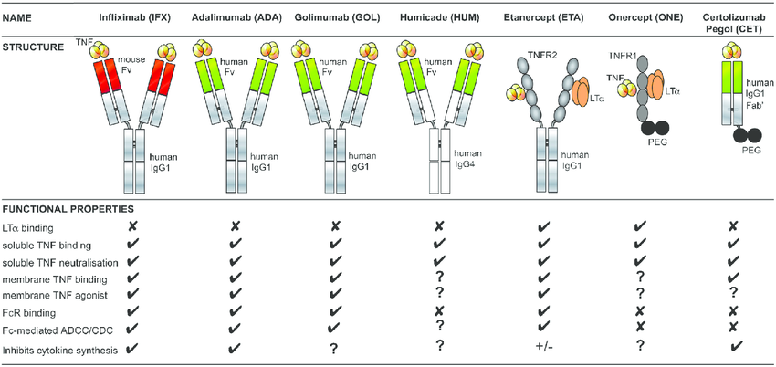
Therapeutic drug monitoring in IBD
TNF alpha inhibitors

Slide 13
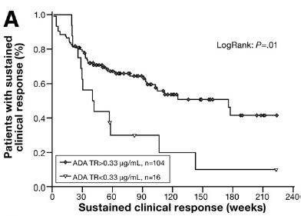
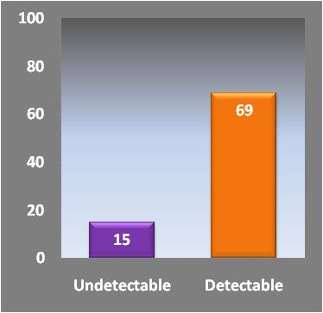
Anti-TNF drug levels correlate with clinical outcome
Early adalimumab levels & response
Infliximab levels & remission (UC)
Remission (% of patients)
Karmiris K, Gastroenterology 2009
Seow CH, Gut 2010

Slide 14
Correlation of anti-TNF drug levels with control of inflammation (Mucosal healing)
p<0.0001
100
90
Infliximab concentration at
Week 54 (μg/mL)
10.0
Mucosal healing (%)
80
70
60
1.0
50
40
30
0.1
20
10
n=
49
109
0
0
<1.9
1.9–4.9
4.9–6.0
>6.0
No
Yes
Adalimumab trough level (µg/mL)
Mucosal
healing
14
Roblin X, Clin Gastroenterol Hepatol 2014
Adedokum OJ, Gastroenterology 2015

Slide 15
Levels of adalimumab drug and anti-drug antibodies: association with outcome of interventions after loss of response to adalimumab
High drug and Low Ab
100
p<0.01
Low drug and Low Ab
Clinical remission (%)
n=82
Low drug and high Ab
80
60
40
20
0
After dose increase
After switch to IFX
Low drug and Low Ab → more remission with dose-increase
Low drug and high Ab → more remission with switch to IFX
Roblin X, Am J Gastroenterol 2014

Slide 16
Adalimumab
What’s the best target concentration ?
Mucosal healing therapeutic range revealed by incremental gain analysis of a-TNF treated IBD patients
Infliximab
MH rate (%)
MH rate (%)
Steep slope:
high gain
range
Drug level (µg/ml)
Drug level (µg/ml)
Ungar B, CGH 2016
n=161

Slide 17
Neither week 2 or 6 Vedolizumab levels were associated with clinical remission at week 6 or 14
Week 6 remission
Week 14 remission
%
%
week 2
level
(μg/ml)
week 6
level
(μg/ml)
Ungar B, Presented at UEGW 2016
n=82
Notes:
We next examined the association between vedolizumab trough serum levels and clinical endpoints during induction
Neither week 2 or 6 vedolizumab levels were associated with clinical remission at week 6 or 14 . Week 2 or 6 levels were also not associated with primary non response by week 14 or steroid free remission.
Furthermore, clinical remission rates at week 6 or 14 were also not associated with drug level quartiles at week 2 and 6

Slide 18
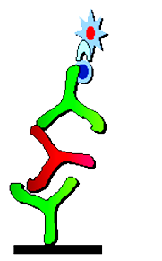
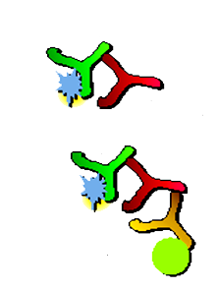
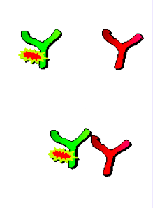
Assay Methods for Monitoring Levels
HRP-Avidin
I ¹²⁵ - Infliximab
FI-Infliximab
ATI
Bio-Infliximab
ATI
+
ATI
Infliximab
Anti-λ
Ig Beads
Complex
Bridging
ELISA
Radio
Immunoassay
Mobility Shift
Assay +acid Dissociation
Plastic Interference
High
Low
Low
Sensitivity
Medium
High
High
False + / -
High
Low
Low
IgG4 Detection
No
Yes
Yes
Tolerance of Drug
Poor
Good
Good
Cost
Low
High
Very high
Complexity
Simple
Complex
Complex

Slide 19
Ustekinumab-
Immunogenicity and TDM

Slide 20
UTK levels and clinical outcomes
Endoscopic response
Steroid-free remission and endoscopic response

Slide 21
UTK levels and clinical outcomes
Steroid-free clinical remission
CRP normalization
p=0.76
p=0.02

Slide 22
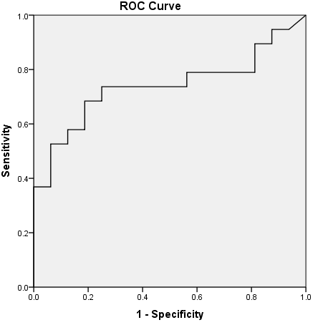
UTK levels and anti-UTK antibodies
Mean UTK levels
  Week 10- 3.36 ±1.8 mcg/ml
  Week 26- 4.2 ±2 mcg/ml (=0.9)
Anti UTK – 1 patient (2%) only
AUC- 0.78, p=0.006
Optimal cut-off level-4.5 μg/mL
  Sensitivity- 72.2%
  Specificity-83.3%
Prediction of endoscopic response

Slide 23
Study aims
To evaluate the correlation between UST trough levels and anti-UST antibodies with clinical and endoscopic outcomes in Crohn’s disease

Slide 24
Methods
serum samples for UST and anti-UST antibodies will be collected at each visit (bridging ELISA)
CRP will be measured at the same time
Clinical response (HBI) will evaluated at each visit
Endoscopic response will be evaluated as per availability
A minimum of 40 patients is required in order to calibrate the assay
ROC analysis will be performed for evaluation of diagnostic accuracy of UST levels for prediction of clinical outcomes

