Slide 1

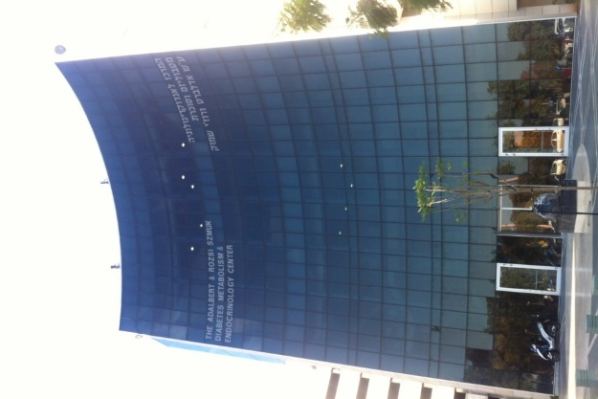
Establishing an Infrastructure for a Virtual Clinic for the Management of Patients with Type 1 Diabetes
Amir Tirosh, MD PhD
Institute of Endocrinology
Sheba Medical Center
December 2017

Slide 2
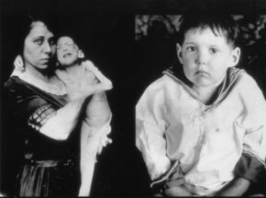
Initiating insulin therapy in the 1920s…
Before After

Slide 3
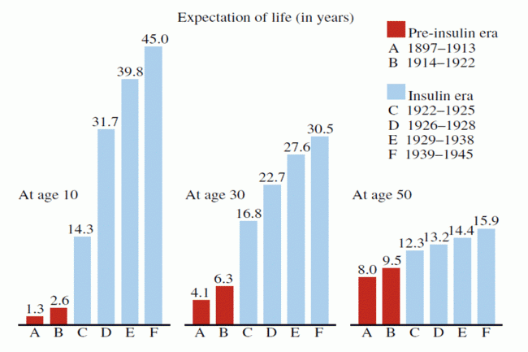
Dublin JI, 1951: Life expectancy by age of diagnosis

Slide 4
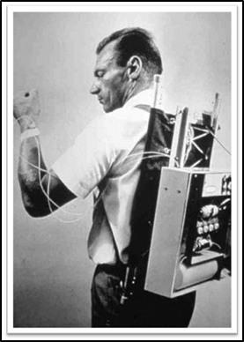
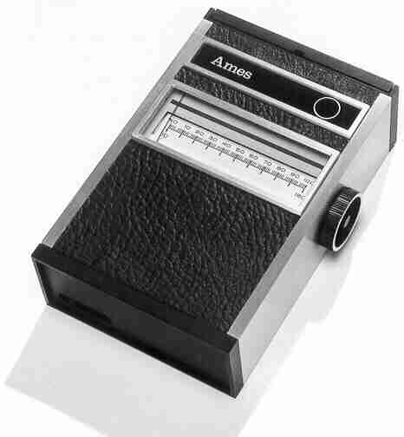
1963 - Dr. Arnold Kadish designed the first insulin pump to be worn as a backpack
First glucometer 1968
Notes:
First marketable pump available in 1976

Slide 5
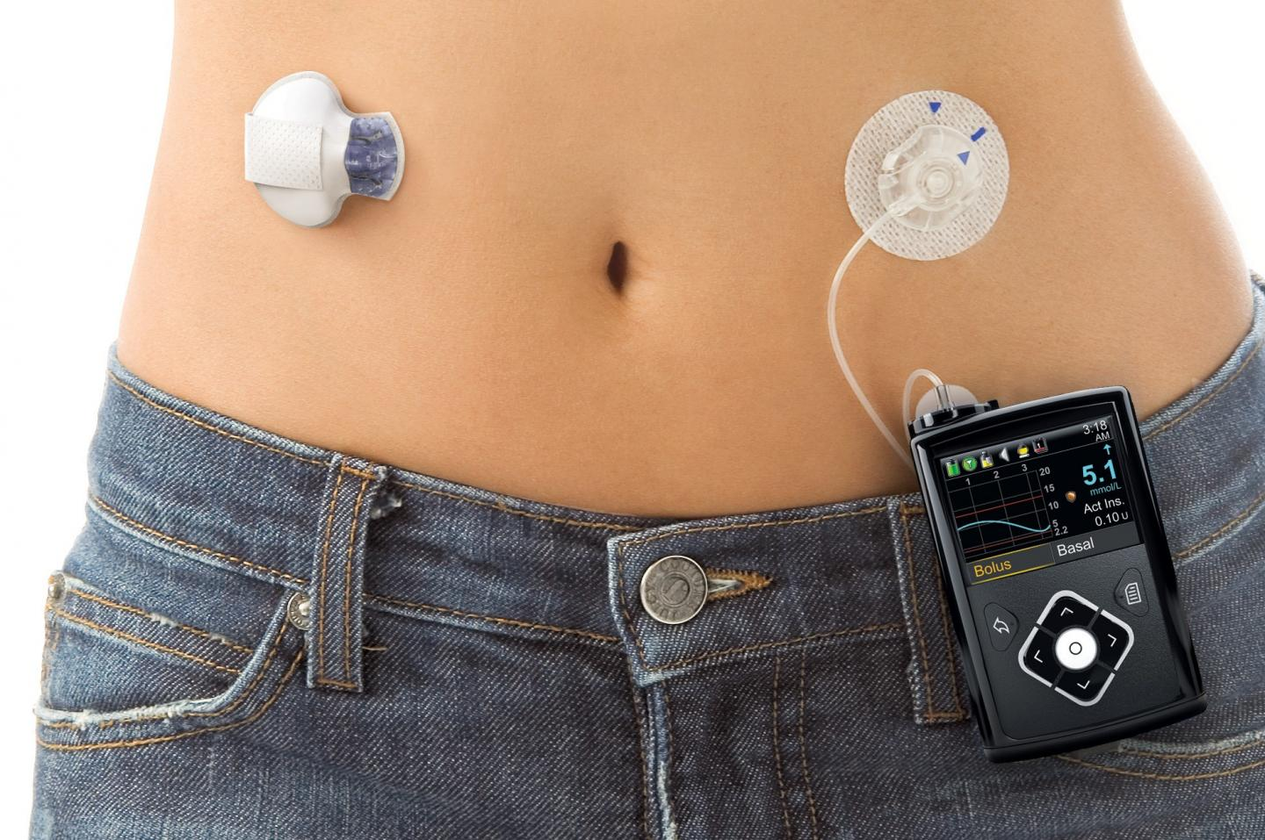
Hybrid closed-loop system - 2017

Slide 6
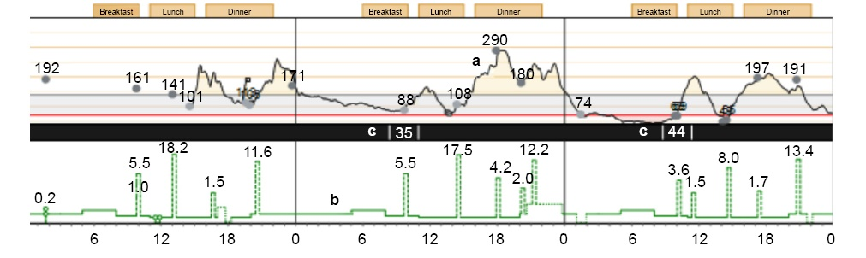
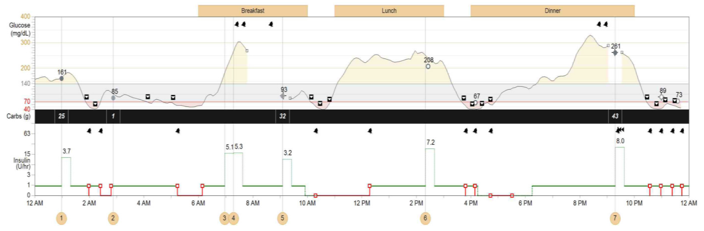
The amount of data collected at a single day using a glucose sensor and a pump…

Slide 7
In patients with inadequately controlled T1DM, sensor augmented pump therapy resulted in significant improvement in A1c, as compared with injection therapy.

Slide 8
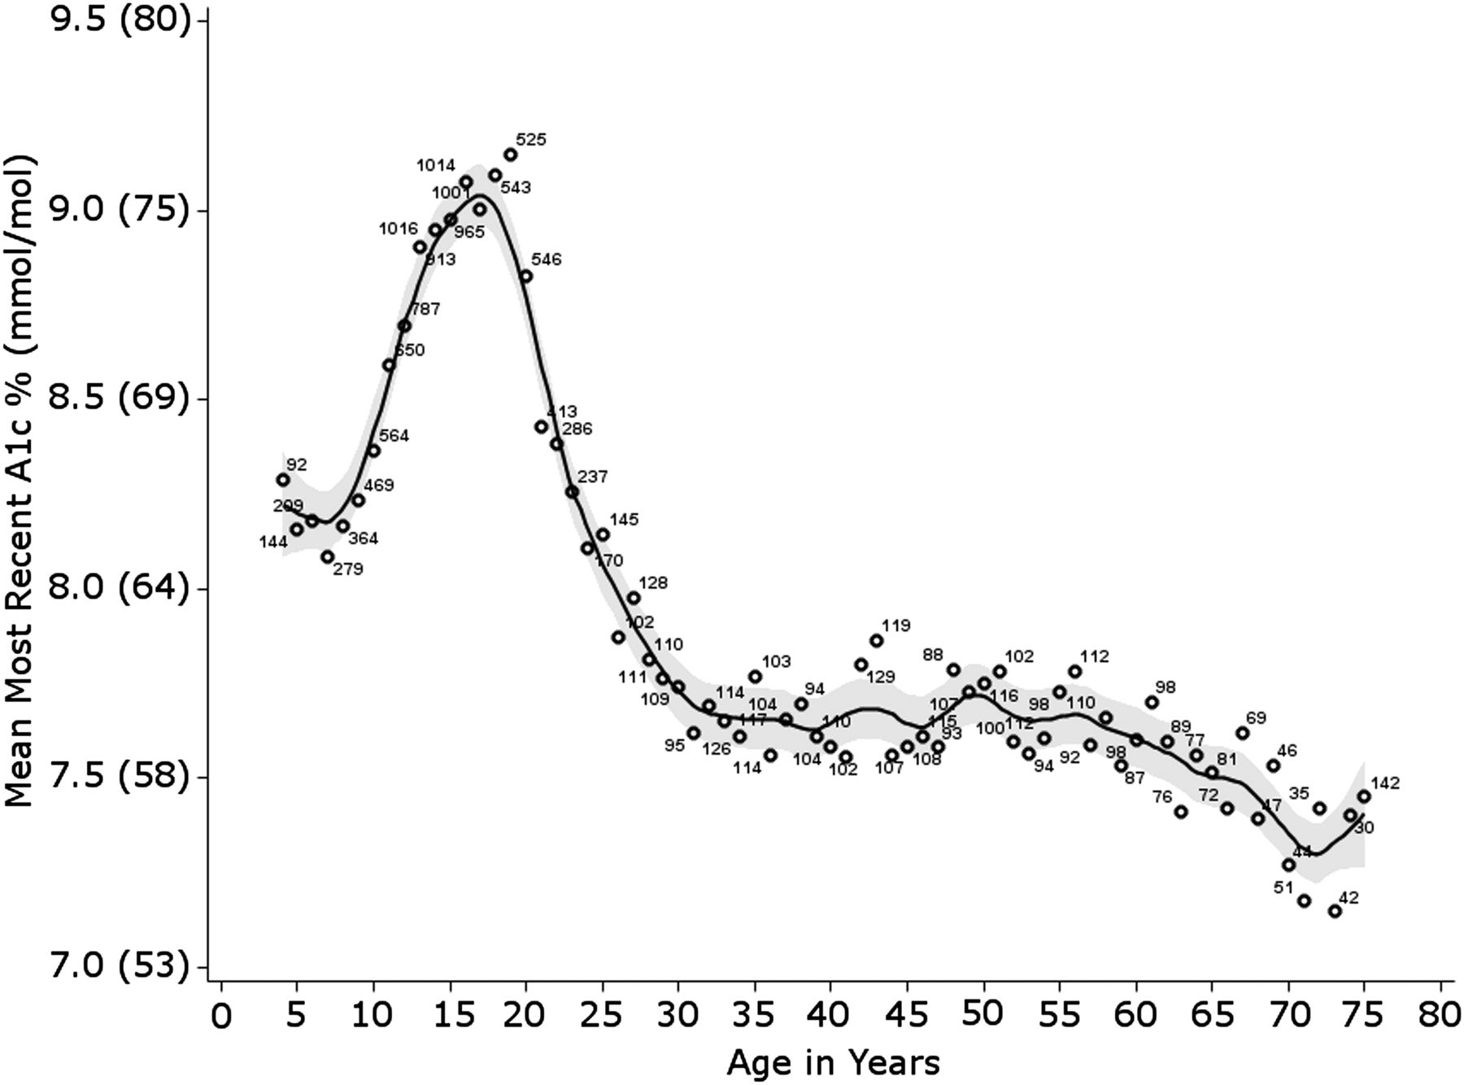

Mean HbA1c levels by age.
Diane K. Wherrett et al. Dia Care 2015;38:1975-1985
©2015 by American Diabetes Association
Notes:
Mean HbA_{1c} levels by age. Circles represent mean HbA_{1c} values for each year of age from 16,057 T1D Exchange registry participants. Participants aged <4 years were grouped as age 4 and those aged ≥75 years were grouped as age 75. Shaded area represents the 95% CI around smoothed line. Numbers next to circles are the N for each year of age. Reprinted with permission from Miller et al. (10).

Slide 9
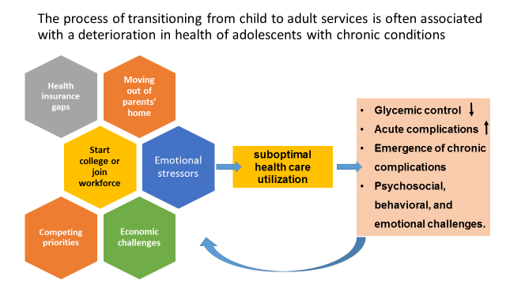

Slide 10
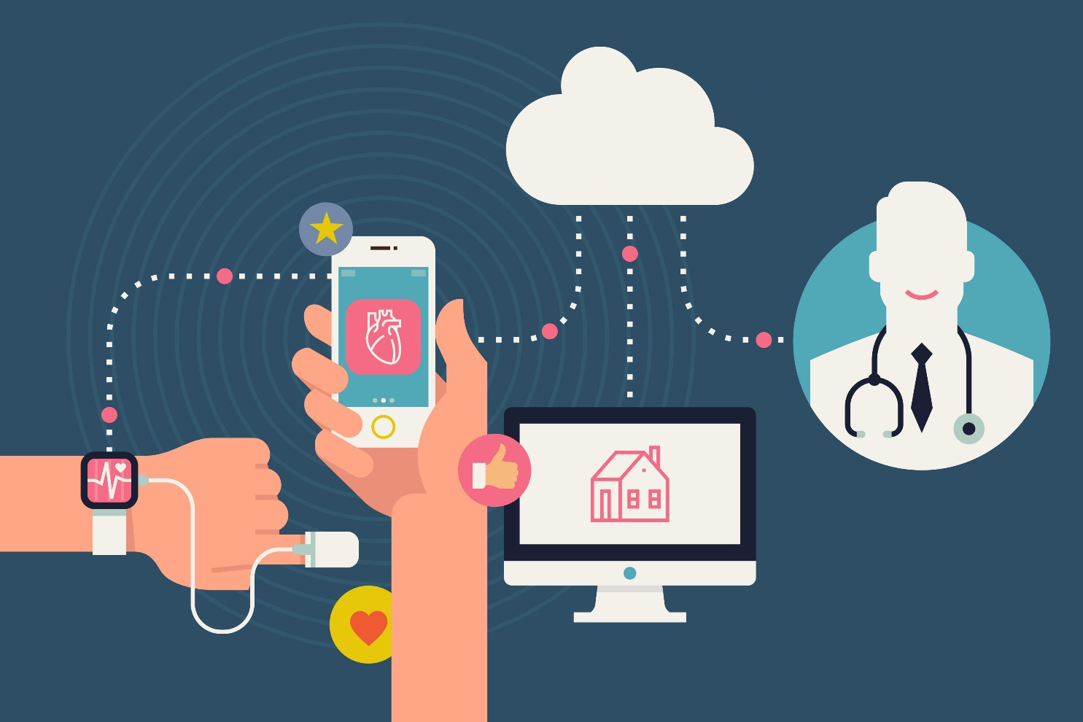
The unmet needs:
There is lack of specialized clinics for adults patients with T1DM in the community.
Advanced technologies are rapidly introduced into the market – lack of expertise among health care providers.
Electronic data (insulin pumps, CGMs) is ‘hand delivered’ to the clinic by patients while most adjustments to insulin regimens could be done online/remotely.

Slide 11
A virtual clinic for advanced technologies for T1DM patients
The Vision: A leading multidisciplinary virtual clinic for patients with T1DM, promoting an efficient clinical care, teaching and research in type 1 diabetes
Goals:
Delivering excellent clinical care for patients (nationwide and international) using a digital/virtual methodologies.
Improving ongoing follow-up and ‘just-in-time’ resources for patients with T1DM.
Providing most medical care at home – saving time and resources for patients.
Improving quality of life.
Training and teaching health care teams at all aspects of care in T1DM.
Using the rapidly growing database to promote R&D.

Slide 12
A model for virtual clinic for T1DM - Sheba

Slide 13
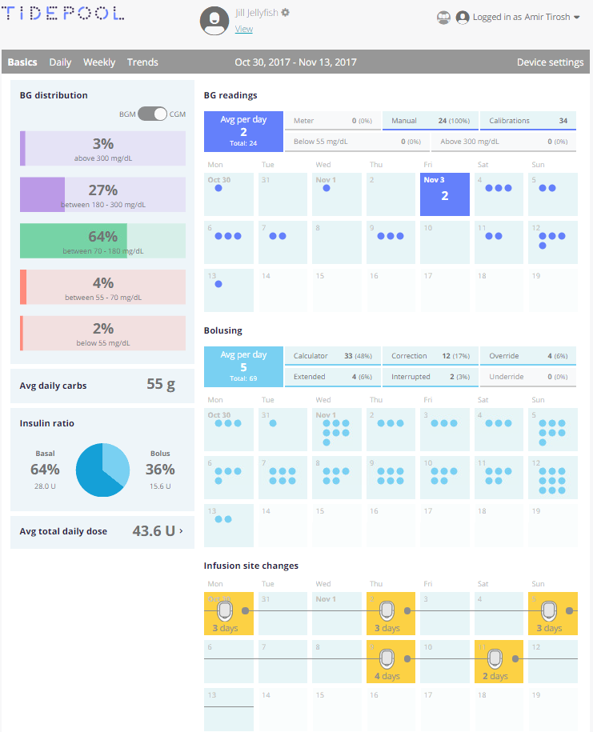

Slide 14
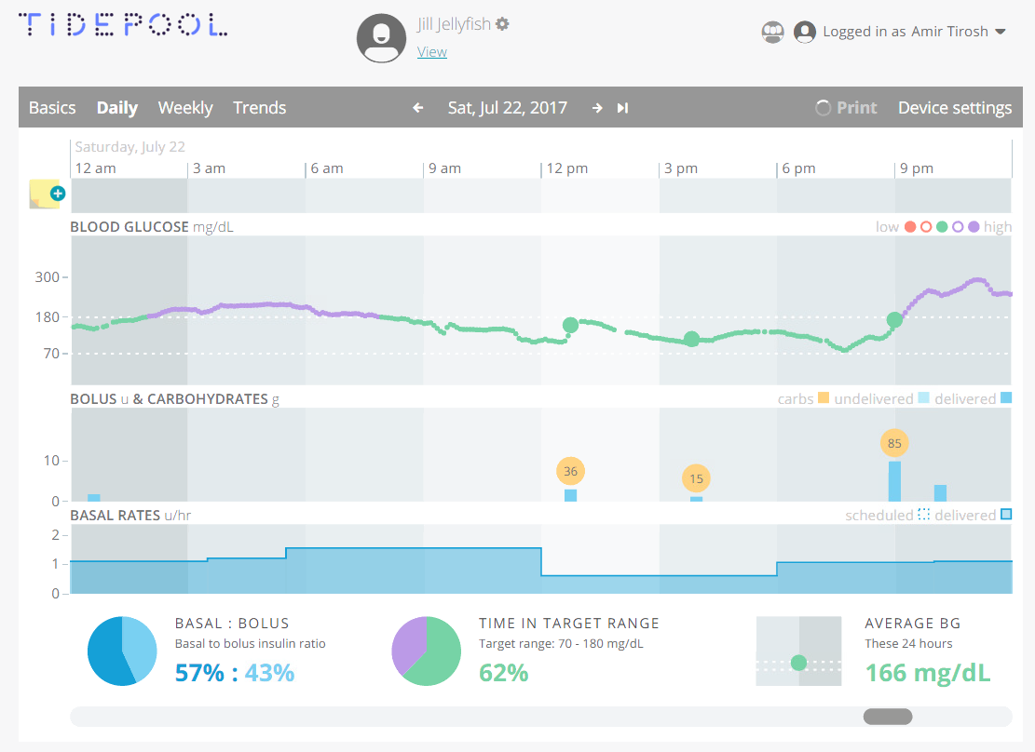

Slide 15
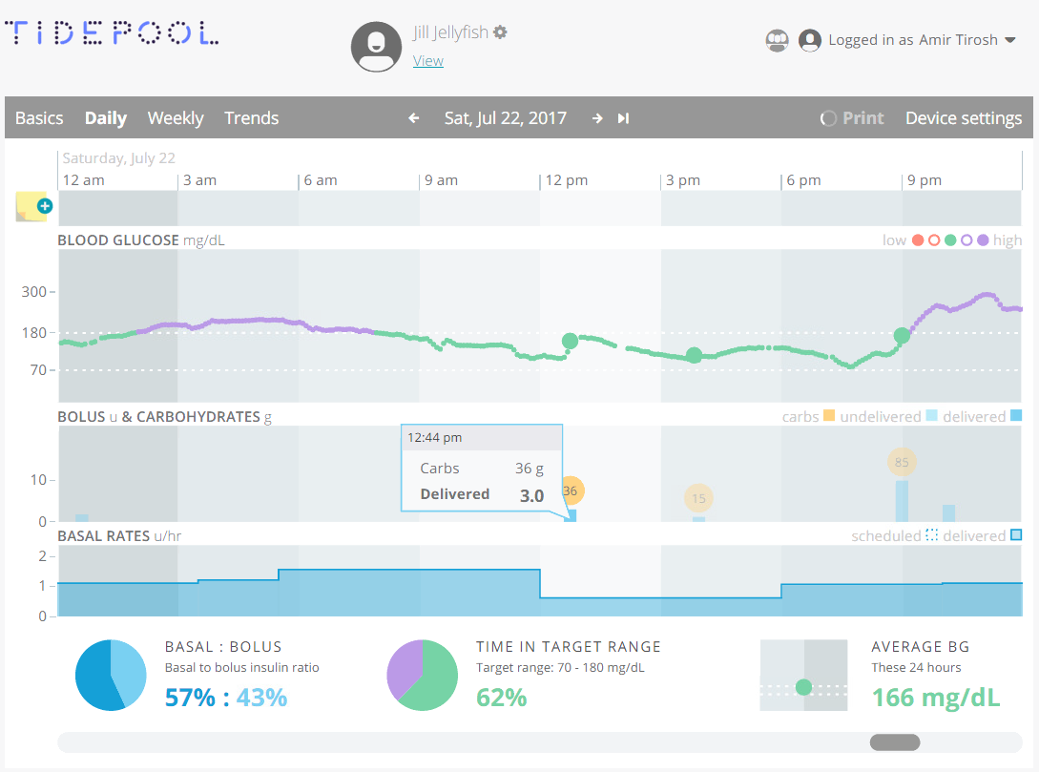

Slide 16
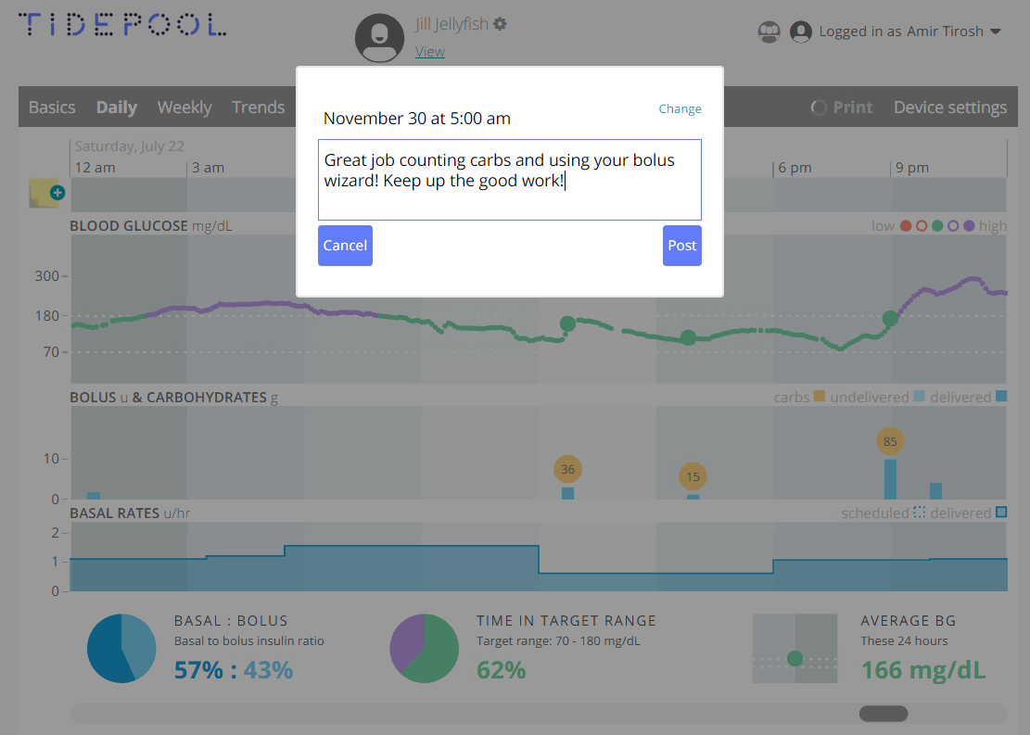

Slide 17
Plan
A pilot of 10 patients begins in December 2018.
About 100 patients will be enrolled during the first year.
All electronic data will be collected and analyzed.
Subjects will fill specific questionnaires to assess patient reported outcomes, quality of life and satisfaction.

Slide 18
The research aspects
Creating a database of all patients joining the virtual clinic.
Measuring the effects of virtual care on:
  Metabolic outcomes: HbA1c, ‘time in range’, rate of hypoglycemia, etc.
  Patient reported outcomes and quality of life
  Patient satisfaction
Outcome measures will be collected at baseline, 3 and 12 months of the intervention.

Slide 19

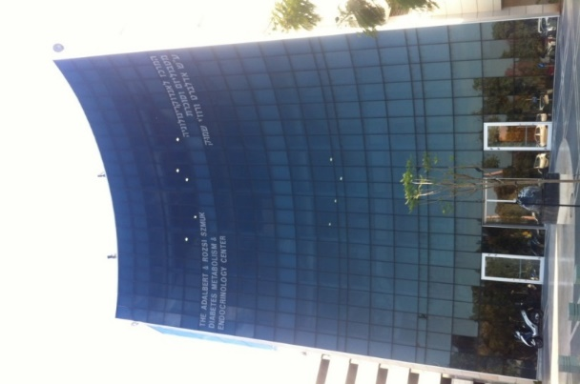
Thank you

