Slide 1
The Role of Q703K in the NLRP3 Gene in Patients with Auto-inflammatory Syndromes
Yael Brantz
Prof. Elon Pras
The Danek Gertner Institute of Human genetics
Notes:
להסביר ברמה בסיסית מה רצינו לעשות?
על הגן (לסיים במעורבותו ב-CAPS)
CAPS
פתוגנזה של המחלה
באיזה מחלות רצינו לבדוק? הסבר כללי
מה ההשערה? למה כן ולמה לא? אפשר להוסיף התייחסות ממאמרים קודמים שמופיעים במצגת
מה עשינו? כולל תמונות של החיתוך + מספרים עדכניים בטבלה לפי מוצא
מה המשמעות הסטטיסטית? מה היה הופך אותה לסיגניפיקנטית?
מסקנה
לציין שהתכנון היה גם על מחלות אימוניות נוספות כמו MS, אבל עק המסקנות לא המשכנו לכיוון הזה

Slide 2
What we’ll be talking about?
Auto-inflammatory diseases
CAPS =Cryopyrin-Associated Periodic Syndromes
NLRP3 gene
Mutation, VOUS and polymorphism
Our project: aim, results and conclusion

Slide 3
Auto-inflammatory disease
Introduced by McDermott and his colleagues in 1999 due to the discovery of mutations in TNF receptor.
In contrast to Auto-immunity which involves the adaptive immune system, auto-inflammation involves the innate immune system.
Notes:
Systemic autoinflammatory diseases (SAIDs), also called periodic fever syndrome, refer to a group of rare hereditary recurrent unprovoked inflammation without high titres of autoantibodies or antigen-specific T lymphocyte in the absence of infection
Disease expression in Autoimmunity is viewed as a defect of either B or T lymphocytes that are involved in adaptive immune activation.
Disease expression in autoinflammation is determined by cells of the innate immune system (neutrophils and macrophages or nonimmune cells).

Slide 4
Auto-imflammatory- single gene diseases
FMF
CAPS
HIDS (MKD)
TRAPS
DIRA
Majeed Syndrome
CRMO
PAPA
Schnitzler Syndrome
Blau (NOD2) (PGA)
NLRP12
CANDLE syndrome

Slide 5
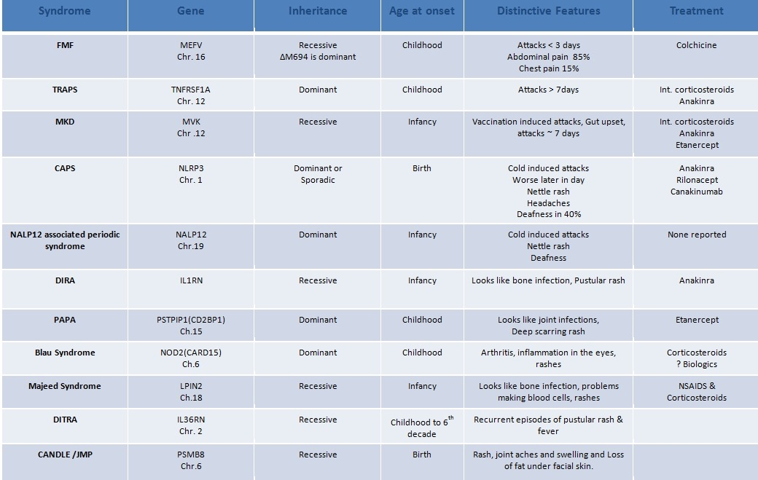

Slide 6
Auto-inflammatory disease
Diverse clinical manifestations -
Episodic fever
Joint pain
Skin rashes
Abdominal pain
Most auto-inflammatory diseases are Mendelian and present during childhood.
Israel -
FMF - 10,000
CAPS - 30
Notes:
The syndromes are diverse, but tend to cause episodic fever accompanied by joint pain, skin rashes, abdominal pain and may lead to chronic complications such as amyloidosis.
The most common and well known autoinflammatory disease is familial Mediterranean fever.

Slide 7
CAPS
Notes:
spectrum of autoinflammatory disorders:
Familial cold autoinflammatory syndrome (FCAS)
Muckle-Wells syndrome (MWS)
Neonatal onset multisystem inflammatory disorder (NOMID)
Once considered to be separate entities, these hereditary autoinflammatory disorders have been found to share a common genetic basis, pathogenesis and treatment, and are therefore now considered to be a continuous clinical spectrum

Slide 8
CAPS
Cryopyrin-Associated Periodic Syndromes - a rare disease
Cryopyrin - Is a family member of NOD-like receptors
Estimated to be between 1-10 cases per million
Caucasians seem to be more affected
No gender preponderance
In Israel there are approximately 30 known CAPS patients, with no ethnic predilection
The true prevalence is probably higher
Notes:
Caucasians seem to be more affected more than other races (FCAS/MWS)
The true prevalence is probably higher (underdiagnosis/misdiagnosis)

Slide 9
Notes:
Nonspecific systemic inflammation:
ESR↑ CRP ↑ SAA ↑ WBC ↑
Anemia and PLT ↑
Patellar hypertrophy/overgrowth and epiphyseal overgrowth on x rays
Elevated CSF pressure and pleocytosis in cases with aseptic meningitis

Slide 10
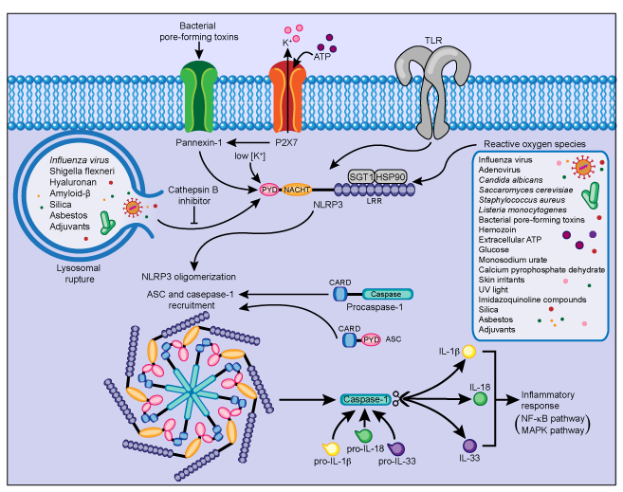
NLRP3 Gene

Slide 11
Genetics and Pathogenesis
AD or de-novo GOF mutations in the NLRP3 gene
NLRP gene encodes NALP3 (=cryopyrin)
Cryopyrin is a family member of the intracellular NOD-like receptors (NLR)
These receptors are pattern recognition receptors (PRRs) that recognize different danger-associated molecular pattern molecules (DAMPs) and pathogen-associated molecular pattern molecules (PAMPs)
All NLRs contain a NACHT domain that enables them to aggregate and to oligomerize
Upon activation, NALP3 oligomerizes and recruits other proteins such as ASC and caspase-1, creating a multi-protein assembly called the inflammasome.

Slide 12
Mutation
VOUS
Polymorphism

Slide 13
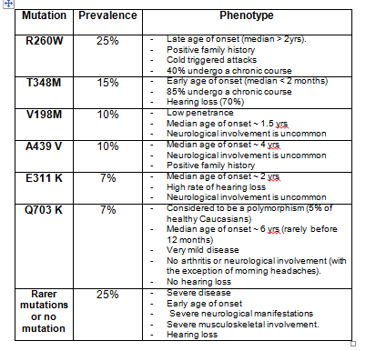
Notes:
Diagnosis is determined by genetic testing for NRLP3 mutations.
Some mutations correlate with phenotypes and can predict outcome.
Diagnosis should be suspected in any patient with recurrent episodes of fever, urticaria, unexplained systemic inflammation, a positive family history, and early onset of symptoms.
possible functional effect on the inflammasomes
Q - glutamine K - lysine

Slide 14
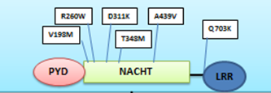
Q703K - Benign polymorphism or a disease causing mutation?
Mutation:
FCAS like clinical phenotype in small case series of Q703K carriers
Associated with increased IL-1β secretion
Somewhat increased prevalence in cases>controls (7% vs. 3%-5%)
Polymorphism :
Located outside the NACHT domain
Same prevalence in case and controls according to other studies.
Notes:
The NACHT domain is an evolutionarily conserved protein domain.

Slide 15
Background
In the last 3 years 90 patients from the auto-inflammatory clinic were checked for mutations in the NLRP3 gene - 14 of them were found to carry the Q703K allele (15.5%)
Most of the patients suffered from symptoms within the spectrum of CAPS (FCAS(
Notes:
90 patients suspected of harboring a systemic autoinflammatory disease (SAID) were referred to our center for genotyping between 2012-2015. 14 patients (15.5%) were found to carry the Q703K allele compared to 22 of 130 (16.9%) healthy, ethnic matched controls.

Slide 16
Amyloidosis | Deafness | Rash | Conjuctivitis | Arthralgia | Fever | Cold induced
 |  | √ | √ | √ | √ | √ | 1
 |  | √ |  | √ | √ | √ | 2
 |  | √ |  | √ | √ |  | 3
 |  | √ |  |  | √ |  | 4
 |  |  |  |  |  |  | 5
 |  | √ |  |  | √ |  | 6
 | √ | √ |  | √ |  |  | 7
 |  | √ |  |  | √ |  | 8
 |  | √ |  |  | √ |  | 9
 |  |  |  |  | √ |  | 10

Slide 17
AIM
To determine whether Q703K is over represented among patients referred to the auto-inflammatory laboratory for evaluation.
If this variant has clinical significance it should be over represented in the patients compared to controls
Notes:
To describe the frequency and clinical phenotype of subjects in whom the Q703K allele was found, and to compare it with the frequency of the allele among ethnic matched healthy controls.

Slide 18
Methods (1)
Creating a control group which will fit the ethnic origin of the positive patients and check the frequency of the Q703K missense change.

Slide 19
Methods (2)
Collect 10 control DNA’s for each positive patient in concordance with his/her ethnic origin
All together 130 samples
Check them for the Q703K change by preforming PCR and restriction enzyme assays
Perform a statistical analysis

Slide 20
Q703K Restriction Assay

Slide 21
Results
 | Controls | Positive | Negative
Ashkenazi | 75 | 14 | 61
Arab | 17 | 2 | 15
Yemeni | 10 | 2 | 8
Bukhari | 5 | 0 | 5
Iraqi | 9 | 0 | 9
Moroccan | 14 | 4 | 10
Total | 130 | 22 | 108

Slide 22
Results
 | Negative | Positive | Total | Percentage
Auto-Inflammatory patients | 76 | 14 | 90 | 15.5%
Healthy Controls | 108 | 22 | 130 | 16.9%
Total | 184 | 36 | 220
p-value (two-tailed) 0.8543

Slide 23
Conclusions
The similar carrier rate of the NLRP3-Q703K variant among patients with manifestations of an Auto-inflammatory disease and healthy controls confirms that this variant is a polymorphism and probably irrelevant in contributing to the clinical phenotype.

Slide 24
Thank you

Slide 25
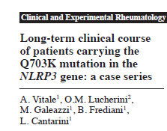
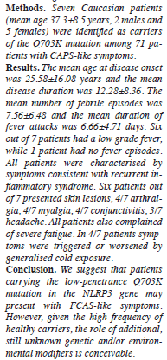
7/71 patients screened for CAPS
Low penetrance mutation
Late disease onset (25 yrs)
On-demand steroid responsive

Slide 26
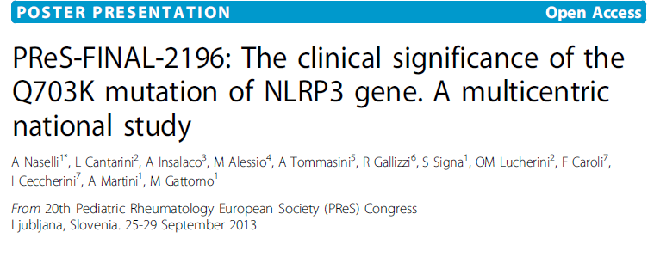
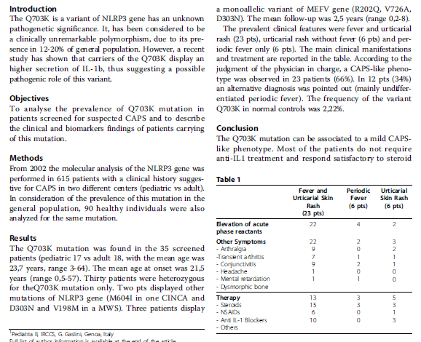
35/615 (6%) patients screened for CAPS
66% - CAPS like phenotype
34% Undifferentiated periodic fever

Slide 27
Conclusion- 1
Israeli subjects carrying the Q703K mutation may present with FCAS-like clinical manifestations or (more commonly) manifestations of an undifferentiated autoinflammatory disorder thus suggesting that this allele acts as a low penetrance mutation rather than a polymorphic variant

Slide 28
Conclusion- 2
Age of onset, clinical manifestations, severity, periodicity and response to therapy are highly variable and suggest contribution of additional modifier genes and/or environmental factors
Q703K
MVK
MEFV

Slide 29
CINCA (NOMID) | MWS | FCAS | Feature
High | Medium | Low | Severity
None | None | Cold exposure | Trigger
Variable: Usually rare fever and daily rash | Variable: Rare to daily | Usually daily | Frequency
Urticaria-like | Urticaria-like | Urticaria-like | Rash
Arthralgia/arthritis/ Overgrowth arthropathy | Arthralgia/arthritis | Arthralgia | Joint involvement
Chronic aseptic meningitis (headache, possible mental delay) | Headache | Headache | Neurological involvement
Uveitis, papillary edema, optic neuritis | Conjuctivitis/uveitis | Conjuctivitis | Eye involvement
Frequent (>60%) | Frequent (60-70%) | No | Deafness
Frequent (25%) | Frequent (25%) | No | Amyloidosis
De novo (typical) or AD (rare) | AD (typical) or de novo (rare) | AD | Inheritance
Notes:
FCAS is the mildest CAPS disorder, in which exposure to mild cold results in a systemic inflammatory response including fever, an urticarial rash, conjunctival injection and arthralgia.
Symptoms develop in over 90% in the newborn period.
Symptoms may improve gradually after a few hours, usually resolving within a day.
Even in the absence of any challenge, patients may experience daily rashes, fatigue, headache, and myalgias and conjunctivitis.
Secondary amyloidosis is uncommon.
MWS is an intermediate phenotype characterized by chronic or intermittent episodes of fever, headache, urticarial rash, arthralgias or arthritis, with no specific trigger.
Patients also suffer from a progressive sensorineural hearing loss and secondary amyloidosis
NOMID is the most severe phenotype of CAPS characterized by chronic rash, MSK involvement, CNS symptoms, progressive sensorineural deafness and ocular involvement with typical morphological features of short stature, head enlargement, saddle back nose and short and thick extremities with clubbing of fingers. Mortality is high.

Slide 30
