Slide 1
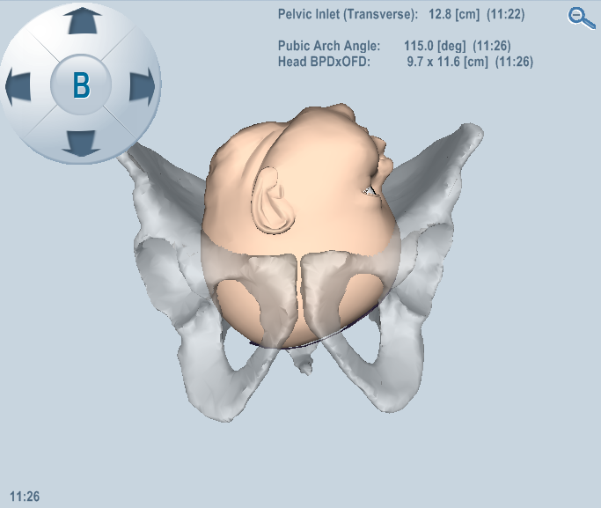
Ultrasound parameters assessment of nulliparae in singleton pregnancy : correlation to delivery mode
Yisca.P Cohen, 3rd year Medical student in the 4-year program
Supervised by: Dr. Yinon Gilboa
Department of Obstetrics and Gynecology,
Sheba Medical Center, Tel-Hashomer, Israel

Slide 2
Vaginally, or Cesarean section?

Slide 3
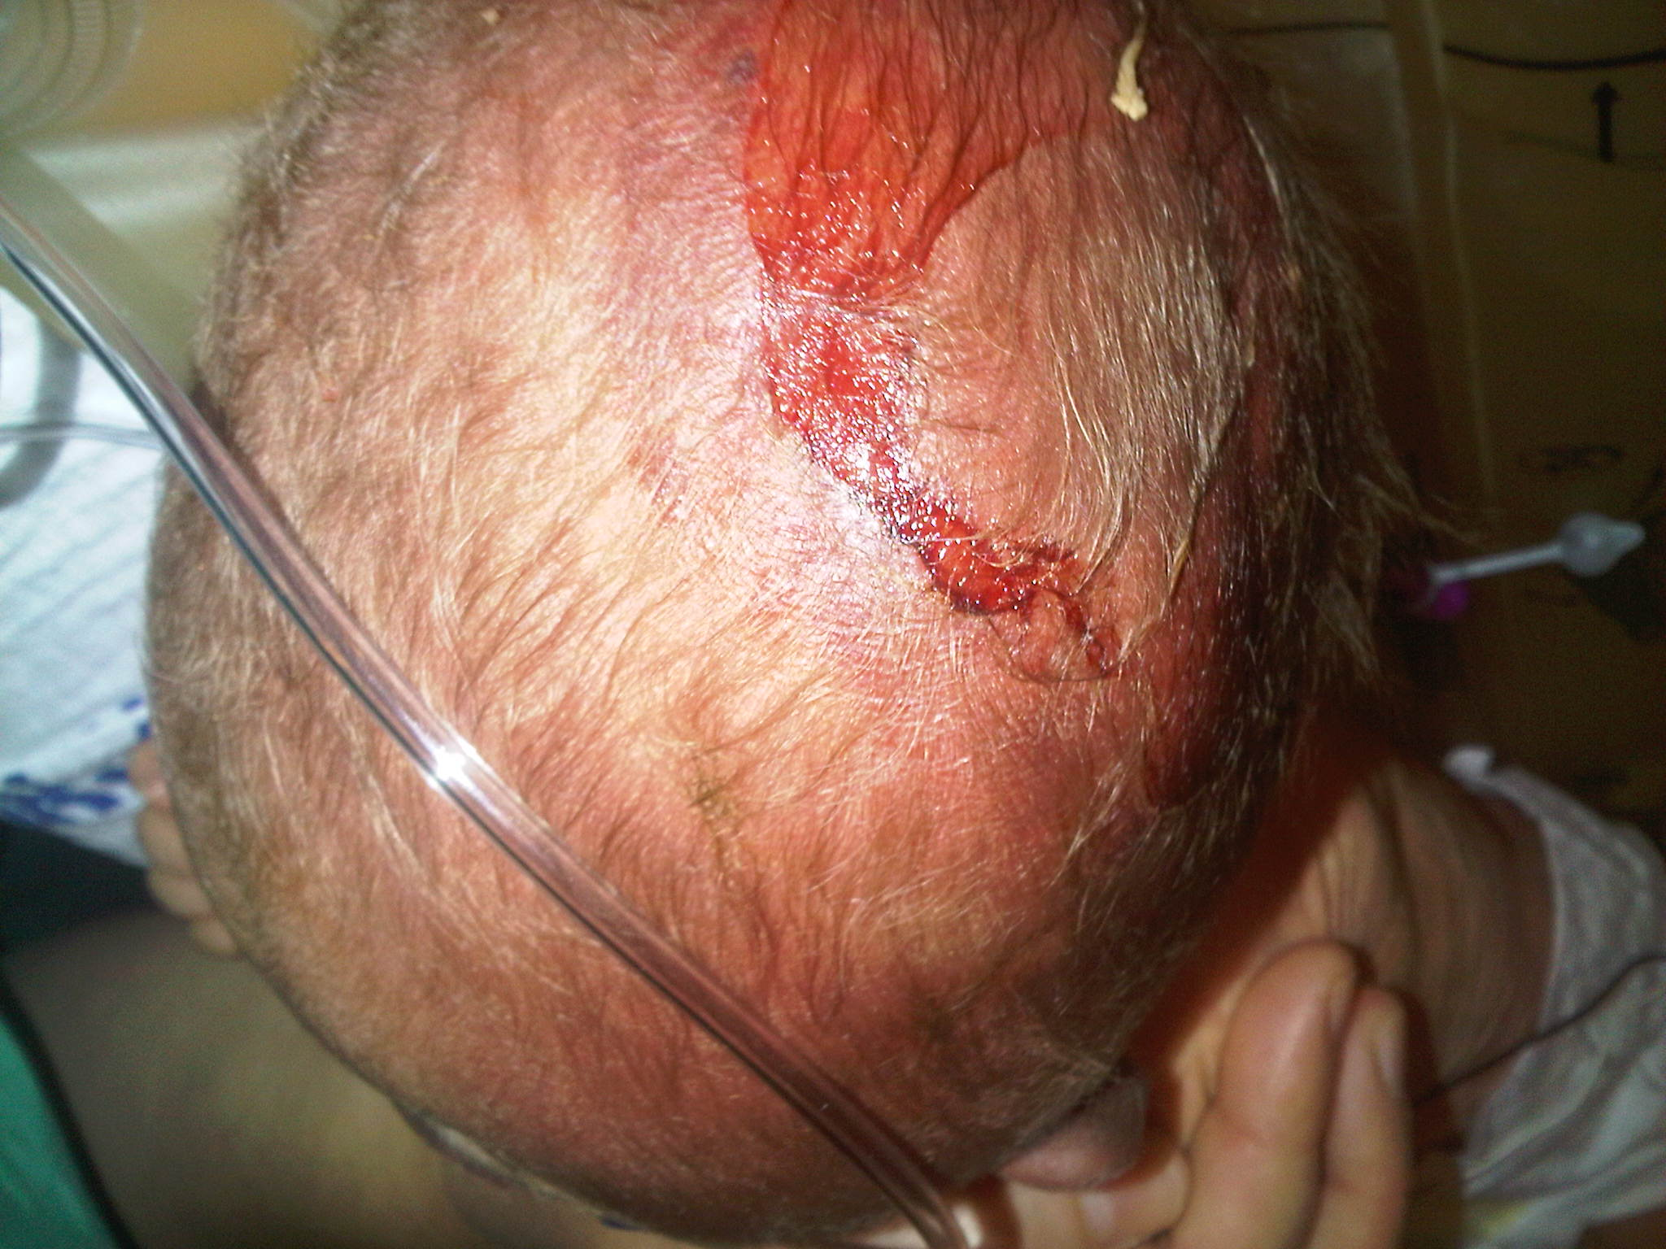
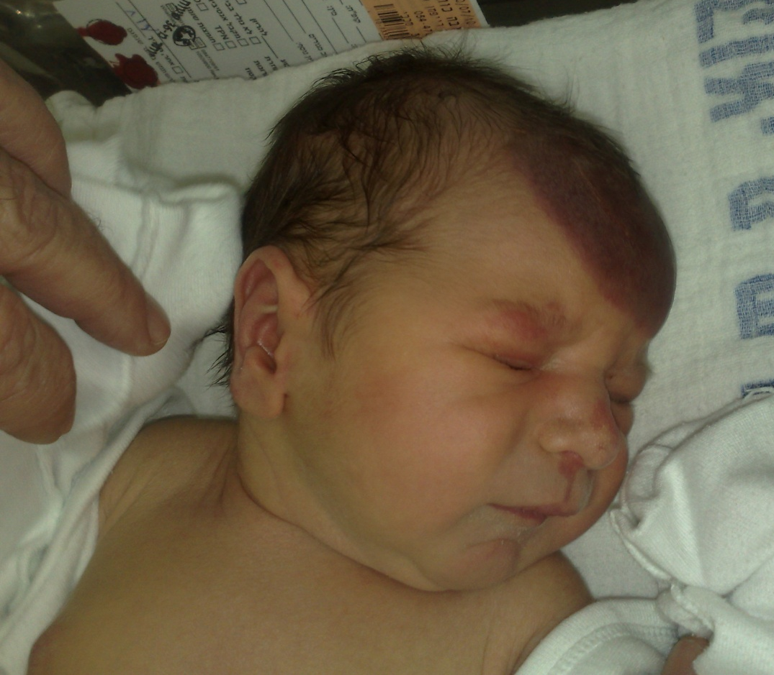
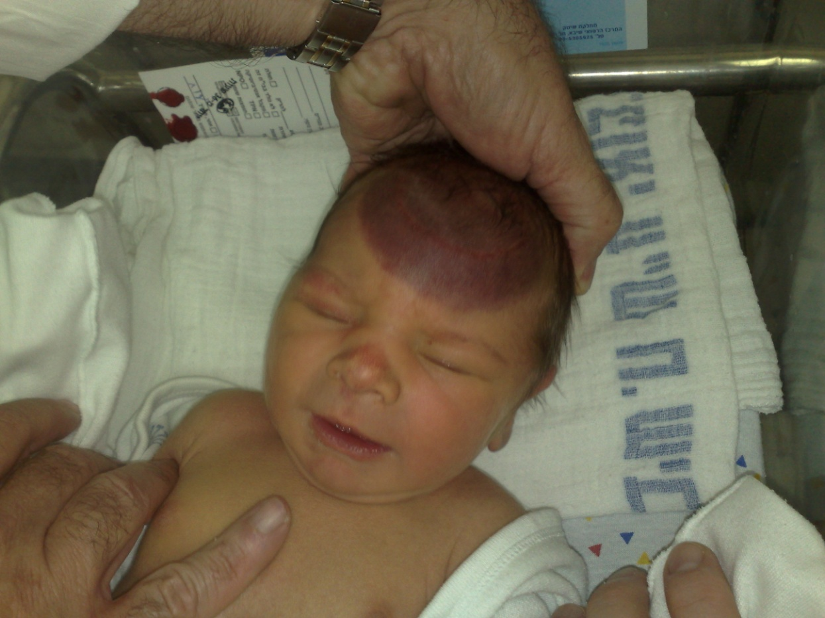
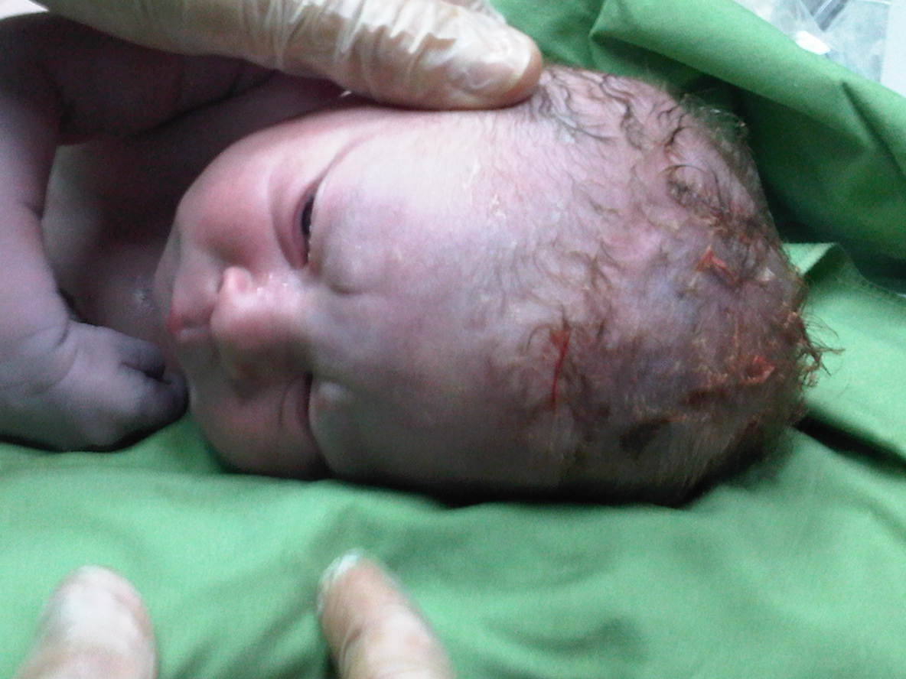
Failed operative delivery
Neonatal head trauma

Slide 4
The normal delivery
For a successful delivery, there should be a:
Power - uterine activity
Passenger - fetus
Passage - maternal pelvis
An abnormal parameter will affect the success of vaginal delivery

Slide 5
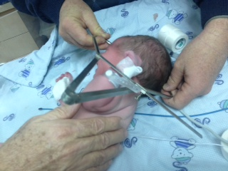
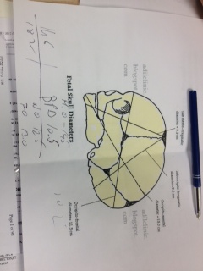
Fetopelvic proportion
The relationship between the fetal head size and the pelvic is important for passing of the fetus through the birth canal.

Slide 6
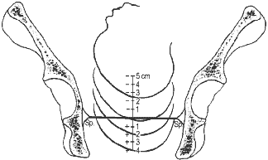
Fetopelvic proportion
We estimate the progression of labor by the relationship of the fetal head to the level of the ischial spines.(midpelvis)

Slide 7
CPD- Cephalopelvic Disproportion
Abnormal delivery Dystocia-
Dystocia means difficult labor and is characterized by abnormally slow labor progress.

Slide 8
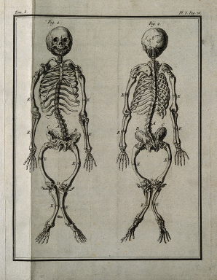
CPD- Cephalopelvic Disproportion
The term CPD was coined in the 19th century when the disparity in size between the fetal head and the maternal pelvis largely resulted from pelvic contracture due to rickets.
Caldwell WE et al Am J Obtet Gynecol 1934
Notes:
היום המצב הכי קרוב ל-CPD זה פתיחה מלאה עם ראש גבוה.

Slide 9
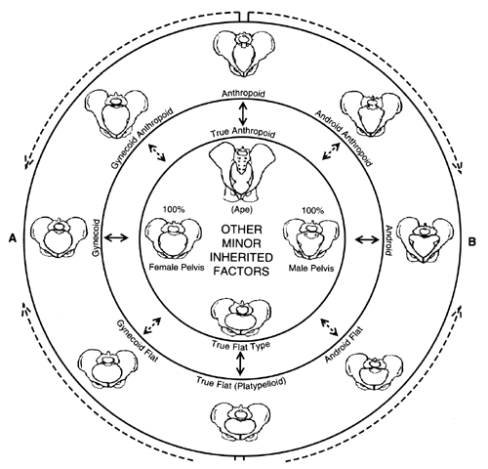
The oldest evidence of obstructed labor can be found in the remains of Queen Henhenit, the wife of Egypt's ruler around the time of 2050 BC.
Prof. Douglas E. Derry, (1923) examined her mummified remains and revealed a large vesico-vaginal fistula in a markedly contracted pelvis.

Slide 10
CPD- Cephalopelvic Disproportion
CPD occurs in 8% of deliveries in women without a history of prior Cesarean section
Sheba Medical Center
CPD is still responsible for 8% of maternal deaths worldwide
World Health Organization.
The World Health Report 2005:
Making every mother and child count

Slide 11
CPD
Complications:
Prolaps of umbilical cord
Prolong labor
Infection .
Tears.
PPH.
Fistula

Slide 12
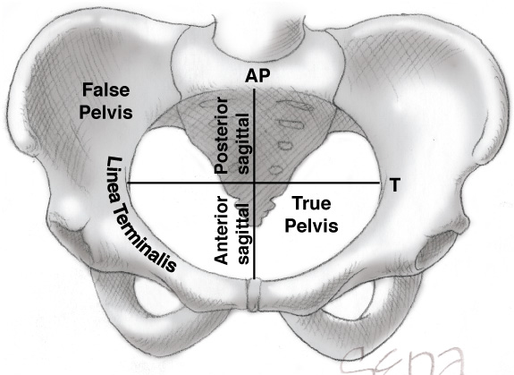
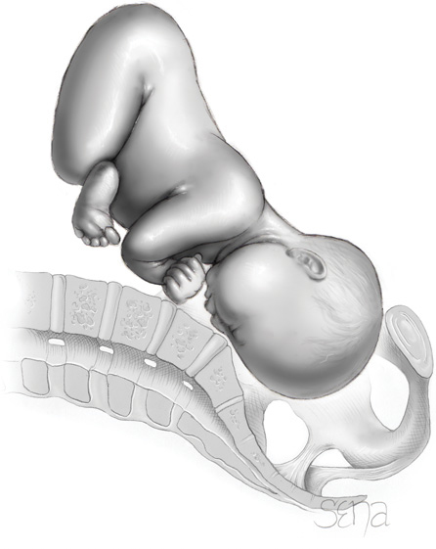
Fetopelvic Dysproportion (CPD)
CPD- Diminished pelvic capacity
Excessive fetal size
Combination of both

Slide 13
Fetopelvic Dysproportion (CPD)
CPD- Diminished pelvic capacity
Excessive fetal size
Combination of both
Notes:
Cephalo-Pelvic Disproportion (CPD) הוא מונח ששימש בעבר לדיסטוציה.

Slide 14
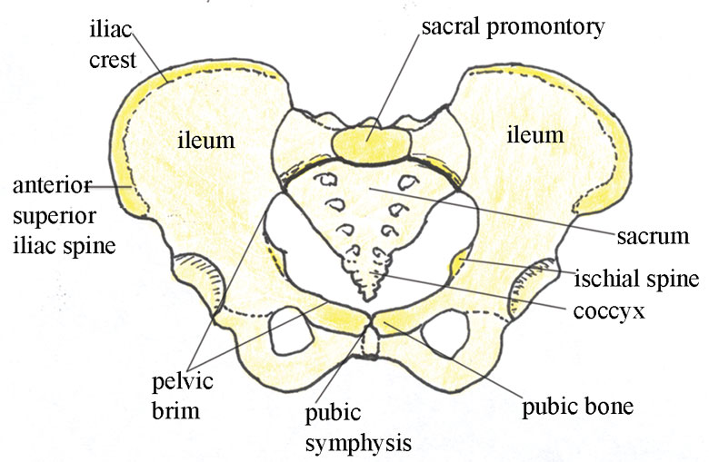
Pelvic capacity
There are three locations that pelvis can be narrow :
Inlet
Midpelvis
Outlet

Slide 15
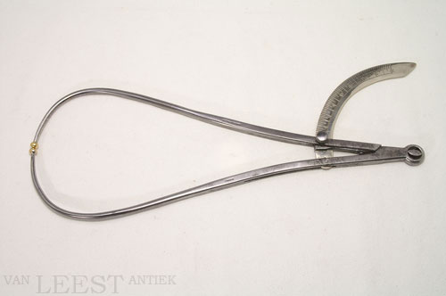
Created obstetrics as scientific discipline
Laid the basis of pelvimetry using external and internal pelvic calipers
Jean-Louis Baudelocque 1745 – 1810
William Smellie 1697–1763

Slide 16
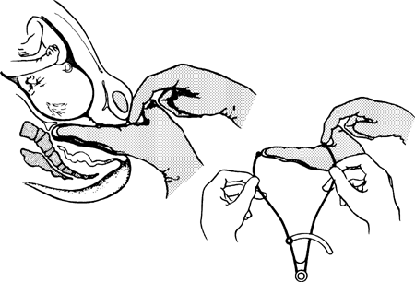
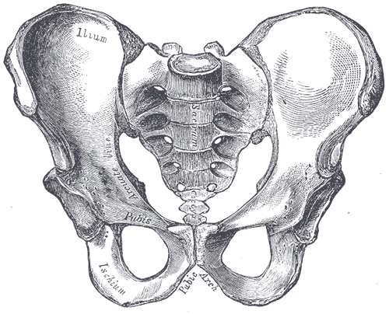
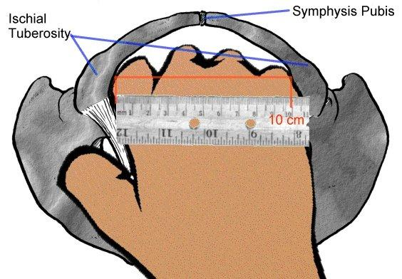
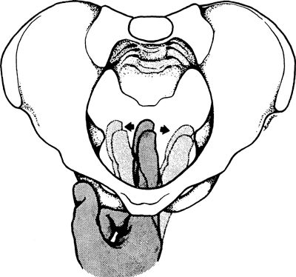
Clinical Assessment of Pelvic Dimensions
Pubic arch
Estimation of diagonal conjugate – pelvic inlet measurement
Estimate interspinous diameter - midpelvis
Estimate ischial tuberosities - outlet

Slide 17
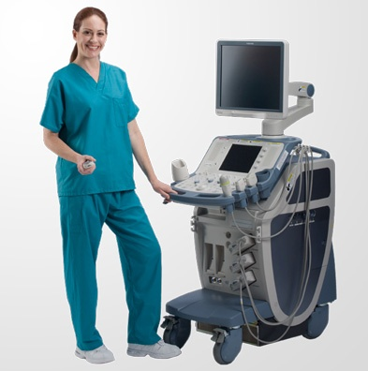
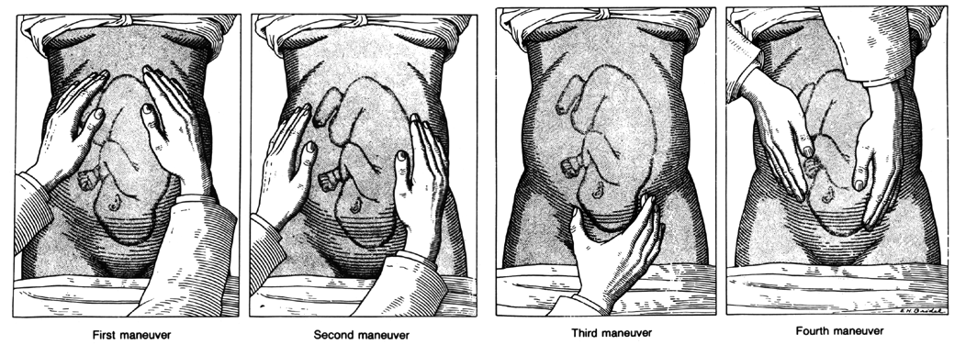
Clinical Assessment
“Hands-on” skills : Leopold’s maneuvers, fetal weight estimation, and clinical pelvimetry have received less emphasis in educational programs and practice.
Imaging vs. Imagination

Slide 18
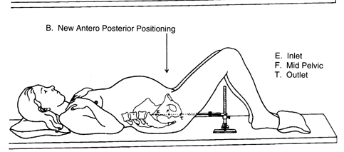
Imaging Assessment of Pelvic Dimensions
X-ray pelvimetry
Computed Tomography
The Cochrane collaboration 2009
Ferguson JE Clin Obstet Gynecol 2000
Lenhard M S et al
Eur J Radiology 2010
Disadvantages:
Unable to assess the impact of the maternal soft tissue of the vaginal walls on the pelvic capacity.
Fetal exposure to ionizing radiation

Slide 19
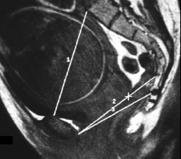
Imaging Assessment of Pelvic Dimensions
Magnetic Resonance
No ionizing radiation
MRI was not a significant
improvement over previously
described pelvimetric techniques
Zaretsky MV et al Obstet Gynecol 2005
Disadvantages:
Cost , time , technical comp.
Claustrophobia

Slide 20
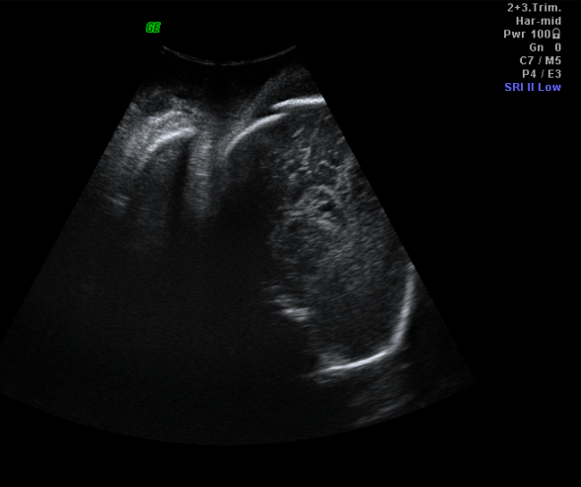
Shall we stay with PINARD ?
“The fetal head is the best pelvimeter”
Adolphe Pinard (1844 – 1934)
Notes:
לא כל כך הצליחו להוכיח שמדדים הללו יכולים לנבא. העובר כן יכול לנבא. אם יש אננגמנט- סימן ש. עבר את האינלטBPd

Slide 21
A new technique combining clinical examination & technology
With the advantage :
Take into account not only bony pelvis but maternal soft tissue of the vaginal walls
No discomfort
Objective information about Head position & Station
Fast evaluation (2 minutes)
No radiation
Low cost

Slide 22
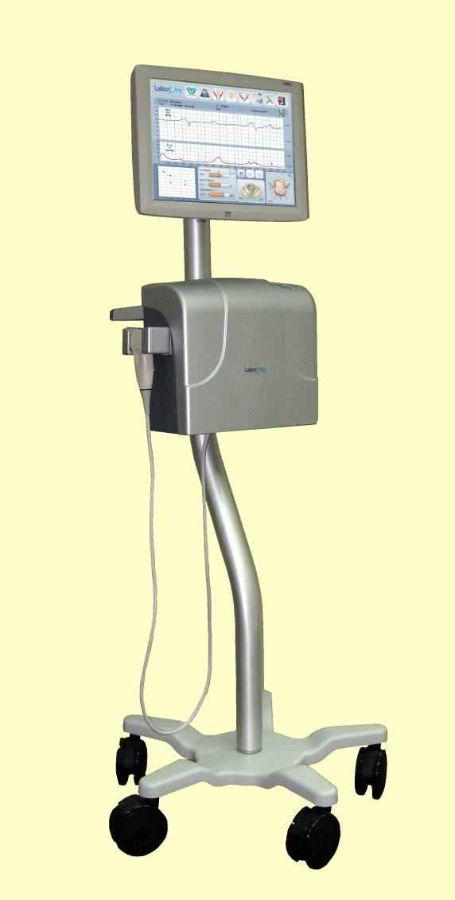
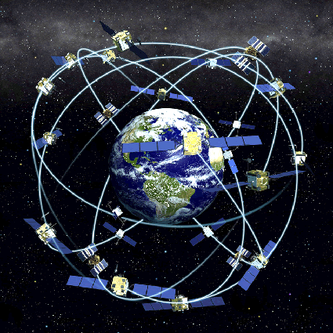
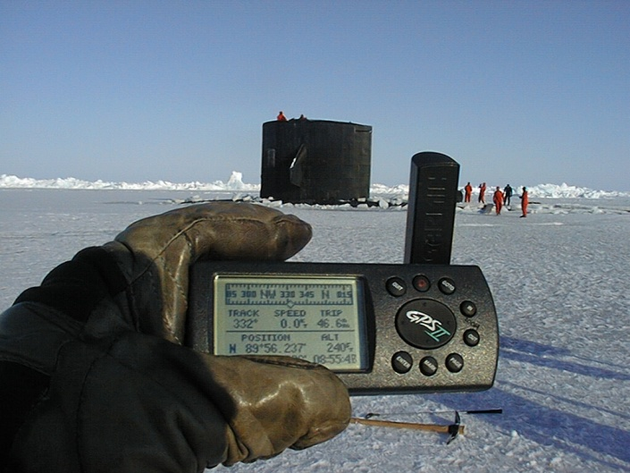
The LaborPro Magnetic Position Tracking System
Transmitter
sensor
Designed for recording and tracking the spatial location of the sensor tip
Notes:
עכשיו הציג עבודה שנעשתה ע"י גלבוע במכשיר מתוכם המבוסס על גי פי אס.

Slide 23
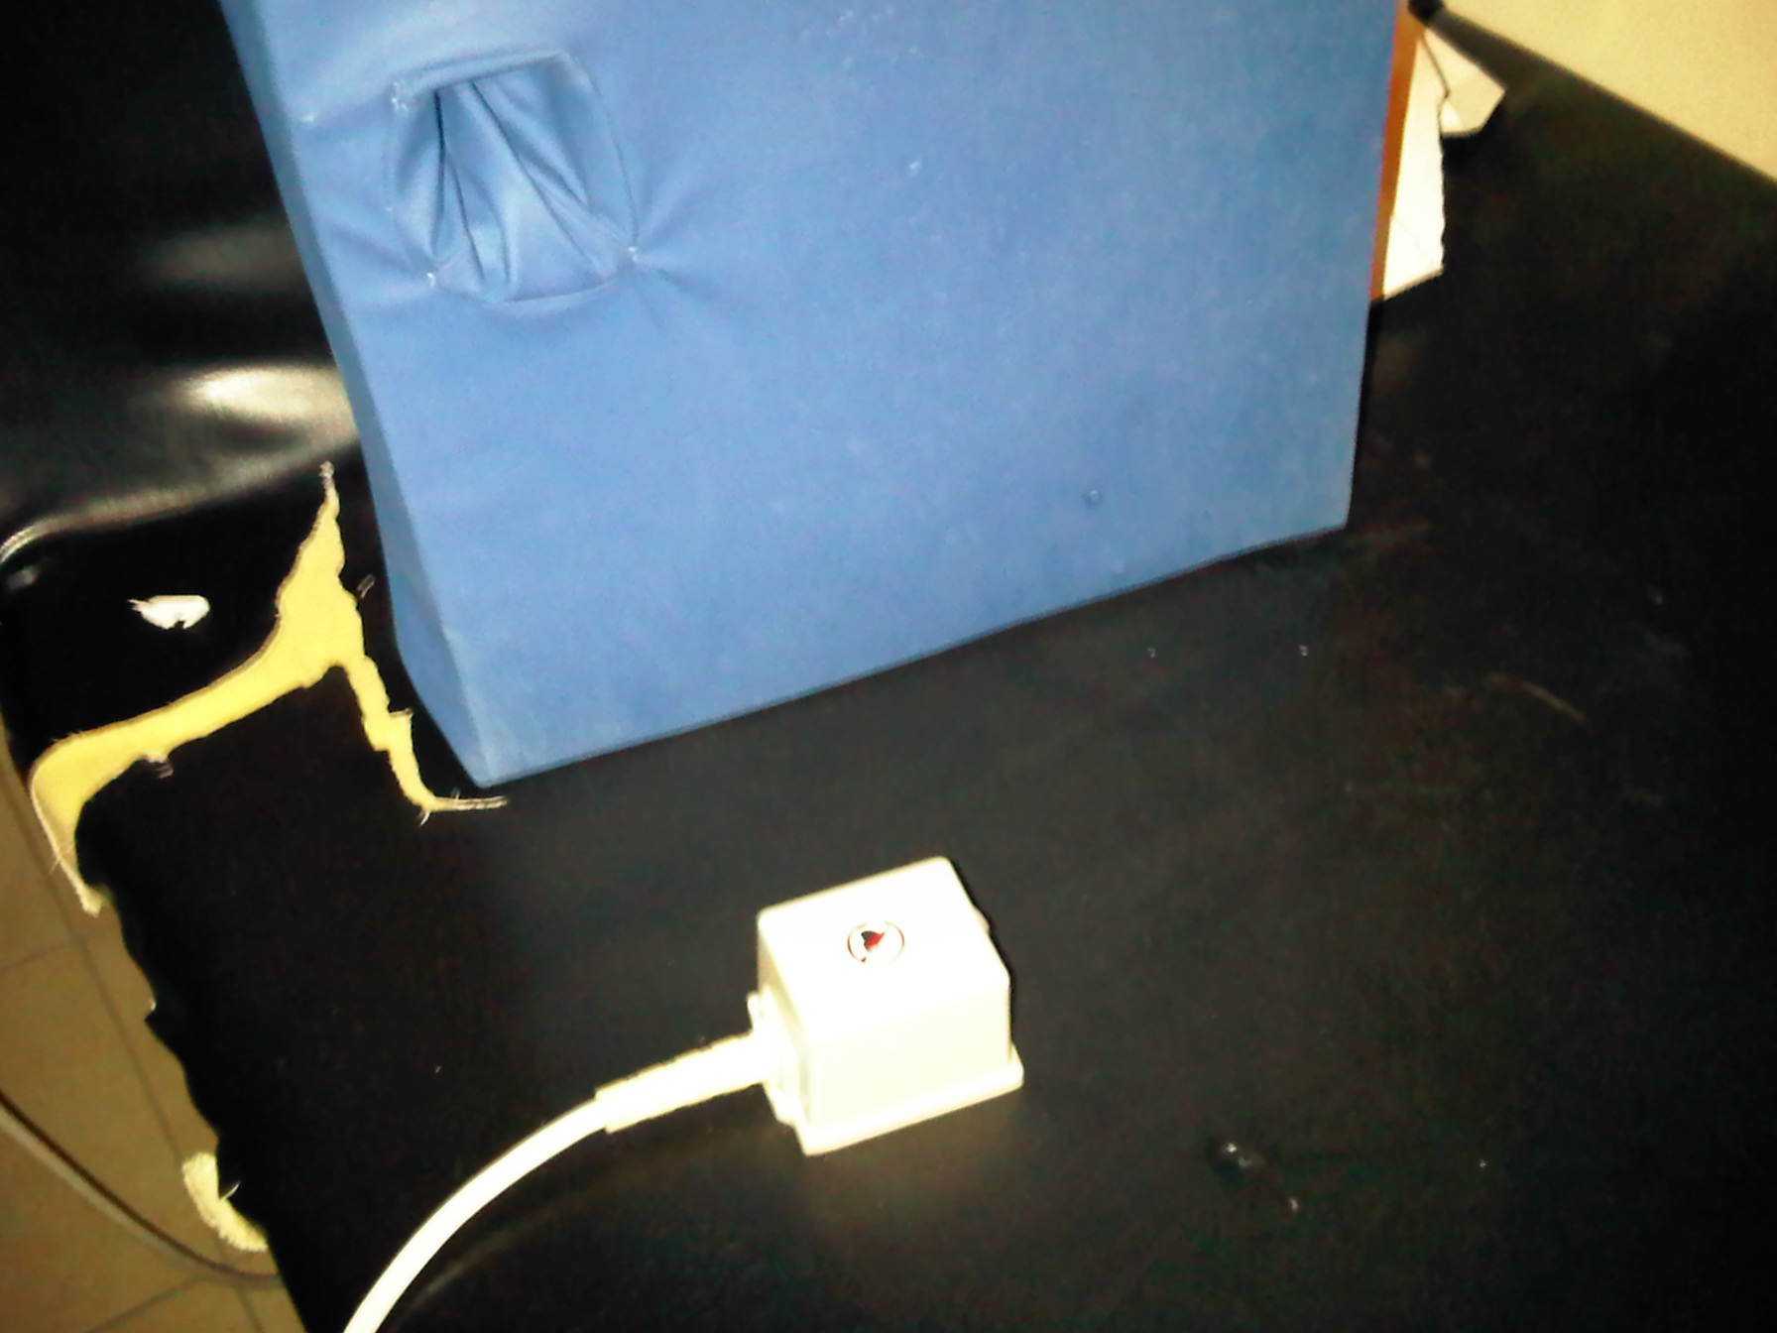
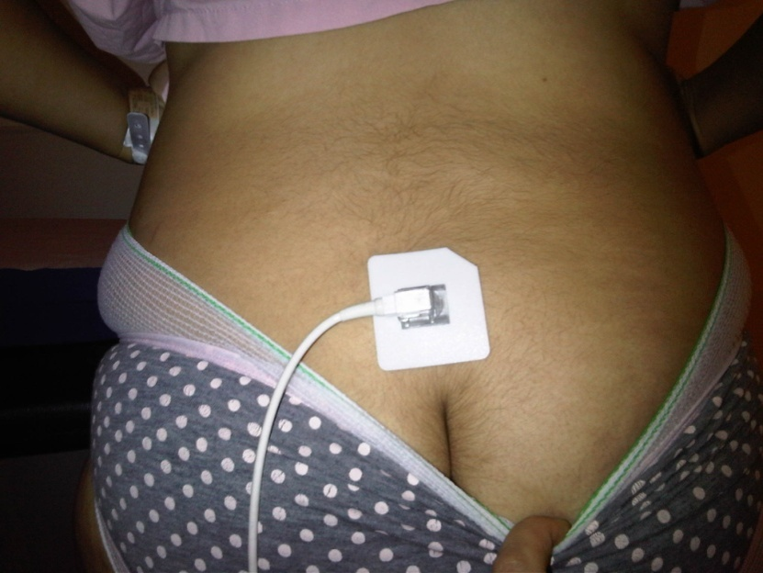
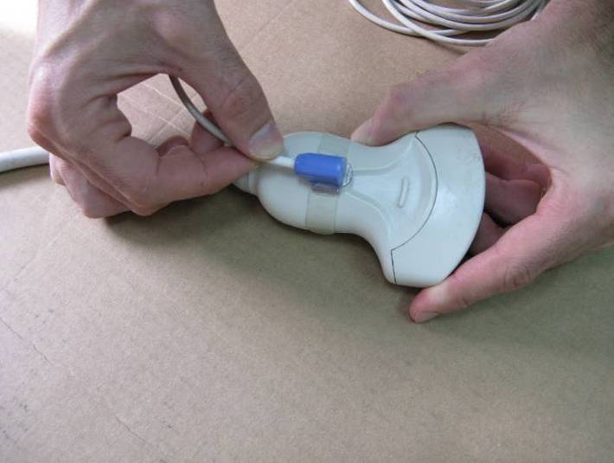
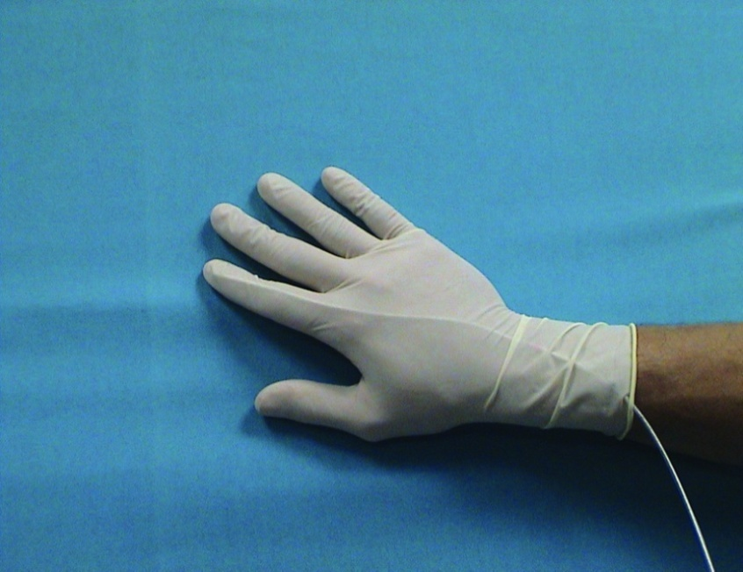
Transmitter & Sensors
Transmitter generating low magnetic field
Back sensor at L5
Sensor Tip
Ultrasound Sensor

Slide 24
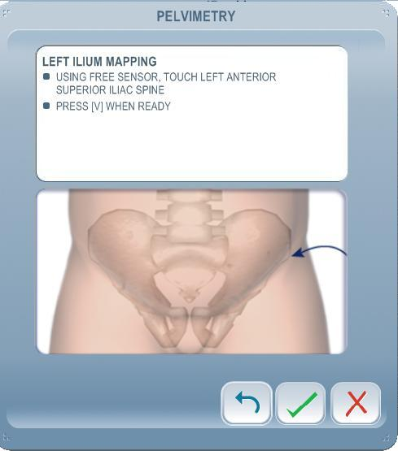
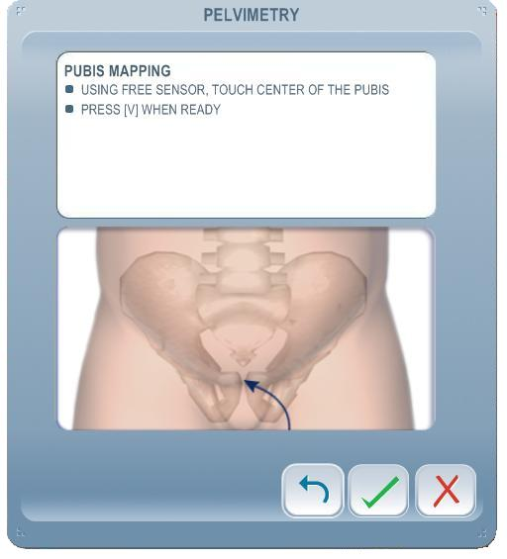
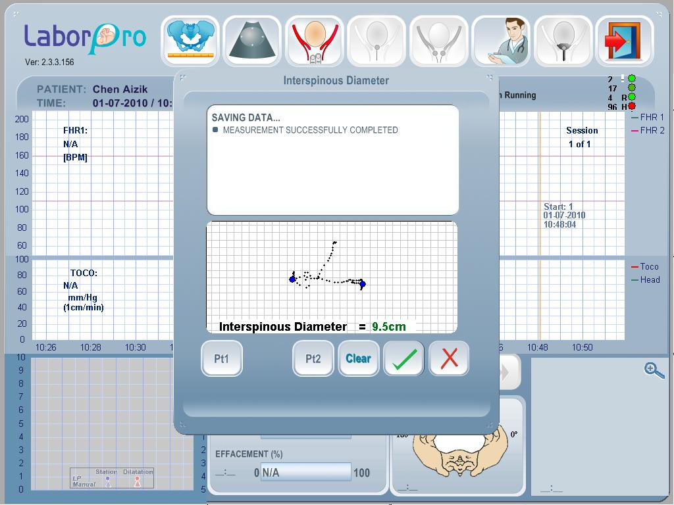
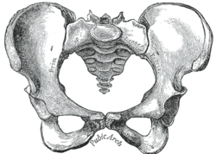
Sensor tip- Ilium/pubis mapping
Sensor tip- Interspinous diameter

Slide 25
Objective
To test the clinical value of the LaborPro pelvimetry for the diagnosis of obstructed labor

Slide 26
Methods
Bi national prospective study – Sheba Medical Center Israel and Modena Italy
Nulliparous women scheduled for vaginal delivery at >39 weeks and consented participate in the study were evaluated by using the LaborPro system
The data observed was not revealed to the staff nor influenced the clinical management

Slide 27
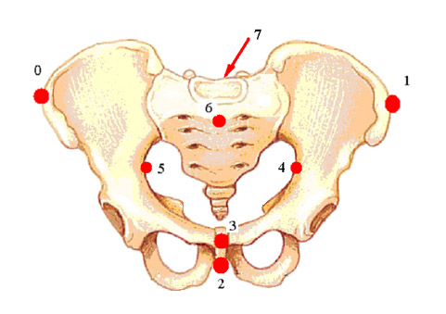
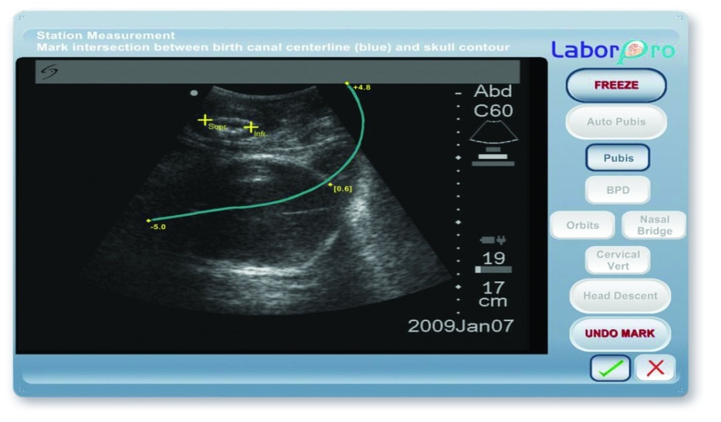
Methods
The pelvic dimensions evaluated:
Inlet :
Inter-iliac Transverse diameter for extrapolating transverse diameter (TD)
Obstetric conjugate (extrapolated)
Midpelvis :
Interspinous diameter
Head parameters :
Station ,BPD, OFD
Position station
Notes:
OFD??

Slide 28
Results
154 patients
CS
38 (24%)
VC
20 (12%)
ND
96 (64%)
Obstructed Labor 30 (19%)
8 FHR(5%)
Prolonged 2nd stage
15 (9%) FHR 5 (3%)
Data | *CS due to Obstructed Labor (n=30) | Operative delivery (n=20) | Spontaneous delivery (n=96) | Statistical significance
Maternal age Hight (cm) Wight (kg) | 31.4±3.4 162±6 73.1±14 | 32.5± 3,7 163±4 66±13 | 31.2±4.1 164±4 70±11 | NS
Body mass index(kg/m²) | 45.2±8 | 40.3±7.9 | 42.9±6 | NS
Gestation age (wk+days) | 40.5±0.5 | 39.5± 0.5 | 40±1.0 | NS
Fetal weight(gr) | 3576±471 | 3221±344 | 3291±490 | NS
Induction(%) | 8(21) | 5(25) | 36(37) | NS

Slide 29
Results
Maternal pelvic diameters and fetal head measurements
between modes of delivery
Data | Obstructed Labor (CS) (n=30) | Operative delivery (n=20) | Spontaneous delivery (n=96) | Pª
BPD(cm) | 9.6 ±0.8 | 9.5 ±0.6 | 9.5 ±0.6 | NS
OFD(cm) | 11.6±1.2 | 11.4±0.9 | 11.5±0.8 | NS
Station | -2.5 ± 0.8 | -2.1±0.8 | -2±0.9 | 0.036
TD | 13.2±1.4 | 13.1±1.2 | 13.1±1.1 | NS
OC | 12.8±1.5 | 12.6±1.1 | 12.8±1.5 | NS
ISD | 8.9±1.1 | 9.2±1.2 | 9.4±1.1 | 0.046

Slide 30
ROC analyses showing the diagnostic accuracy of combining
ISD and station in the prediction of obstructive labor
Comparison | Predictors | Sensitivity | Specificity
OL vs. NVD | Station | 57% | 78%
OL vs. NVD | Station +ISD | 59% | 83%

Slide 31
Conclusions
Patients having CS due to OL had significantly different ISD and fetal head station in comparison with patients with NVD
Combining with other pelvic parameters obtained by LaborPro devise STATION and ISD we could predict obstructed labor in women at term before onset of labor

Slide 32
Our Study-Aim
To test the clinical value of the US pelvimetry and fetal head station for the diagnosis of obstructed labor.

Slide 33
Our study- methods
Study Patients
Nulliparous women scheduled for vaginal delivery at >39 weeks and consented participate in the study were evaluated by US.
Patients were recruited from the general population that attended the Ultrasound Unit at the Chaim Sheba Medical Center.
The data observed was not revealed to the staff nor influenced the clinical management

Slide 34
Our study- methods
Ultrasonographic parameters :
Angle of progression- HEAD STATION
HPD: Head progression distance- HEAD STATION
Pubic arch angle – Pelvimetry
Those parameters are based upon anatomical structures that can be detected easily by US

Slide 35
TRANS LABIAL

Slide 37
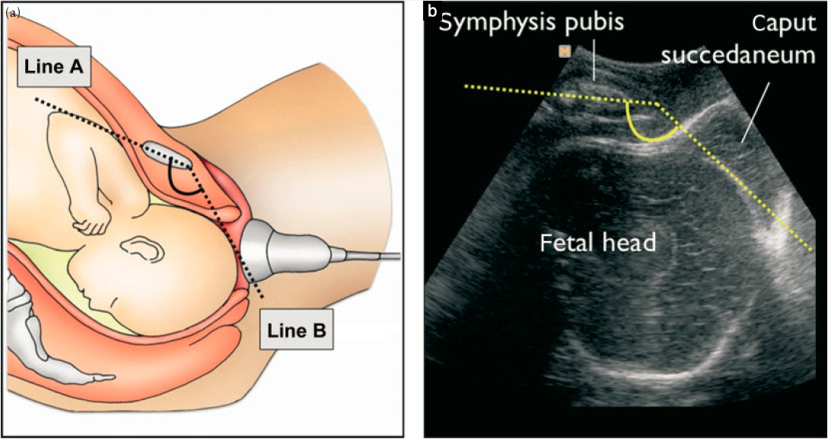
AoP: Angle of progression
A narrow AOP (< 95°) in non-laboring nulliparous women at term is associated with a high rate of Cesarean delivery.(R.levy)

Slide 38
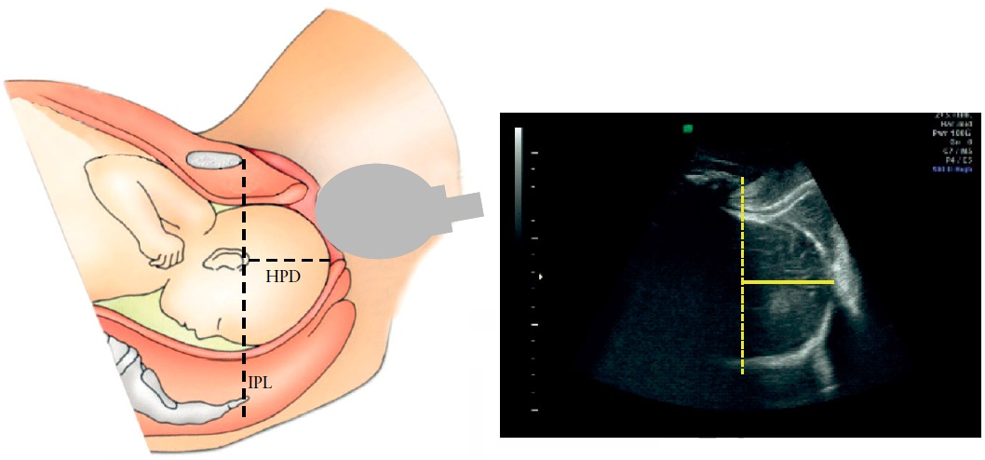
HPD: Head progression distance
Assumption was that the longer the distance, the greater is the chance for a spontaneous delivery. Correlation has been found between the HPD and the fetal head station, but not with the decision of the mode of delivery.
(GILBOA et al . UOG 2013)

Slide 39
Pubic arch angle

Slide 40
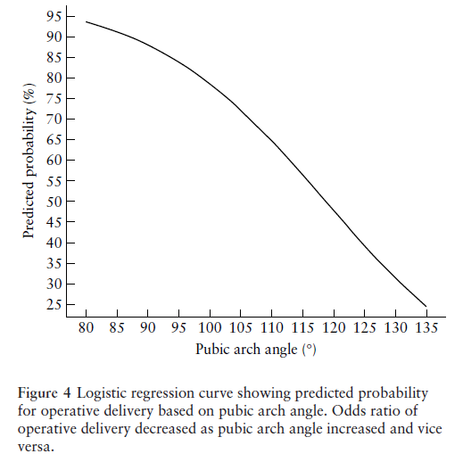
Logistic regression curve showing the
predicted probability , for operative delivery
based on the pubic arch angle.

Slide 41
My part in the study
Collecting Demographic data
Collecting data about the labor and delivery processes
Complications maternal
Mode of delivery.
Fetal -weight, Apgar score and complications.

Slide 42
Our Study
The advantages of predicting mode of delivery before the onset of labor :
preventing the complications of a prolonged labor.
The option to notify the staff earlier about the potential risk.
The option to give the mother precise information about delivery mode .

Slide 43
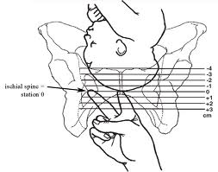
Ruler like measurements

Slide 44
How accurate are we in determining head station by digital examination?

Slide 45
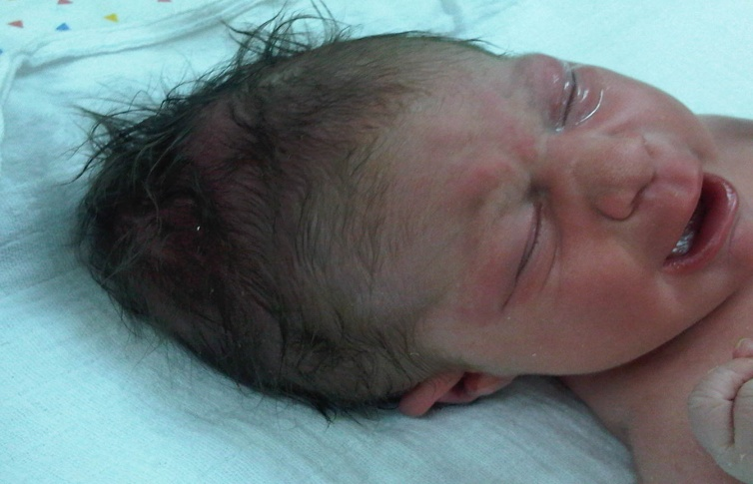
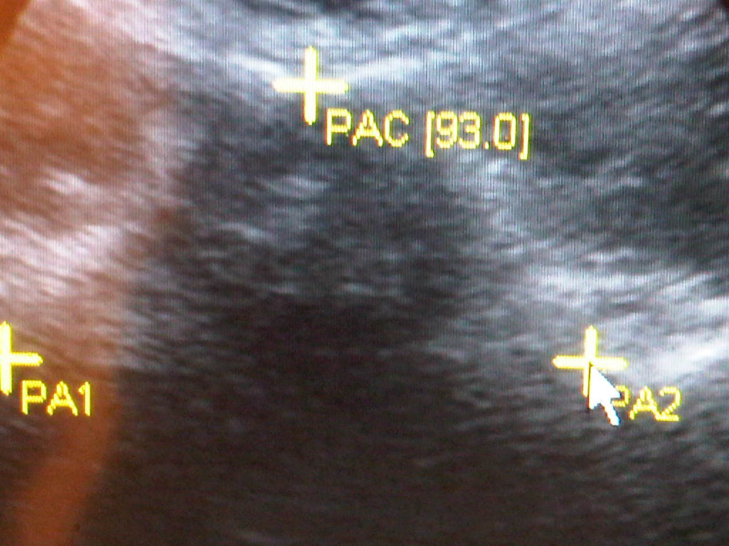
Failed vacuum
Objective information in the next delivery ?
Pubic arch angle(⁰) < 100(⁰ )
Notes:
לא מובן?

Slide 46
Thanks for your attention!

Slide 47
?

