Slide 1
Cytotoxic Drugs and Cancer Incidence in Health-Care Workers Yossi Tzur, 3rd Year Medical Student, 4-Year Program
Arrow Project 01.03.2013

Slide 2
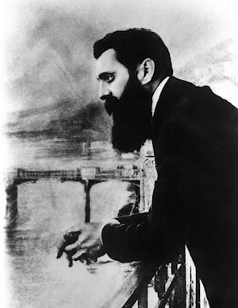
Vision
To reduce cancer incidence among healthcare providers by enhancing screening and predictions methods

Slide 3
From Vision to daily life

Slide 4
והיכן עובדי מערכת הבריאות?

Slide 5
Outline
Risk
Exposure
Exposure is measurable
DNA damage is measurable
DNA Damage

Slide 6
Outline
Risk
Exposure
Exposure is measurable
DNA damage is measurable
DNA Damage

Slide 7
Cytotoxic drugs cause DNA damage
Cytotoxic drugs interfere with cell division or DNA synthesis
Malignant cells are especially prone to these drugs due to frequent cell division
Yet, healthy cells such as mucous cells of the GI and hematopoietic cells are harmed as well.

Slide 8
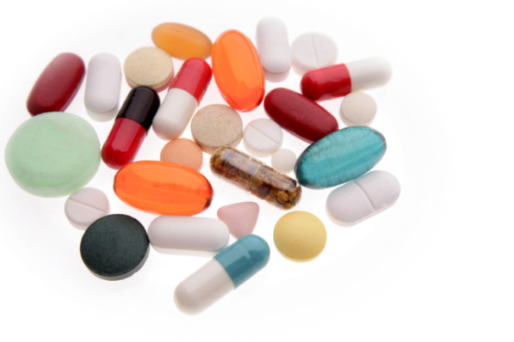
DNA damage – cont’d
Drug Classification – according to mechanism: .
Alkylating agents – like Cyclophosphamide. Attachment of an alkyl group to DNA → cross-linkages → apoptosis
Anti-metabolites – like 5-FU. blocks synthesis of thymidine → preventing DNA replication.
Alkaloids – like Taxane, prevent microtubule function
Topoisomerase inhibitors – like Etopside, upsetting DNA supercoiling

Slide 9
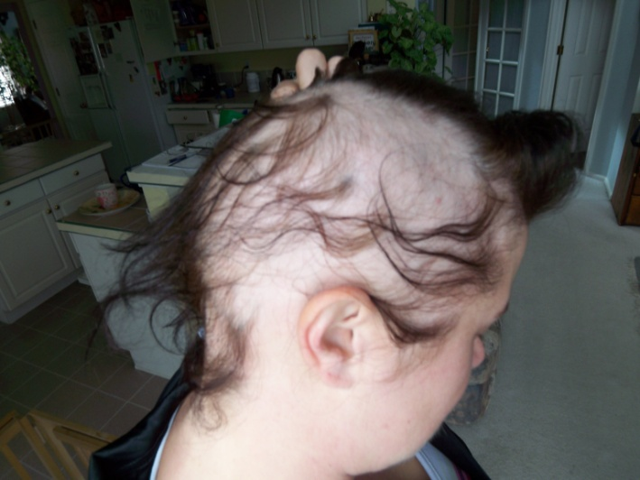
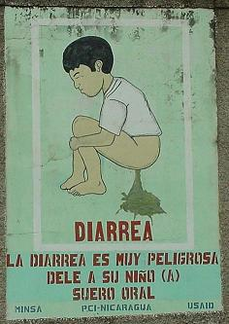
DNA damage – cont’d
Side effects include:
Diarrhea
Alopecia
Immunosuppression
Thrombocytopenia
Infertility
Teratogenicity
Cardiotoxicity, hepatotoxicity, and nephrotoxicity

Slide 10
Risk
Exposure
Exposure is measurable
DNA damage is measurable
DNA Damage

Slide 11
Risk
A 2010 Canadian prospective study on 56,213 registered nurses
7,635 were exposed to cytotoxic drugs
Notes:
Work history 1974-2000

Slide 12
Risk – Cont’d
RR for exposed nurses was 1.83 (95% CI = 1.03 - 3.23)
RR for exposed nurses was 1.87 (95% CI = 1.07 - 3.29)
Notes:
P value = 0.037

Slide 13
Risk– cont’d
IARC & WHO carcinogenic classification:
Group | Description | members | Sample agent
1 | Carcinogenic to humans | 11 | Cyclophosphamid, Tamoxifen
2A | Probably carcinogenic to humans | 12 | Adriamycin
2B | Possibly carcinogenic to humans | 11 | Bleomycin
3 | Not classifiable as to its carcinogenicity | 503* | 5FU
4 | Probably not carcinogenic to humans | 1* | Caprolactam
IARC. Monographs on the evaluation of carcinogenic risks to humans. Vol. 100Part A: Pharmaceuticals. Lyon: International Agency for Research on Cancer; 2011

Slide 14
Risk
Exposure
Exposure is measurable
DNA damage is measurable
DNA Damage

Slide 15
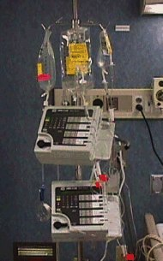
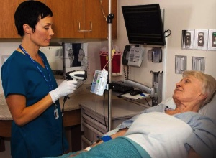
Exposure in numbers
According to NIOSH:
8 million Americans are potentially exposed
Increased administration of chemo
Multiple modes of administration
Notes:
Points to discuss:
Not only pharmacists and nurses but also physicians, therapists, technicians, etc.
Increased administration due to: more neoplastic agents, earlier diagnosis, and usage in non-neoplastic diseases such as: ng ankylosing spondylitis, multiple sclerosis, Crohn's disease, psoriasis, psoriatic arthritis, systemic lupus erythematosus, rheumatoid arthritis, and scleroderma.

Slide 16
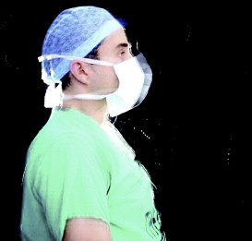
Exposure – modes of transition
Not limited to direct contact with drugs, but occurs via preparation, inhalation & ingestion:
Injectable drugs generate powder and liquid aerosols
Drugs are often delivered with residues on the outside of the vials
Some hazardous drugs vaporize in room temperature
contamination of work area and surfaces
Notes:
Points to discuss:

Slide 17
Exposure in Israel
First vague guidelines in 1984
Only in 2000 were formal safety regulations introduced
Yet, a 2001 study in found:
Only 64% of nurses use protective gloves
Only 48% wash hands after drug administration
Less than 1% use protective eyewear & gowns
*Ben-Ami, S., et al., The influence of nurses' knowledge, attitudes, and health beliefs on their safe behavior with cytotoxic drugs in Israel. Cancer Nurs, 2001. 24(3): p. 192-200
Notes:
By vague I mean just mentioned risk, no safety regulation, no enforcement
Study was performed in Tel Aviv Medical center. 33 nurses participated, 13 of whom oncologic ambulatory day care unit and 20 from the oncologic department.

Slide 18
Risk
Exposure
Exposure is measurable
DNA damage is measurable
DNA Damage

Slide 19
Exposure is measurable
A 2003 study conducted in Germany
100 nurses and pharmacists from 14 medical centers participated
Urine samples were collected 4 times over the course of 3 years
6 antineoplastic agents were evaluated
Notes:
cyclophosphamide, ifosfamide, doxorubicin, epirubicin and platinum from cisplatin and carboplatin

Slide 20
Exposure is measurable
Results: all 6 agents were detected in up to 40% of urine samples collected

Slide 21
Risk
Exposure
Exposure is measurable
DNA damage is measurable
DNA Damage

Slide 22
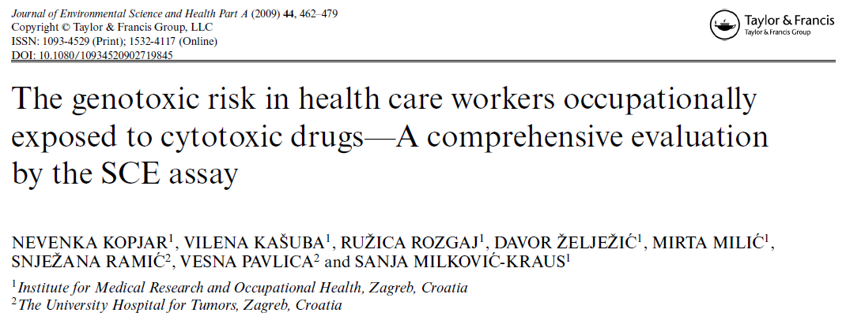
DNA damage can be monitored
A 2009 Croatian study on a population of 402 exposed subjects from 22 hospitals
Evaluating Sister Chromatid Exchange (SCE) rate
Notes:
392 female and 10 male; average age 36 ±
10; range 18–60 years) employed in 22 Croatian hospitals

Slide 23
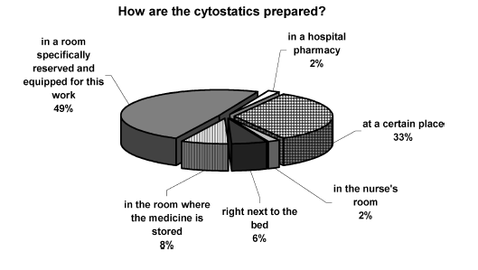
Study results

Slide 24
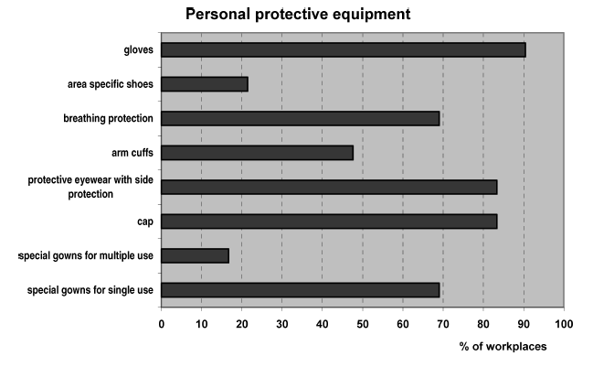
Study results – cont’d
Notes:
Only 70% use breathing protection

Slide 25
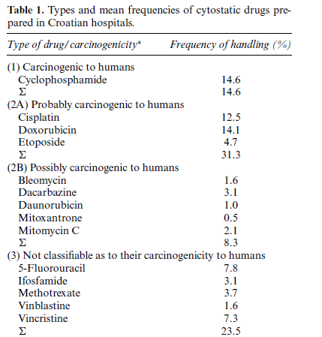
Study results – cont’d
Notes:
The most hazardous drugs are the most frequently used ones! In mixture of cocktails such as CHOP, RCHOP, etc.

Slide 26
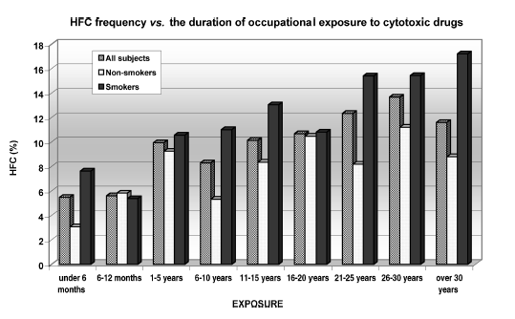
Study results – cont’d
HFC vs. Occupational exposure length
Notes:
Mean HFC frequencies recorded in subgroups of nurses that are distributed with regard to the duration of their occupational exposure, as well to their smoking habits. HFC are usually deﬁned as cells whose SCE frequency exceeds the 95th percentile of the SCE distribution in a pooled data set from control
Individuals. [40] As demonstrated in many studies, the proportion of HFC may be the important parameter when
analyzing data from human population studies. [37,40,41] It is likely that HFC are subpopulation of longer-lived lymphocytes that accumulate higher levels of DNA lesions through
time, therefore could be used in the evaluation of exposure
to genotoxins.

Slide 27
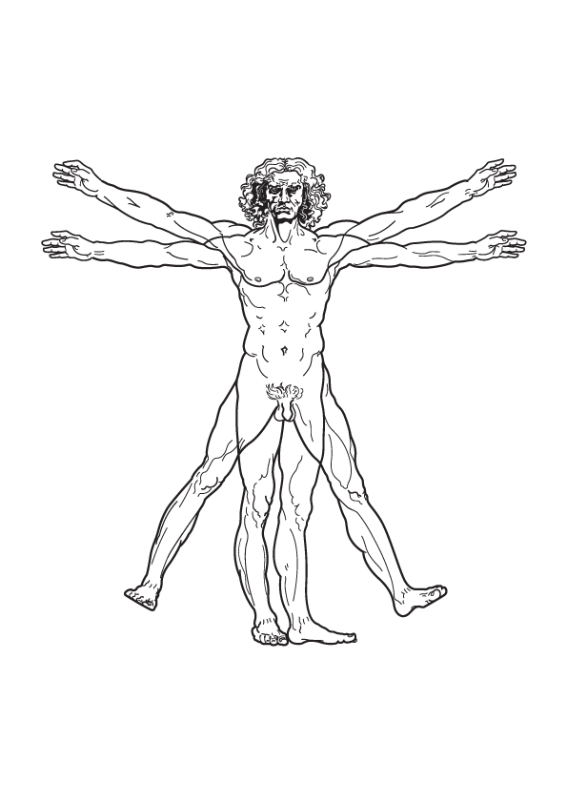
Risk
Exposure
Exposure is measurable
DNA damage is measurable
DNA Damage

Slide 28
In the current study…
What’s been done:
This presentation.
Chief Scientist Office grant application.
Helsinki committee form.
What’s next:
Epidemiological phase.
Clinical phase.

Slide 29
A - Epidemiological phase
Retrospective study of cancer incidence among 600 exposed employees
Exposure over the last two decades
Incidence will be compared with control groups of:
300 non-exposed nurses
300 aged-matched office workers
Results will be crossed with the national cancer registries for general cancer incidence
Notes:
בתנאי כניסה הכוללים: עיסוק ומגע עם תרופות ציטוטוקסיות למשך שנה אחת לפחות מתוך שני העשורים האחרונים, היעדר גידולים אחרים או מוטציות ברקע ועוד

Slide 30
B - Clinical phase
Understanding the pathogenesis
40 participants who are in a high-risk
Quantifying the exposure degree to:
cyclophosphamide and 5-FU in urine samples using HPLC analysis
Assessing DNA damage
blood test for peripheral leukocytes
Analyzed by Gamma H2Ax Assay
Notes:
e.g. nurses of the hemato-oncology department who are exposed to high drug levels

Slide 31
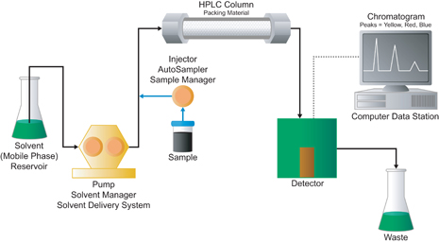
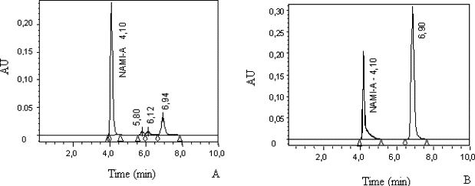
B – Quantifying the exposure in urine sample.
HPLC (High-performance liquid chromatography)
Notes:
Chromatography can be described as a mass transfer process involving adsorption. HPLC relies on pumps to pass a pressurized liquid and a sample mixture through a column filled with a sorbent, leading to the separation of the sample components. The active component of the column, the sorbent, is typically a granular material made of solid part

Slide 32
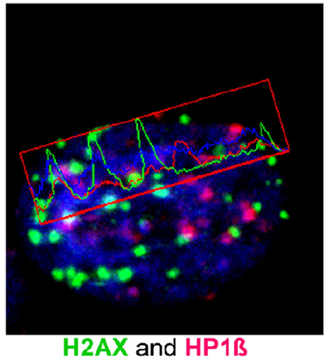
B – Assessing DNA damage
The γH2AX assay
The histone H2AX is key DNA-repair factor
H2AX is phosphorylated to γH2AX in the vicinity of a DNA double -strand break.
The phosphorylated γH2AX constitutes the primary step of recruiting DNA repair factors.
Notes:
e.g. nurses of the hemato-oncology department who are exposed to high drug levels

Slide 33
Conclusions
This study examines an epidemiological phenomenon concurrent to understanding the underlying pathogenesis
It will provide empirical safety data, which will ultimately be used to redefine safety standards
Thus, aiming to eliminate cancer induced by occupational exposure

Slide 34
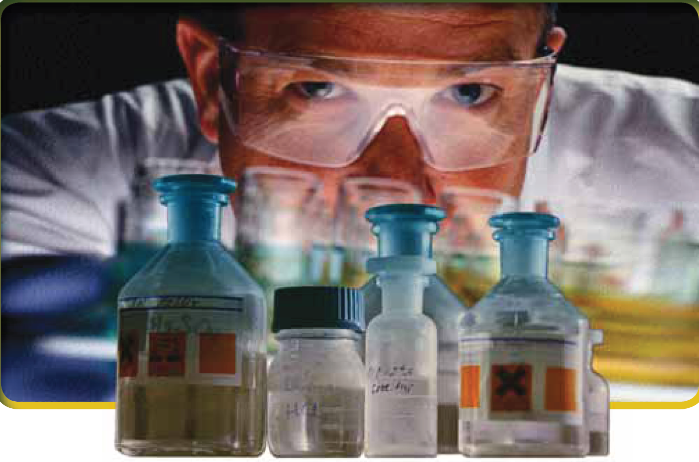
Thanks for your attention!
Yossi Tzur
Arrow Project

