Slide 1
The nature and course of sensory changes following spinal cord injury: predictive properties and implications on the mechanism of central pain
By : Nardine Zoubi – 3rd year student , 6 year program.
Dr Gabi Zeilig – Department of Neurological Rehabilitation
Prof Ruth Defrin – The department of Physical Therapy , School of Allied Health Professions, Sackler Faculty of Medicine, TAU

Slide 2
What is central pain ?
Central pain syndrome is defined as pain associated with malfunction or damage to the central nervous system. It has a low incidence but is frequently intractable and does not have effective treatment.
The cause of central pain is speculative; however, the single common sensory abnormality in patients with central pain is interruption of spinothalamocortical nociceptive pathways.
Its usually described as spontaneous and/or evoked burning, pressing, electric like, cold stabbing, shooting pain diffusely located in dermatomes corresponding to the level of injury or 2-3 dermatomes below it.

Slide 3
causes
The extent of pain and the areas affected are related to the cause of the injury, which can include:
- Motor vehicle accidents.
trauma.
Sport injuries
spinal stroke.
tumors.
after surgery.
Multiple Sclerosis.
Immune system disorders.
-Parkinson's disease.

Slide 4
Spinal cord injury
50% of individuals with SCI are estimated to develop CP.
5-15% of individuals after spinal stroke
Estimated prevalence 34-67%
CP develops within weeks to months after the SCI

Slide 5
The nature and course of sensory changes following spinal cord injuty: predictive preoperties and implications on the mechanism of central pain
Tested Hypothesis:
Central pain may result from hyperexcitability of the nervous system. Thus patients who exhibit soon after the injury a significant damage to the Spinothalamic tract along the signs of hyperexcitability are those who are at risk to develop below level central pain.
Notes:
Back to first research : pathophysiological theory behind CP development

Slide 6
Patients and methods
Subjects: 57 both M and F.
30 suffered from acute SCI .
27 healthy controls.
Sensory Testing :
- Thermal testing.
- Light touch and graphaesthesia testing.
- Evaluation of neuronal hyperexcitability.

Slide 7
Results
46% of the patients developed CP. Onset averaged at 3.8 +/- 2 months
An increase in warm – and heat-pain thresholds.
A decrease in touch threshold.
An increase in the graphaesthesia score.
The group with below-level central pain exhibited higher thermal threshold than the group with no CP.

Slide 8
Conclusion
1- The results suggest a worsening of the spinothalamic tract function and small improvement of dorsal column function with time towards the emergence of below-level CP - changes observed in the group with CP only.
2- The group with below-level central pain exhibited more extensive spinothalamic tract damage.
3- More extensive spinothalamic tract damage exists prior to the emergence of below-level central pain.

Slide 9
Purpose of study
1- Evaluate pain modulation capabilities immediately after SCI and its evolution with time.
2- Evaluate pain modulation capabilities of individuals with chronic SCI with or without CP In order to explore whether poor pain modulation capabilities can determine the intensity of pain in those patients.

Slide 10
Objectives and Hypotheses
Part A will be a prospective study evaluating pain modulation capabilities in individuals immediately after the SCI and their evolution over 8 months, and examine the relations between these capabilities and the development of CP during the same period.
Part B will be a cross sectional study in which we will evaluate pain modulation capabilities of individuals with chronic SCI (injured ≥12 months prior to inclusion in the study) with and without chronic CP .

Slide 11
Participants
Part A: 40 subjects.
** 20 matched healthy volunteers will serve as a control group
Part B: 60 subjects (30 with chronic CP ≥ 6 and 30 without CP).
Inclusion criteria
- Ages: 18-70.
- Below Segments C7 (no qauda equina).
- Complete/incomplete injury
No additional neurological problems.
No neuropathic pain development in acute patients.

Slide 12
Overall Design
Part A: Assessments of pain modulation capabilities of recently injured individuals and completing the questionnaires will be carried out beginning as soon as possible after the SCI (2-3 weeks post trauma) and will be repeated 1.5 month, and 3 months after the injury.
At the end of the follow up we will compare the outcome measures between those who developed CP and those who did not.
Part B: Each individual with chronic SCI will undergo a single assessment of pain modulation capabilities and will complete all the questionnaires The intensity of CP will be assessed with VAS and the McGill pain questionnaire.

Slide 13
Assessment of pain modulation mechanisms
Pain modulation capabilities are manifested in the concept of diffuse noxious inhibitory control (DNIC)
The nature of pain modulation capabilities in our designated individuals with SCI can be evaluated by using three experimental protocols:
1. Conditioned pain modulation (CPM).
2. Response to tonic stimulation.
3.Temporal summation of pain (wind-up).

Slide 14
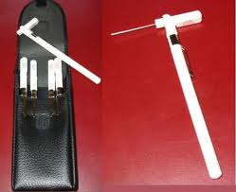
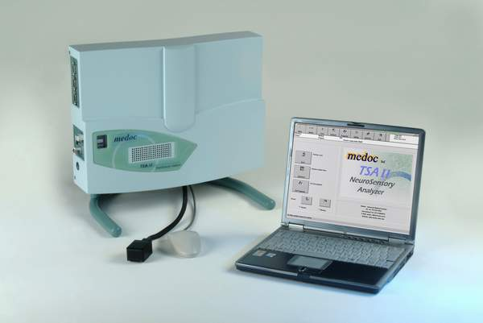

Slide 15
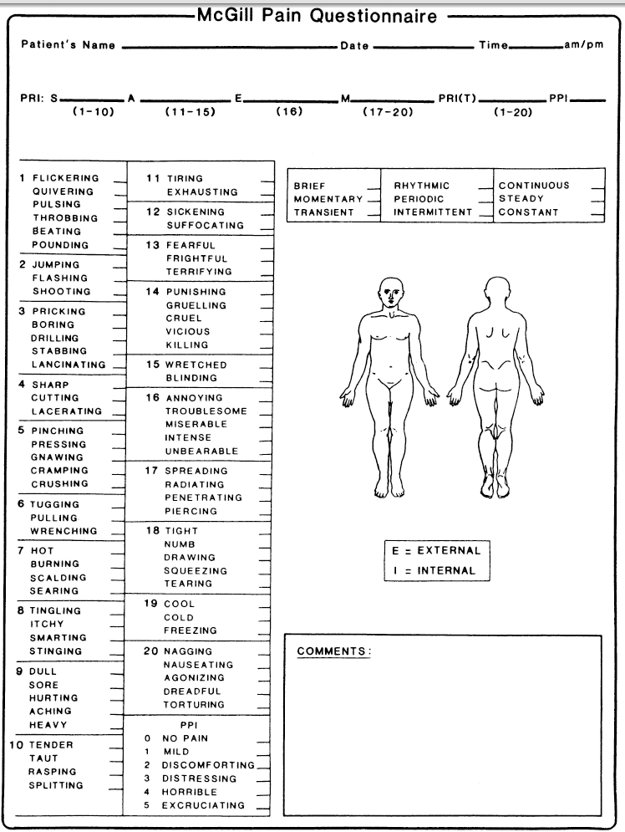
Questionnaires
The Mc'Gill pain questionnaire (MPQ): provides a quantitative evaluation of the patient’s pain experience with a separate measure of its sensory, affective and cognitive dimensions.

Slide 16
The Pain Catastrophising Scale (PCS): instructions ask participants to reflect on past painful experiences and to indicate the degree to which they experienced each of 13 thoughts or feelings when experiencing pain.
Fear of Pain: Participants are asked to rate how fearful they are of the pain associated with each situation.
The Post Traumatic Stress inventory: evaluates post traumatic symptomatology.

Slide 17
Research to be continued …

